Slide 1
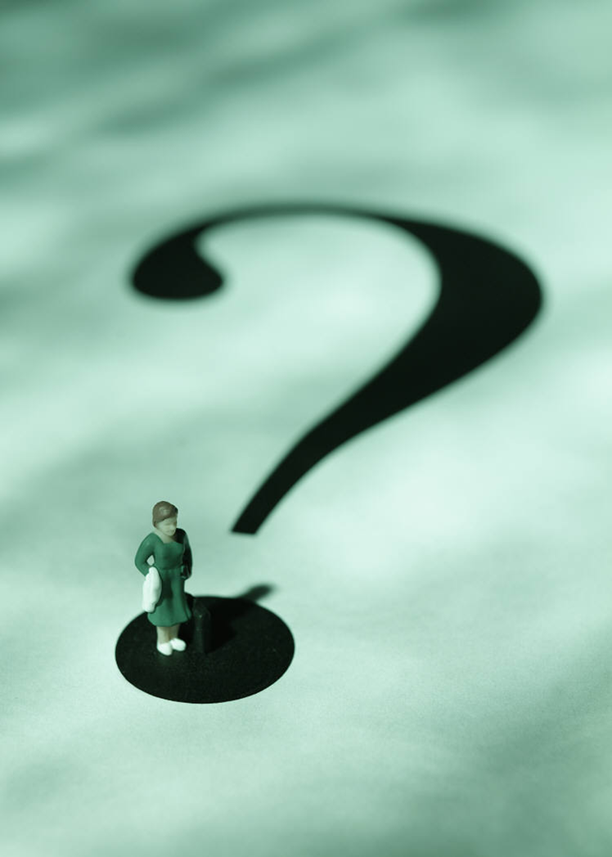
The Purpose
People of

Slide 2
The Purpose
People of
Remember the former things, those of long ago; I am God and there is no other; I am God and there is none like me.
Isa 46:9-10

Slide 3
The Purpose
People of
I make known the end from the beginning, from ancient times, what is still to come. I say my purpose will stand, and I will do all that I please.
Isa 46:9-10

Slide 4
People of
The great question in life is…
Why am I here?
INTRO
The Purpose

Slide 5
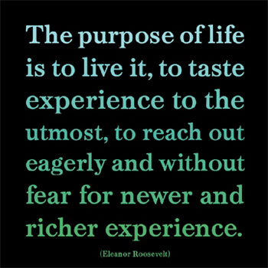
People of
INTRO
The Purpose

Slide 6
People of
People of
INTRO
The Purpose

Slide 7
People of
INTRO
The Purpose

Slide 8
People of
Purpose implies…
Creation, intention, planning, preparation, competence, confidence, evaluation, and satisfaction.
INTRO
The Purpose

Slide 9
People of
IMAGE
BEARER
POINT 1
The Purpose

Slide 10
People of
So God created man in his own image, in the image of God he created him; male and female he created them.
(Gen 1:27)
POINT 1
The Purpose

Slide 11
People of
Humanity is:
Unique among creation
Representation of God
Given choice
POINT 1
The Purpose

Slide 12
People of
TROPHY
OF MERCY
POINT 2
The Purpose

Slide 13
People of
People of
What if he did this to make the riches of his glory known to the objects of his mercy, whom he prepared in advance for glory – even us whom he even called. (Rom 9:23,24)
POINT 2
The Purpose

Slide 14
People of
People of
Mercy – despite our disobedience and ignorance we can come by faith and as a result the angels can see examples of God’s mercy – we failed and Jesus succeeded!!
POINT 2
The Purpose

Slide 15
People of
People of
GLORY
REFLECTOR
POINT 3
The Purpose

Slide 16
People of
People of
Bring my sons from afar and my daughters from the ends of the earth-everyone who is called by my name, whom I created for my glory…
(Isa 43:7)
POINT 3
The Purpose

Slide 17
People of
People of
Therefore, I urge you in view of God’s mercy, to offer yourselves as living sacrifices…be transformed by the renewing of your mind…prove the will of God… (Rom 12:1,2)
POINT 3
The Purpose

Slide 18
People of
People of
The believer is unique. Because of the believer the world sees the glory of God…
We give God glory
We reflect His glory
POINT 3
The Purpose

Slide 19
People of
People of
GRACE
AGENT
POINT 4
The Purpose

Slide 20
People of
People of
We have different gifts according to the grace given us… (Rom 12:6)
And God is able to make all grace abound to you, so that in all things at all times, having all that you need, you will abound in every good work. (2 Cor 9:6)
POINT 4
The Purpose

Slide 21
People of
People of
God’s power is to move through our:
personality
character
ability
spiritual gifts
presence
…to touch others
POINT 4
The Purpose

Slide 22
People of
People of
DARKNESS
DESTROYER
POINT 5
The Purpose

Slide 23
People of
People of
The reason the Son of God appeared was to destroy the devil’s work. (1 John 3:8)
I will build my church and the gates of Hades will not overcome it. I will give you the keys…bind and loose… (Matt 16:18)
POINT 5
The Purpose

Slide 24
People of
People of
PUSH BACK AGAINST DARKNESS ALWAYS!
POINT 5
The Purpose

Slide 25
People of
People of
It is not enough to fulfill a purpose – it is only enough to fulfill HIS PURPOSE!
CONCLUSION
The Purpose

Slide 26
People of
People of
Are you aligned with…
THE PURPOSE?
CONCLUSION
The Purpose

