Slide 1
Re-igniting a Passion for God
Tingles, Testing, and Triumph

Slide 2
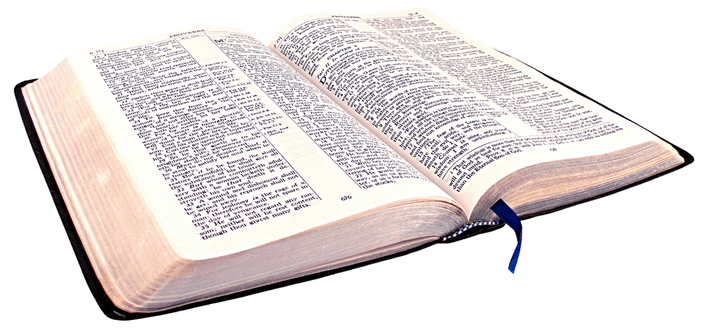
INTRODUCTION: 2 Corinthians 6:1
“ As God’s fellow workers we urge you not to receive God’s grace in vain”

Slide 3
INTRODUCTION: GRACE
Grace is often misunderstood
Law is fulfilled and exceeded by Grace
III. The Christians works are an outflow of Grace

Slide 4
1 Samuel 16:1,13 (NIV)
“The Lord said to Samuel, ‘ How long will you mourn for Saul, since I have rejected him as king over Israel? Fill your horn with oil and be on your way; I am sending you to Jesse of Bethlehem. I have chosen one of his sons to be king’ ”

Slide 5
1 Samuel 16:13 (NIV)
“ So Samuel took the horn of oil and anointed him in the presence of his brothers, and from that day the Spirit of the Lord came upon David in power. Samuel then went to Ramah ”

Slide 6
I. TINGLES– David’s Early Experiences
The anointing for the kingship
The slaying of a lion and a bear
The slaying of Goliath of Gath
The song of the people “ Saul has slain his thousands and David his ten-thousands”
TINGLES, TESTING, & TRIUMPH

Slide 7
I. TINGLES– The Believers Early Experiences
The reception of Salvation is glorious
The baptism in water is glorious
The baptism in the Holy Spirit is glorious
The revelation of the Holy Spirit showing you his gifts & calling is glorious
TINGLES, TESTING, & TRIUMPH

Slide 8
II. TESTING– The FAITH Challenge
James 1:2-4 “ Consider it pure joy, my brothers, whenever you face trials of many kinds, because you know the testing of your faith develops perseverance. Perseverance must finish its work so that you may be mature and complete, not lacking anything.
TINGLES, TESTING, & TRIUMPH

Slide 9
II. TESTING– The FAITH Challenge
The TEST began chewing at David as the Spirit leaves Saul and jealousy takes his place. He throws a spear at him. (1 Sam 18 & 19)
TINGLES, TESTING, & TRIUMPH

Slide 10
II. TESTING– The FAITH Challenge
The TEST continues as he finds himself with his men fleeing Saul and living like animals on the run.(1 Samuel 20-29)
TINGLES, TESTING, & TRIUMPH

Slide 11
II. TESTING – The FAITH Challenge
The TEST brought David to his own counsel.
“ But David thought to himself, “ One of these days I will be destroyed by the hand of Saul. The best thing I can do is to escape to the land of the Philistines…” ( 1 Samuel 27:1)
TINGLES, TESTING, & TRIUMPH

Slide 12
II. TESTING – The FAITH Challenge
The TEST found David living in enemy territory and serving a pagan king and fighting against their mutual enemies. (1 Sam 27:12)
TINGLES, TESTING, & TRIUMPH

Slide 13
II. TESTING – The FAITH Challenge
The TEST is as vital and necessary as the TINGLE
The TEST is a revealer of our hearts as we are tested in the choice between taking our counsel or the counsel of God
The TEST often finds us feeling like a hero – and leaves us feeling like a zero. That is when we meet a deeper aspect of Grace
TINGLES, TESTING, & TRIUMPH

Slide 14
III. The TRIUMPH – The GRACE Revelation
God’s divine power operating on our behalf - MINISTRY
God’s power is made evident when we are rendered weak and powerless – HUMILITY
God’s grace operates to bring his divine plan to fruition - DESTINY
TINGLES, TESTING, & TRIUMPH

Slide 15
III. The TRIUMPH – The GRACE Revelation
David was on the brink of being seen as a total and complete traitor by everyone in Israel (1 Sam 29:1-3)
David was sent back to Ziklag and was on the brink of being stoned to death by his own men (1 Samuel 30)
David ends up destroying Israel’s enemy (Amalek), recovers everything PLUS PLUNDER and avoiding being in the battle that ended up killing Saul. (1 Samuel 30:18-20)
TINGLES, TESTING, & TRIUMPH

Slide 16
CONCLUSION
TINGLES are wonderful ENJOY them and REMEMBER them – they are a part of the JOY of your salvation!
TESTING – is vital and is inevitable. Accept it. Receive it. Be encouraged. GO THROUGH IT!
TRIUMPH – is the consequence of successful testing. At the end of a test is a TESTIMONY. The battle is necessary in order to get to the TRIUMPH. It is the full realization of the down-payment of the TINGLES.
TINGLES, TESTING, & TRIUMPH

Slide 17
CONCLUSION
Where are you in this process? Press towards the NEXT. If you are out of the cycle and sidetracked – now is the opportunity to get back in!
TINGLES, TESTING, & TRIUMPH

