Slide 1
Returning to our First Love

Slide 2
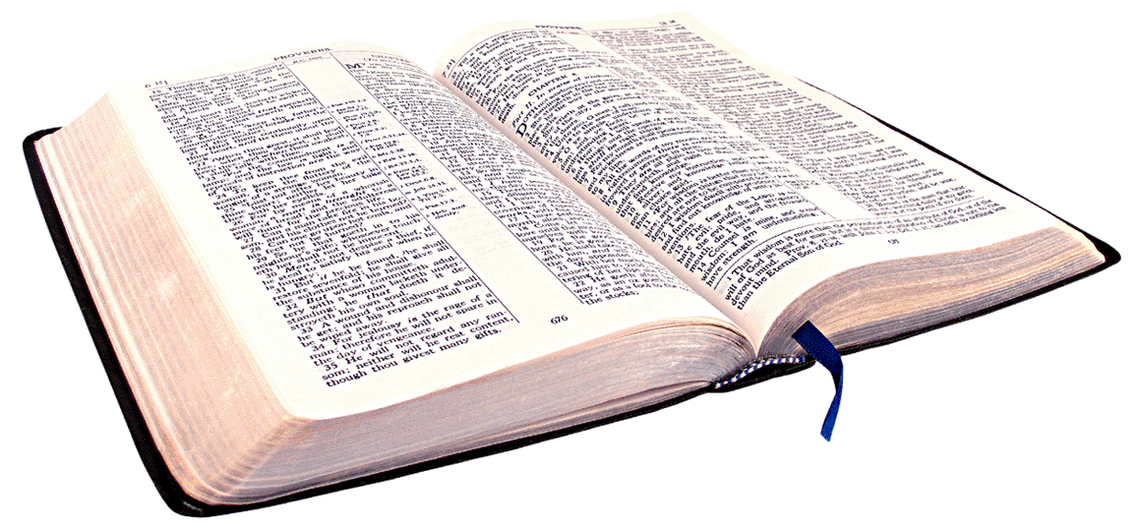
Revelation 2:2-4 (NIV)
“I know your deeds, your hard work, and you perseverance. I know that you cannot tolerate wicked men, that you have tested those who claim to be apostles but are not”

Slide 3
Revelation 2:2-4 (NIV)
“and have found them to be false. You have persevered and have endured hardships for my name, and have not grown weary. Yet I hold this against you: You have forsaken your first love. ”

Slide 4
“Christianity is not first of all a philosophy for life or discipline for the mind – it is first of all an experience for the heart (spirit), transforming everything else from there. ”
Returning to Our First Love

Slide 5
In order to return we need to accurately remember…
Returning to Our First Love

Slide 6
I. Remember the Purpose of Salvation
To become a habitation not a visitation…
2 Corinthians 6:16
“ I will dwell in them and walk among them.
I will be their God and they shall be my people”
Returning to Our First Love

Slide 7
…To become a habitation not a visitation…
Ephesians 2:22
“ And in him too you are being built together to become a dwelling in which God lives by His Spirit”
Returning to Our First Love

Slide 8
To come into an intimate relationship with God
Exodus 19:3
“ You yourselves have seen what I did to Egypt, and how I carried you on eagles’ wings and brought you to myself.”
Returning to Our First Love

Slide 9
II. Remember the Purity of the One Inviting us
He is light – He is FIRE/PURITY
Sin is darkness and darkness cannot persist where light is – men love darkness
2 Corinthians 6:17
“ Come out from among them And be separate, says the Lord. Do not touch what is unclean,
And I will receive you. ”
Returning to Our First Love

Slide 10
III. Remember That This World is Corrupt
2 Corinthians 6:17 The Message Bible
“ ‘So leave the corruption and compromise; leave it for good,’ says God. ‘ Don’t link up with those who will pollute you. I want you all for myself.’ ”
Returning to Our First Love

Slide 11
IV. Remember the Path of Humility Back
The Return of the Wayward Son
Returning to Our First Love

Slide 12
James 4:8-10
“ Come near to God and he will come near to you. Wash your hands you sinners and purify your hearts you double-minded. Grieve, mourn and wail. Change your laughter to mourning and your joy to gloom. Humble yourselves before the Lord and He will lift you up ”
Returning to Our First Love

