Slide 1
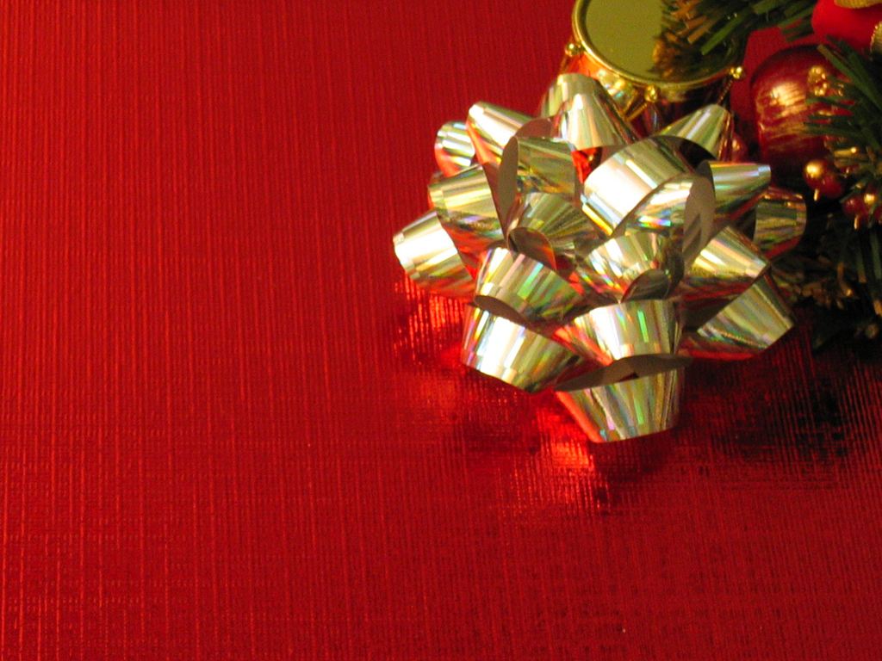
Three Gifts

Slide 2
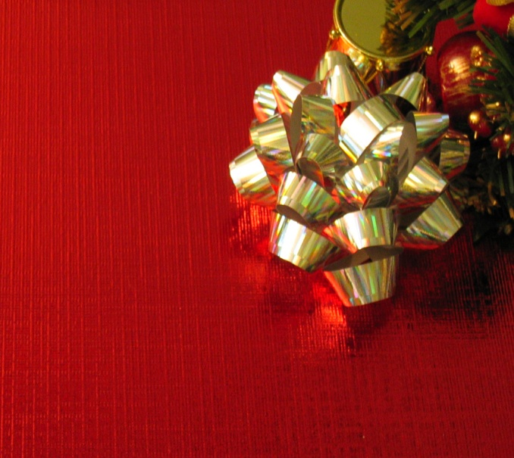
Three Gifts
The idea of giving is because of a gospel fact. The Father gave His Son and those who receive are called to give.
INTRO

Slide 3
Three Gifts
We are also expected to bring forth fruit or evidence of the Kingdom of Heaven in our life as a gift to God.
INTRO

Slide 4
Three Gifts
How can we combine all of this and live in such a way as to constantly be a giver?
INTRO

Slide 5
Three Gifts
GIFT #3

Slide 6
Three Gifts
GIFT #3

Slide 7
Three Gifts
PEACE
GIFT #3

Slide 8
Three Gifts
For unto us is born, to us a son is given, and the government will be on his shoulders. And he will be called Wonderful Counselor, Mighty God, Everlasting Father, Prince of Peace.
Isaiah
9:6

Slide 9
Three Gifts
This PEACE is from “out of this world” and is not “natural”. It is embodied in JESUS.
BIG IDEA
#1

Slide 10
Three Gifts
The world desires PEACE desperately and offers us some hints but only God can give us the goods!
BIG IDEA
#1

Slide 11
Three Gifts
You will keep in perfect peace those whose minds are steadfast, because they trust in you.
Isaiah
26:3

Slide 12
Three Gifts
PEACE can only come to those who TRUST
The mind is settled
The heart is engaged
Through FAITH
BIG IDEA
#2

Slide 13
Three Gifts
The fruit of that righteousness will be peace; its effect will be quietness and confidence forever.
Isaiah 32:7

Slide 14
Three Gifts
RIGHT STANDING precedes PEACE with its quietness and confidence.
BIG IDEA
#3

Slide 15
Three Gifts
“There is no peace,” says the Lord, “ for the wicked.”
Isaiah 48:22

Slide 16
Three Gifts
PEACE is desperately sought but never obtained by the wicked.
BIG IDEA
#4

Slide 17
Three Gifts
Billions of dollars are spent on substances advertised as bringing peace and offering escape.
BIG IDEA
#4

Slide 18
Three Gifts
But he was pierced for our transgressions, he was crushed for our iniquities; the punishment that brought us peace was on him, and by his wounds we were healed.
Isaiah 53:5

Slide 19
Three Gifts
Therefore, since we have been justified through faith, we have peace with God through our Lord Jesus Christ.
Romans 5:1

Slide 20
Three Gifts
PEACE only comes at a price. Justice must be satisfied. Jesus did it!
BIG IDEA
#5

Slide 21
Three Gifts
Peace, I leave with you; my peace I give you. I do not give to you as the world gives. Do not let your hearts be troubled and do not be afraid.
JOHN
14:1

Slide 22
Three Gifts
Jesus’ peace confronted demoniacs and a thrashing Galilee and imposed upon them.
BIG IDEA
#6

Slide 23
Three Gifts
And the peace of God, which transcends all understanding, will guard your hearts and minds in Christ Jesus.
Philippians
4:7

Slide 24
Three Gifts
PEACE is practical as it guards our spirit and our mind.
BIG IDEA
#7

Slide 25
Three Gifts
In what way do you need to receive this gift, today?
QUESTION

Slide 26
Three Gifts
In what way do you need to bring this gift into a situation?
QUESTION

