Slide 1
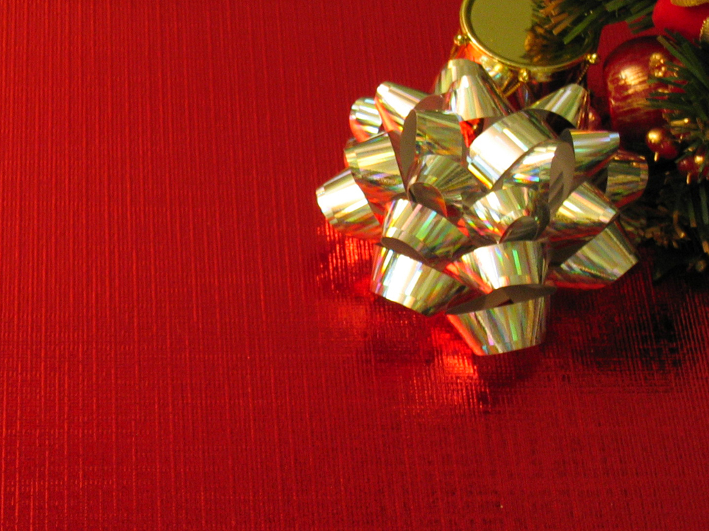
Three Gifts

Slide 2
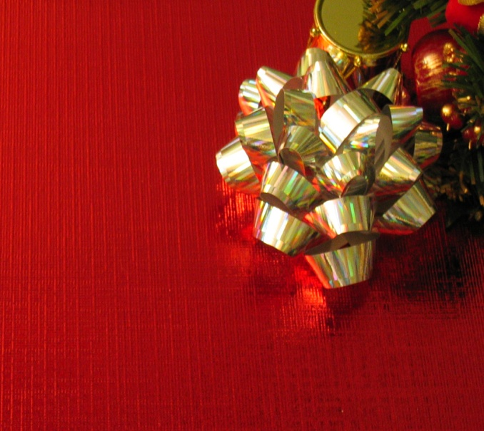
Three Gifts
The idea of giving is because of a gospel fact. The Father gave His Son and those who receive are called to give.
INTRO

Slide 3
Three Gifts
We are also expected to bring forth fruit or evidence of the Kingdom of Heaven in our life as a gift to God.
INTRO

Slide 4
Three Gifts
How can we combine all of this and live in such a way as to constantly be a giver?
INTRO

Slide 5
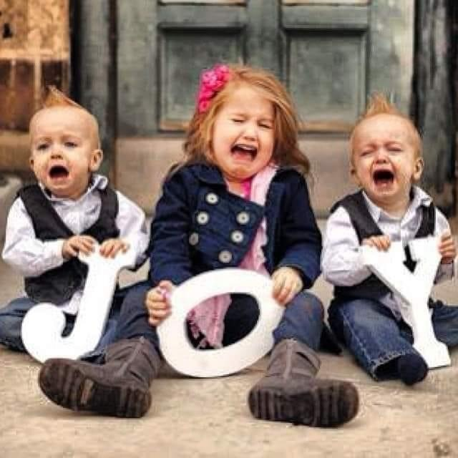
Three Gifts
GIFT #2

Slide 6
Three Gifts
JOY
GIFT #2

Slide 7
Three Gifts
And Mary said: “My soul glorifies the Lord and my spirit rejoices in God my Savior,
Luke
1:46,47

Slide 8
Three Gifts
This JOY is “out of this world” and is not “natural”.
BIG IDEA
#1

Slide 9
Three Gifts
The world shows us some hints but only God can give us the goods!
BIG IDEA
#1

Slide 10
Three Gifts
You have loved righteousness and hated wickedness; therefore God, your God, has set you above your companions by anointing you with the oil of joy.”
Heb 1:9

Slide 11
Three Gifts
This JOY has a price-tag of emotional priority:
Love Righteousness
Hate Wickedness
BIG IDEA
#2

Slide 12
Three Gifts
Jesus operated every day loving right- standing with God and hating mixture and compromise.
BIG IDEA
#2

Slide 13
Three Gifts
Others, like seed sown on rocky places, hear the word and at once receive it with joy.
Mark 4:16

Slide 14
Three Gifts
This JOY is the first, best response to any WORD from God.
BIG IDEA
#3

Slide 15
Three Gifts
JOY is the first step towards the potential TRANSFORMATION of a person.
BIG IDEA
#3

Slide 16
Three Gifts
Never be lacking in zeal, but keep your spiritual fervor, serving the Lord. Be joyful in hope, patient in affliction, faithful in prayer.
Romans 12:12

Slide 18
Three Gifts
This JOY is a vital spark that is constantly needed to keep us spiritually effervescent.
BIG IDEA
#4

Slide 19
Three Gifts
JOYFUL in hope
PATIENT in affliction
FAITHFUL in prayer
BIG IDEA
#4

Slide 20
Three Gifts
If you keep my commands, you will remain in my love, just as I have kept my Father’s commands and remain in his love.
John 15:10,11

Slide 21
Three Gifts
I have told you this so that my joy may be in you and that your joy may be complete.
John 15:10,11

Slide 22
Three Gifts
LOVE is a decision – but it makes way for JOY and JOY in FULLNESS & FULFILLMENT.
BIG IDEA
#5

Slide 23
Three Gifts
People need to experience that JOY that floods right in where LOVE is.
BIG IDEA
#5

Slide 24
Three Gifts
I have given you authority to trample on snakes and scorpions and to overcome all the power of the enemy; nothing will harm you.
LUKE
10:19,20

Slide 25
Three Gifts
I have given you authority to trample on snakes and scorpions and to overcome all the power of the enemy; nothing will harm you.
LUKE
10:19,20

Slide 26
Three Gifts
However, do not rejoice that the spirits submit to you, but rejoice that your names are written in heaven.”
LUKE
10:19,20

Slide 27
Three Gifts
When he came near the place where the road goes down the Mount of Olives, the whole crowd of disciples began joyfully to praise God in loud voices for all the miracles they had seen:
LUKE
19:37

Slide 28
Three Gifts
JOYFUL expression is a perfect response to a breakthrough of GRACE!!
BIG IDEA
#6

Slide 29
Three Gifts
fixing our eyes on Jesus, the pioneer and perfecter of faith. For the joy set before him he endured the cross, scorning its shame, and sat down at the right hand of the throne of God.
HEBREWS
12:2

Slide 30
Three Gifts
This JOY is vital to carry us properly through testing and trouble – it is the taste of the victory.
BIG IDEA
#7

Slide 31
Three Gifts
In what way do you need to receive this gift, today?
QUESTION

Slide 32
Three Gifts
In what way do you need to be infectious with this gift, today?
QUESTION

