Slide 1
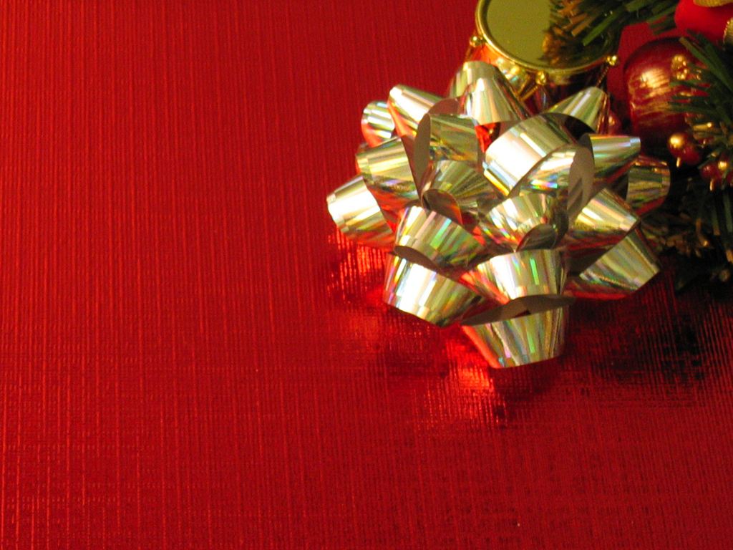
Three Gifts

Slide 2
Three Gifts
The idea of giving is because of a gospel fact. The Father gave His Son and those who receive are called to give.
INTRO

Slide 3
Three Gifts
We are also expected to bring forth fruit or evidence of the Kingdom of Heaven in our life as a gift to God.
INTRO

Slide 4
Three Gifts
How can we combine all of this and live in such a way as to constantly be a giver?
INTRO

Slide 5
Three Gifts
LOVE
GIFT #1

Slide 6
Three Gifts
Whoever does not love does not know God, because God is love.
1 John 4:8

Slide 7
Three Gifts
This LOVE is “out of this world” and is not “natural”.
BIG IDEA
#1

Slide 8
Three Gifts
The world shows us some hints but only God can give us the goods!
BIG IDEA
#1

Slide 9
Three Gifts
“And a voice from heaven said, “This is my Son, whom I love; with him I am well pleased.”
Matt 3:17

Slide 10
Three Gifts
…may have the power, together with all the Lord’s holy people, to grasp how wide and long and high and deep is the love of Christ,
Ephesians 3:18

Slide 11
Three Gifts
and to know this love that surpasses knowledge – that you may be filled to the measure of all the fulness of God.
Ephesians 3:19

Slide 12
Three Gifts
See what great love the Father has lavished on us, that we should be called children of God! And that is what we are! The reason the world does not know us is that it did not know him.
1 John 3:1

Slide 13
Three Gifts
This LOVE is not based upon performance but is based upon relationship.
BIG IDEA
#2

Slide 14
Three Gifts
Jesus operated every day grasping the love of God and knowing He was loved by the Father. That brought him into fullness.
BIG IDEA
#2

Slide 15
Three Gifts
“But I tell you, love your enemies and pray for those who persecute you.”
Matt 5:44

Slide 16
Three Gifts
This LOVE is the first, best thing to give to an adversary.
BIG IDEA
#3

Slide 17
Three Gifts
LOVE is the only thing that can TRANSFORM a person.
BIG IDEA
#3

Slide 18
Three Gifts
“Love the Lord your God with all your heart and with all your soul and with all your mind.”
Matt 22:37

Slide 19
Three Gifts
This LOVE is to be totally expressed as a response to God
BIG IDEA
#4

Slide 20
Three Gifts
This LOVE works first in the spirit then works into the whole person.
BIG IDEA
#4

Slide 21
Three Gifts
“For God so loved the world that He gave his and and only Son, that whoever believes in Him shall not perish but have eternal life”
John 3:16

Slide 22
Three Gifts
But God demonstrates his own love for us in this: While we were still sinners, Christ died for us.
Romans 1:8

Slide 23
Three Gifts
A new command I give you: Love one another. As I have loved you, so you must love one another.”
John 13:34

Slide 24
Three Gifts
This LOVE is more than a feeling – it is expressed in a hopeful action.
BIG IDEA
#5

Slide 25
Three Gifts
People need DEMONSTRATIONS of the product!
BIG IDEA
#5

Slide 26
Three Gifts
For in Christ Jesus neither circumcision nor uncircumcision has any value.. The only thing that counts is faith expressing itself through love.
Galatians 5:6

Slide 27
Three Gifts
Love partners up with faith in order to find tangible and meaningful expression
BIG IDEA
#6

Slide 28
Three Gifts
Yet I hold this against you: You have forsaken the love you had at first.
REV
2:4

Slide 29
Three Gifts
This LOVE must be refreshed and renewed through ongoing relationship.
BIG IDEA
#7

Slide 30
Three Gifts
In what way do you need to receive this gift, today?
QUESTION

Slide 31
Three Gifts
In what way do you need to give this gift away , today?
QUESTION

