Slide 1
The Battle is real

Slide 2
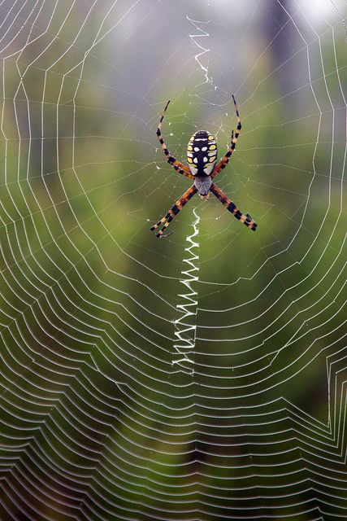

Slide 3
INTRODUCTION
The great Welsh preacher, Dr. Martyn Lloyd-Jones, once said, “There is no grosser or greater misrepresentation of the Christian message than that which depicts it as offering a life of ease with no battle or struggle at all…sooner or later every believer discovers that the Christian life is a battleground, not a playground.”

Slide 4
The pandemic has caused a division in the church.

Slide 5
We the church, cannot afford to fight a civil war. If we do, we all lose.

Slide 6
2 Corinthians 10:2-3
We are human, but we don’t wage war as humans do.
We use God’s mighty weapons, not worldly weapons, to knock down the strongholds of human reasoning and to destroy false arguments.

Slide 7
Ephesians 6:11-12
Put on all of God’s armor so that you will be able to stand firm against all strategies of the devil.
For we are not fighting against flesh-and-blood enemies, but against evil rulers and authorities of the unseen world, against mighty powers in this dark world, and against evil spirits in the heavenly places.

Slide 8
Ephesians 6:13-14
Therefore, put on every piece of God’s armor so you will be able to resist the enemy in the time of evil. Then after the battle you will still be standing firm.
Stand your ground, putting on the belt of truth and the body armor of God’s righteousness.

Slide 9
Ephesians 6:15-16
For shoes, put on the peace that comes from the Good News so that you will be fully prepared.
In addition to all of these, hold up the shield of faith to stop the fiery arrows of the devil.

Slide 10
Ephesians 6:17-18
Put on salvation as your helmet, and take the sword of the Spirit, which is the word of God.
Pray in the Spirit at all times and on every occasion. Stay alert and be persistent in your prayers for all believers everywhere.

Slide 11
Point one
The Weapon of God’s Word.

Slide 12
Point one
Without God’s Word we don’t know what is in our arsenal.

Slide 13
Point two
The Weapon of Prayer.

Slide 14
Point two
Prayer brings wisdom and knowledge of how to use the weapons in your arsenal.

Slide 15
Point two
Prayer brings reinforcements or help.

Slide 16
Point three
The Weapon of Unity

Slide 17
John 17:20-21
“I am praying not only for these disciples but also for all who will ever believe in me through their message.
I pray that they will all be one, just as you and I are one—as you are in me, Father, and I am in you. And may they be in us so that the world will believe you sent me.

Slide 18
John 17:22-23
I have given them the glory you gave me, so they may be one as we are one.
I am in them and you are in me. May they experience such perfect unity that the world will know that you sent me and that you love them as much as you love me.

Slide 19
Point four
Satan has weapons

Slide 20
Point four
Fear seems to be his weapon of choice.

Slide 21
2 timothy 1:7
For God has not given us a spirit of fear and timidity, but of power, love, and self-discipline.

Slide 22
Point four
There is a healthy fear and an unhealthy fear. We need to respect the healthy fear and destroy the unhealthy or the unhealthy will destroy you.

Slide 23
Point four
Fear is attacking our unity.

Slide 24
Point five
Practice makes perfect. We can practice using our weapons against fear.

Slide 25
conclusion
Our weapons against fear are:
The weapon of the Word.
The weapon of Prayer.
The weapon of Unity.

