Slide 1
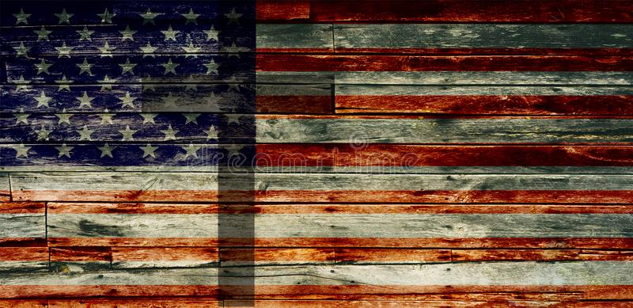
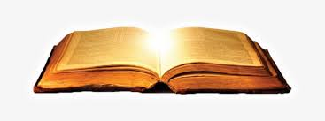
FREEDOM

Slide 2
FIRST THINGS

Slide 3
Where the Spirit of the Lord is there is freedom. 2 Cor 3:17

Slide 4
Angels & Adam first encounter with God. Choices. (Adam) “Of all the trees you may freely eat…” Gen 2:16

Slide 5
It is for freedom that Christ has set us free.
Gal 5:1(a)

Slide 6
REVEALER

Slide 7
Live as free people, but do not use your freedom as a cover-up for evil; live as God’s slaves. 1 Pet 2:16

Slide 8
Freedom allows the heart to be revealed – the real nature of a person is revealed in freedom.

Slide 9
EXCEPTIONAL

Slide 10
Jesus answered them, “Truly, truly, I say to you, everyone who commits sin is the slave of sin. John 8:34

Slide 11
We know that we are children of God, and that the whole world is under the control of the evil one.
1 John 5:19

Slide 12
Freedom is EXCEPTIONAL in the world. American exceptionalism is an expression of this idea.

Slide 13
EQUALIZER

Slide 14
We hold these truths to be self-evident, that all men are created equal, that they are endowed by their Creator with certain unalienable rights, that among these are life, liberty and the pursuit of happiness

Slide 15
DEFENDED

Slide 16
It is for freedom that Christ has set us free. Stand firm, then, and do not let yourselves be burdened again by a yoke of slavery.
Gal 5:1

Slide 17
“The tree of liberty must be refreshed from time to time with the blood of patriots and tyrants. It is its natural manure,” (Jefferson wrote in a letter to William S. Smith, a diplomatic official in London, on November 13, 1787.)

Slide 18
OFFERED

Slide 19
“The Spirit of the Lord is on me,because he has anointed me to proclaim good news to the poor. He has sent me to proclaim freedom for the prisoners and recovery of sight for the blind, to set the oppressed free,” Luke 4:18

Slide 20
The offer may be given and the opportunity afforded – it is the response that is critical.

Slide 21
MAXIMIZED

Slide 22
For the creation was subjected to frustration, not by its own choice, but by the will of the one who subjected it, in hope that the creation itself will be liberated from its bondage to decay and brought into the freedom and glory of the children of God. Romans 8:20,21

