Slide 1
BUILD A MEMORIAL

Slide 2
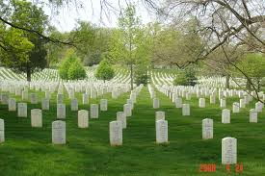

Slide 3
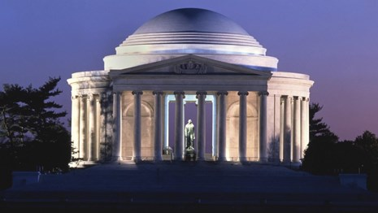

Slide 4
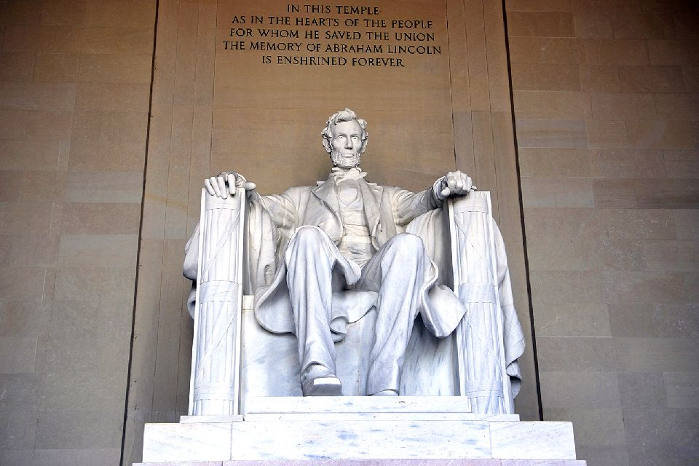

Slide 5
Early in the morning Joshua and all the Israelites set out from Shittim and went to the Jordan, where they camped before crossing over.
Joshua 3:1 – 4:7(NIV)

Slide 6
After three days the officers went throughout the camp, giving orders to the people: “When you see the ark of the covenant of the LORD your God, and the Levitical priests carrying it, you are to move out from your positions and follow it.
Joshua 3:1 – 4:7(NIV)

Slide 7
Then you will know which way to go, since you have never been this way before. But keep a distance of about two thousand cubits between you and the ark; do not go near it.”
Joshua 3:1 – 4:7(NIV)

Slide 8
Joshua told the people, “Consecrate yourselves, for tomorrow the LORD will do amazing things among you.”
Joshua 3:1 – 4:7(NIV)

Slide 9
Joshua said to the priests, “Take up the ark of the covenant and pass on ahead of the people.” So they took it up and went ahead of them.
Joshua 3:1 – 4:7(NIV)

Slide 10
And the LORD said to Joshua, “Today I will begin to exalt you in the eyes of all Israel, so they may know that I am with you as I was with Moses.
Joshua 3:1 – 4:7(NIV)

Slide 11
Tell the priests who carry the ark of the covenant: ‘When you reach the edge of the Jordan’s waters, go and stand in the river.’ ”
Joshua 3:1 – 4:7(NIV)

Slide 12
Joshua said to the Israelites, “Come here and listen to the words of the LORD your God. This is how you will know that the living God is among you
Joshua 3:1 – 4:7(NIV)

Slide 13
and that he will certainly drive out before you the Canaanites, Hittites, Hivites, Perizzites, Girgashites, Amorites and Jebusites.
Joshua 3:1 – 4:7(NIV)

Slide 14
See, the ark of the covenant of the Lord of all the earth will go into the Jordan ahead of you.
Joshua 3:1 – 4:7(NIV)

Slide 15
Now then, choose twelve men from the tribes of Israel, one from each tribe.
Joshua 3:1 – 4:7(NIV)

Slide 16
And as soon as the priests who carry the ark of the LORD—the Lord of all the earth—set foot in the Jordan, its waters flowing downstream will be cut off and stand up in a heap.”
Joshua 3:1 – 4:7(NIV)

Slide 17
So when the people broke camp to cross the Jordan, the priests carrying the ark of the covenant went ahead of them.
Joshua 3:1 – 4:7(NIV)

Slide 18
Now the Jordan is at flood stage all during harvest. Yet as soon as the priests who carried the ark reached the Jordan and their feet touched the water’s edge,
Joshua 3:1 – 4:7(NIV)

Slide 19
the water from upstream stopped flowing. It piled up in a heap a great distance away, at a town called Adam in the vicinity of Zarethan,
Joshua 3:1 – 4:7(NIV)

Slide 20
while the water flowing down to the Sea of the Arabah (that is, the Dead Sea) was completely cut off.
Joshua 3:1 – 4:7(NIV)

Slide 21
So the people crossed over opposite Jericho. The priests who carried the ark of the covenant of the LORD stopped in the middle of the Jordan and stood on dry ground,
Joshua 3:1 – 4:7(NIV)

Slide 22
while all Israel passed by until the whole nation had completed the crossing on dry ground.
Joshua 3:1 – 4:7(NIV)

Slide 23
When the whole nation had finished crossing the Jordan, the LORD said to Joshua,
Joshua 3:1 – 4:7(NIV)

Slide 24
“Choose twelve men from among the people, one from each tribe, and tell them to take up twelve stones from the middle of the Jordan, from right where the priests are standing, and carry them over with you and put them down at the place where you stay tonight.”
Joshua 3:1 – 4:7(NIV)

Slide 25
So Joshua called together the twelve men he had appointed from the Israelites, one from each tribe, and said to them,
Joshua 3:1 – 4:7(NIV)

Slide 26
“Go over before the ark of the LORD your God into the middle of the Jordan.
Joshua 3:1 – 4:7(NIV)

Slide 27
Each of you is to take up a stone on his shoulder, according to the number of the tribes of the Israelites,
Joshua 3:1 – 4:7(NIV)

Slide 28
to serve as a sign among you. In the future, when your children ask you, ‘What do these stones mean?’
Joshua 3:1 – 4:7(NIV)

Slide 29
tell them that the flow of the Jordan was cut off before the ark of the covenant of the LORD. When it crossed the Jordan, the waters of the Jordan were cut off.
Joshua 3:1 – 4:7(NIV)

Slide 30
These stones are to be a memorial to the people of Israel forever.”
Joshua 3:1 – 4:7(NIV)

Slide 31
son HEAR PRAISE JUDGE WRESTLING F.O.G.
HAPPINESS RETURN HONOR POWER release fruitful

Slide 32
QUESTIONS

Slide 33
WHAT MEMORIAL STONE(s) DO YOU ALREADY HAVE?

Slide 34
WHAT MEMORIAL STONE DO YOU STILL NEED TO RETRIEVE FROM THE MIDDLE OF THE JORDAN?

