Slide 1

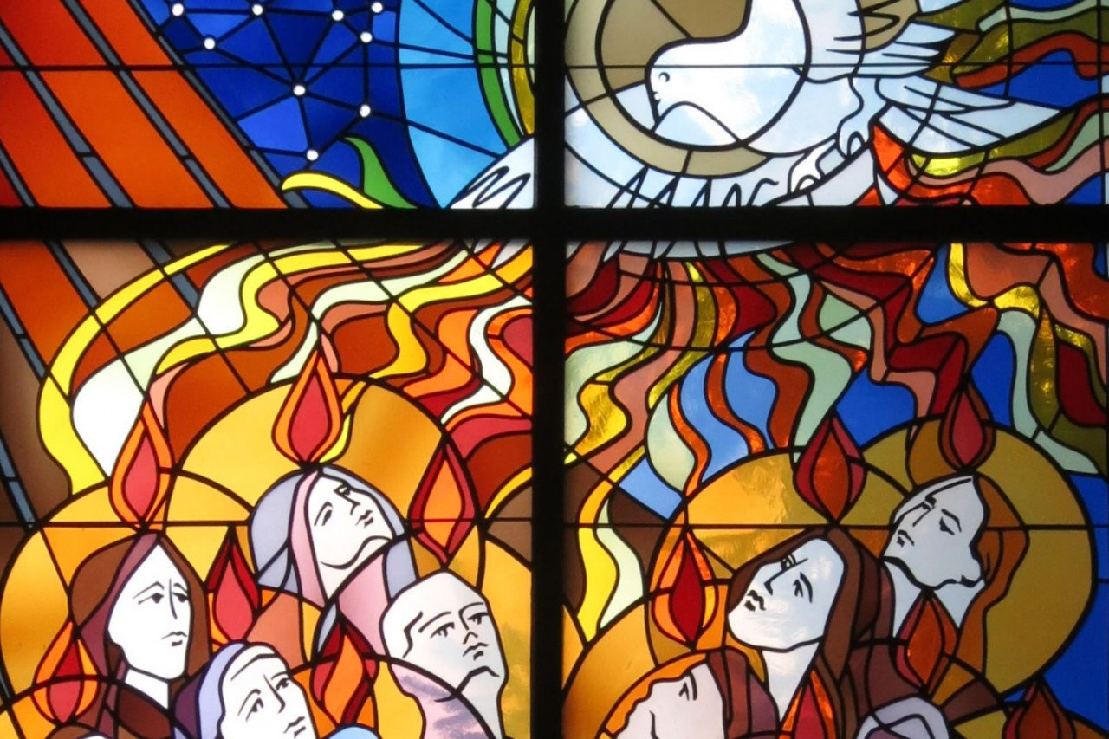
FILLED WITH THE SPIRIT

Slide 2
PENTECOST
The Jewish feast of Pentecost (Shavuot) was primarily thanksgiving for the firstfruits of the wheat harvest, but it was later associated with a remembrance of the Law given by God to Moses on Mount Sinai.

Slide 3
CHRISTIAN PENTECOST
For Christians it is the firstfruits of the powerful presence of God and Jesus in our midst—
the precious Holy Spirit.

Slide 4
ACTS 2:1-4
When the day of Pentecost arrived, they were all together in one place. 2 And suddenly there came from heaven a sound like a mighty rushing wind,
and it filled the entire house where they were sitting.
3 Divided tongues as of fire appeared to them and rested on each one of them. 4 And they were all filled with the Holy Spirit and began to speak in other tongues as the Spirit gave them utterance. ESV

Slide 5
Acts 2:9-11
There were 9 Parthians and Medes and Elamites, Mesopotamians, from Judea and Cappadocia, Pontus and Asia, 10 Phrygia and Pamphylia, Egypt and of Libya; visitors from Rome, 11 both Jews and proselytes, Cretans and Arabians—we hear them telling in our own tongues the mighty works of God." ESV

Slide 6
Tongues are languages
They heard 17 different languages and dialects declaring the mighty works of God.
Explanation--It was a miraculous event.

Slide 7
Five things happened
1. All together (unified) in one place.
2. A sound like a mighty rushing wind.
3. Filled the entire house.
4. Divided tongues as of fire on each of them.
5. All filled with the Holy Spirit.

Slide 8
Purpose of pentecost
Why were they there? Why 10 days?
A: Jesus commanded them to wait there for the promise of the Father.
A: It had to be on the day of Pentecost.

Slide 9
Acts 1:4
4 He (Jesus) commanded them to stay in Jerusalem, and to wait for the promise of the Father.
“You will be baptized with the Holy Spirit not many days from now." ESV

Slide 10
Mark 1:8
John the Baptist said….“I have baptized you with water, but he will baptize you with the Holy Spirit." ESV

Slide 11
Luke 11:13
“If you then, who are evil (sinful, corrupt, fallen), know how to give good gifts to your children, how much more will the heavenly Father give the Holy Spirit to those who ask him!" ESV

Slide 12
John 14:26
But the Helper (paraclete), the Holy Spirit, whom the Father will send in my name, he will teach you all things and bring to your remembrance all that I have said to you.
ESV

Slide 13
Ephesians 5:18-19
Be filled with the Spirit, 19 addressing one another in psalms and hymns and spiritual songs, singing and making melody to the Lord with all your heart. ESV

Slide 14
it’s for everybody
The Holy Spirit is for everyone, not just for Pentecostals.

Slide 15
What makes us pentecostals?
What makes us Pentecostals is not speaking in tongues—that’s one of nine gift.
It’s that the Holy Spirit helps us declare the gospel boldly and powerfully.

Slide 16
Daily filled
There is one baptism, but many fillings.
Take a big drink every day, not a little sip!

