Slide 1
PRACTICE PERSISTENCE

Slide 2
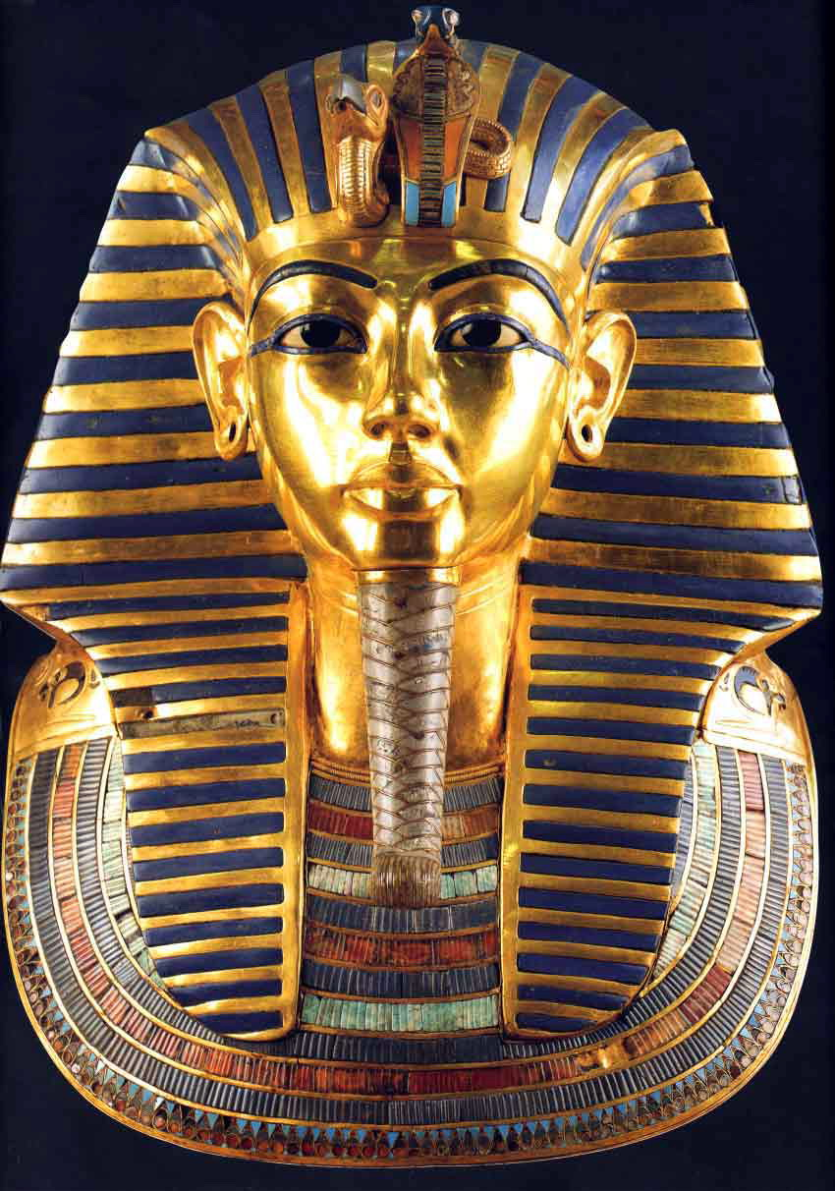

Slide 3


Slide 4
64% say they pray more than once a day. · 56% say they most often pray for family members, with 3.3% saying that they pray for strangers. A little over 38% say that the most important purpose of prayer is intimacy with God.

Slide 5
Ephesians 6:18
Pray in the Spirit at all times and on every occasion. Stay alert and be persistent in your prayers for all believers everywhere.

Slide 6
Luke 11:4-13
Then, teaching them more about prayer, he used this story: “Suppose you went to a friend’s house at midnight, wanting to borrow three loaves of bread. You say to him, a friend of mine has just arrived for a visit, and I have nothing for him to eat.’

Slide 7
Luke 11:4-13
And suppose he calls out from his bedroom, ‘Don’t bother me. The door is locked for the night, and my family and I are all in bed. I can’t help you.’

Slide 8
But I tell you this—though he won’t do it for friendship’s sake, if you keep knocking long enough, he will get up and give you whatever you need because of your shameless persistence.

Slide 9
Luke 11:4-13
“And so I tell you, keep on asking, and you will receive what you ask for. Keep on seeking, and you will find. Keep on knocking, and the door will be opened to you.
For everyone who asks, receives. Everyone who seeks, finds. And to everyone who knocks, the door will be opened.

Slide 10
Luke 11:4-13
“You fathers—if your children ask for a fish, do you give them a snake instead?
Or if they ask for an egg, do you give them a scorpion? Of course not!
So if you sinful people know how to give good gifts to your children, how much more will your heavenly Father give the Holy Spirit to those who ask him.”

Slide 11
DEFINITION - ask
To ask, beg, call for, crave, desire, require

Slide 12
ask
Asking requires humility and right motives

Slide 13
James 4:3
And even when you ask, you don’t get it because your motives are all wrong—you want only what will give you pleasure.

Slide 14
Definition - seek
To seek in order to find
  to seek a thing
  to seek [in order to find out] by thinking, meditating, reasoning, to enquire into
  to seek after, seek for, aim at, strive after

Slide 15
seek
Put aside laziness. Lazy people do not seek anything.

Slide 16
Definition - knock
To knock: at the door

Slide 17
knock
Get someone's attention. More forceful asking. Expends more energy.

Slide 18
KNOCK
Do you knock on God’s door expecting an answer?

Slide 19
conclusion
Ask with right motives.
Seek, knowing this may take time.
Knock expecting an answer.

