Slide 1
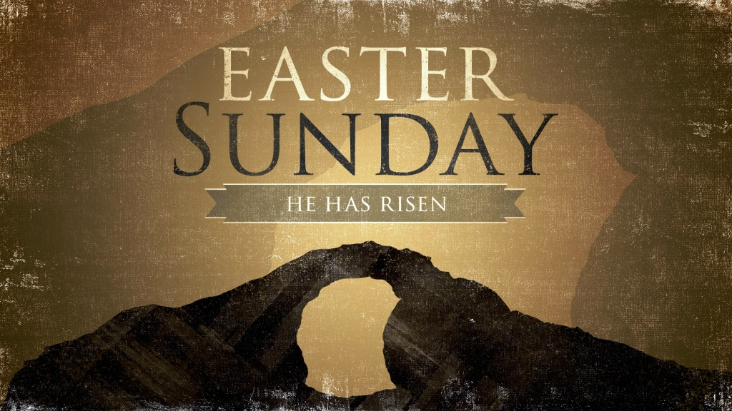
RESURRECTION

Slide 2


Resuscitation?
Resurrection?
INTRODUCTION

Slide 3
“Body stolen”
“He swooned”
“The Christ spirit”
INTRODUCTION

Slide 4
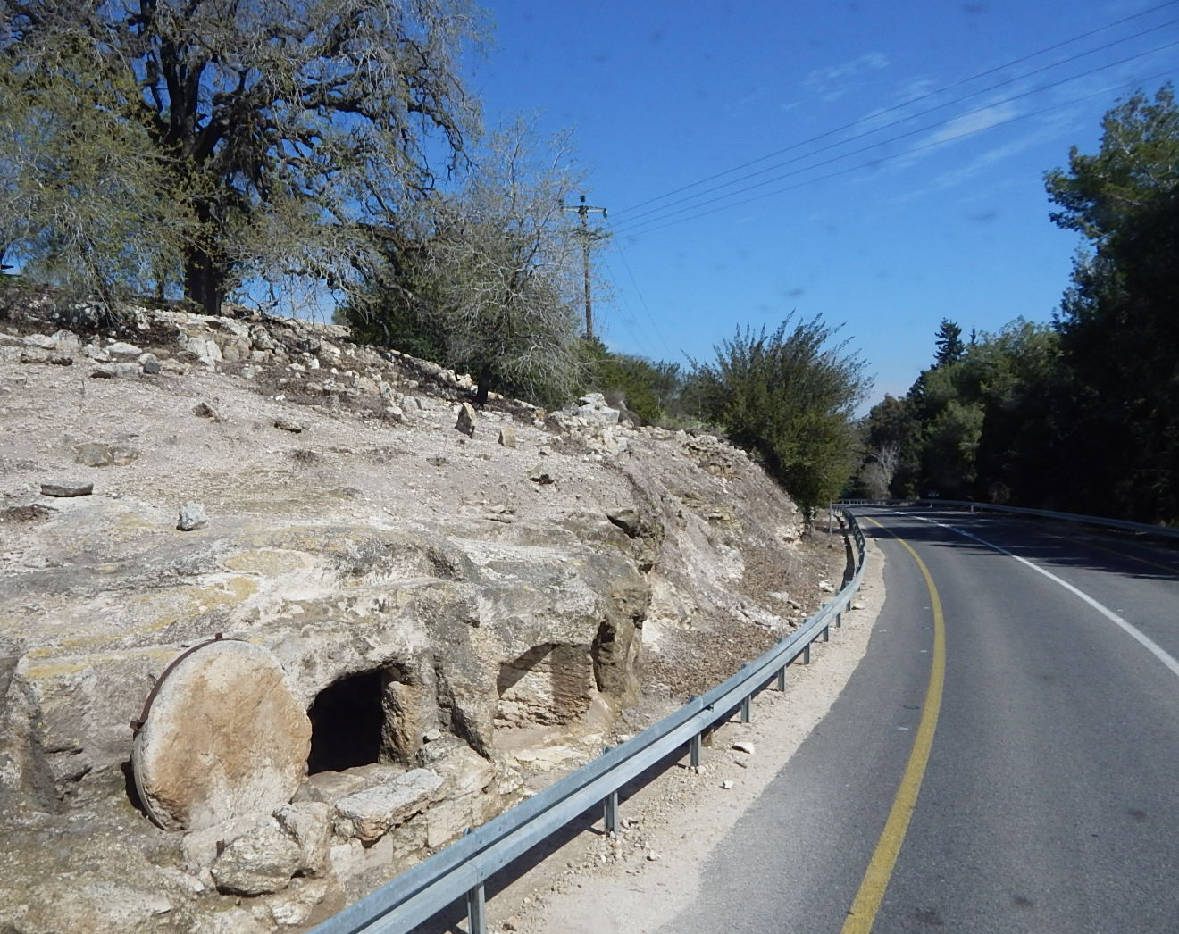
ILLUSTRATION

Slide 5
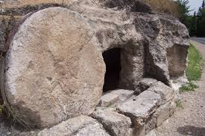
ILLUSTRATION

Slide 6
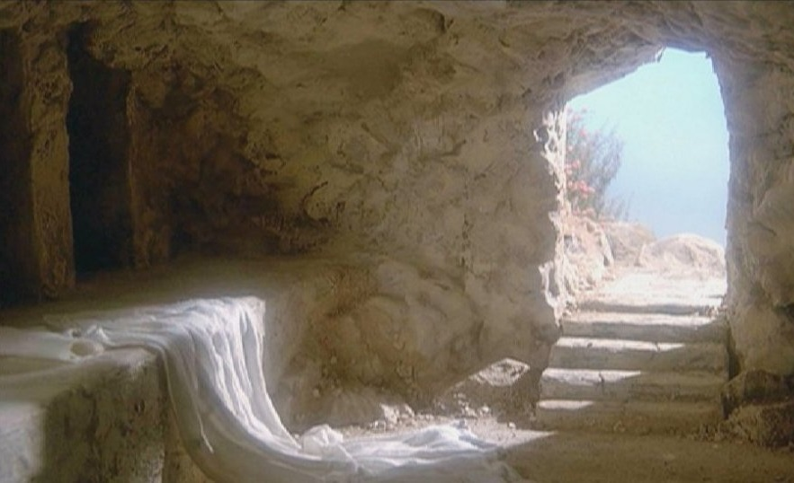
ILLUSTRATION

Slide 7
Why Resurrection?
INTRODUCTION

Slide 8
²⁵ He was delivered over to death for our sins and was raised to life for our justification.
Romans 4:25

Slide 9
The Soul that Sins Shall Die
Point #1

Slide 10
He is Risen… because payment is accepted in full
Point #1

Slide 11
²⁴ But God raised him from the dead, freeing him from the agony of death, because it was impossible for death to keep its hold on him.
Acts 2:24

Slide 12
He is Risen…
LIFE always beats DEATH
LIGHT always shatters DARKNESS
Point #2

Slide 13
³⁴ God raised him from the dead so that he will never be subject to decay. As God has said,
“‘I will give you the holy and sure blessings promised to David.’
Acts 13:34

Slide 14
He is Risen… to prove that God keeps His promises
Point #3

Slide 15
⁴ We were therefore buried with him through baptism into death in order that, just as Christ was raised from the dead through the glory of the Father, we too may live a new life.
Romans 6:4

Slide 16
He is Risen… because God gives us new LIFE
Point #4

Slide 17
¹⁰ then know this, you and all the people of Israel: It is by the name of Jesus Christ of Nazareth, whom you crucified but whom God raised from the dead, that this man stands before you healed.
Acts
4:10

Slide 18
He is Risen… so that His grace may flow from His people
Point #5

Slide 19
¹⁴ because we know that the one who raised the Lord Jesus from the dead will also raise us with Jesus and present us with you to himself.
Second Corinthians4:14

Slide 20
He is Risen… because He is an example to us of our physical resurrection
Point #6

Slide 21
³¹ For he has set a day when he will judge the world with justice by the man he has appointed. He has given proof of this to everyone by raising him from the dead.”
Acts 17:31

Slide 22
He is Risen… because God will have a MAN judge all of mankind
Point #7

Slide 23
God is not in the condemnation and killing business but in the life and resurrection business
CONCLUSION

Slide 24
Where in your life do you need a RESURRECTION?
CONCLUSION

