Slide 1
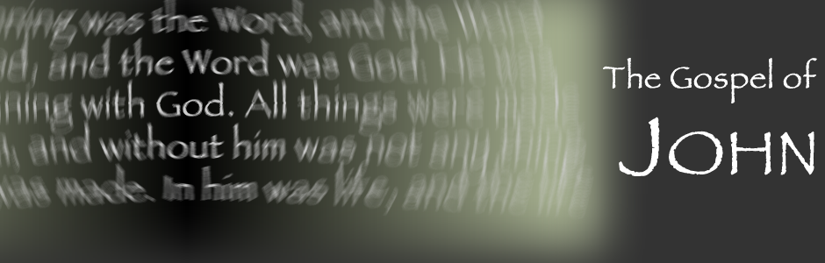
Just Who
Is this
Jesus?
The Grand
Entrance

Slide 2
Cornerstone? Priest?
King?
Will the real Messiah please ride into town!?
Introduction
Just Who Is This Jesus?
The Grand Entrance

Slide 3
¹² The next day the great crowd that had come for the Feast heard that Jesus was on his way to Jerusalem.
John 12: 12-15
Just Who Is This Jesus?
The Grand Entrance

Slide 4
¹³ They took palm branches and went out to meet him, shouting, "Hosanna!" "Blessed is he who comes in the name of the Lord!" "Blessed is the King of Israel!“
John 12: 12-15
Just Who Is This Jesus?
The Grand Entrance

Slide 5
¹⁴ Jesus found a young donkey and sat upon it, as it is written,
¹⁵ "Do not be afraid, O Daughter of Zion; see, your king is coming, seated on a donkey's colt.“
John 12: 12-15
Just Who Is This Jesus?
The Grand Entrance

Slide 6
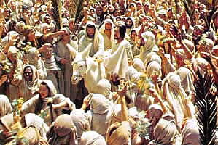

Slide 7
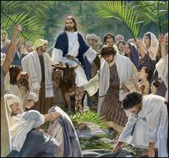

Slide 8
If we see the triumphant entrance just as that of a KING we miss 2/3 of the picture
OBSERVATION:
Just Who Is This Jesus?
The Grand Entrance

Slide 9
With God there is always more going on than meets the eye!
OBSERVATION:
Just Who Is This Jesus?
The Grand Entrance

Slide 10
Have you ever attended a grand event and enjoyed it but felt like you missed most of it?
QUESTION:
Just Who Is This Jesus?
The Grand Entrance

Slide 11
The prophecies of The Messiah meet together in Jesus of Nazareth! There are over 300 but here we can delve into ZECHARIAH’s BIG THREE
OBSERVATION:
Just Who Is This Jesus?
The Grand Entrance

Slide 12
Jesus (Joshua) the Messiah is the High Priest in the New Temple
POINT #1:
Just Who Is This Jesus?
The Grand Entrance

Slide 13
This is what the Lord almighty says: If you walk in my ways and keep my requirements then you will govern my house and have charge of my courts and I will give you a place among those standing here.
POINT #1: Zechariah 3:6-8
Just Who Is This Jesus?
The Grand Entrance

Slide 14
Listen O High priest Joshua and your associates seated here before you, who are men symbolic of things to come; I am going to bring my servant the Branch.
POINT #1: Zechariah 3:6-8
Just Who Is This Jesus?
The Grand Entrance

Slide 15
Jesus (Joshua) the Messiah is the Temple Builder and Capstone/Cornerstone
POINT #2: Zechariah 4: 6-9
Just Who Is This Jesus?
The Grand Entrance

Slide 16
This is the Word to Zerubbabel: Not by might, nor by power but by my spirit says the Lord Almighty. What are you mighty mountain? Before Zerubbabel you will become level ground.
POINT #2: Zechariah 4: 6-9
Just Who Is This Jesus?
The Grand Entrance

Slide 17
Then he will bring the capstone to the shouts of ‘God Bless It! God bless it!”
POINT #2: Zechariah 4: 6-9
Just Who Is This Jesus?
The Grand Entrance

Slide 18
Jesus (Joshua/Yeshua) the Messiah
is the King-Priest of the New Kingdom
POINT #3: Zechariah 6:11-13
Just Who Is This Jesus? The Grand Entrance

Slide 19
Take the silver and the gold and make a crown and set it on the head of the high priest, Joshua son of Jehozadak. Tell him this is what the Lord Almighty says: ‘Here is the man whose name is the ‘Branch’, and he
POINT #3: Zechariah 6:11-13
Just Who Is This Jesus? The Grand Entrance

Slide 20
Will branch out from this place and build the temple of the Lord. It is he who will build the temple of the Lord and he will be clothed with majesty and will sit and rule on his throne and he will be a priest on his throne. And there will be harmony between the two.
POINT #3: Zechariah 6:11-13
Just Who Is This Jesus?
The Grand Entrance

Slide 21
Jesus came to establish himself as cornerstone and humanity as the temple of God first…
CONCLUSION:
Just Who Is This Jesus?
The Grand Entrance

Slide 22
Jesus came to establish himself as cornerstone and humanity as the temple of God first…
Jesus came to establish the kingdom of God around the new temple next…
CONCLUSION:
Just Who Is This Jesus?
The Grand Entrance

Slide 23
Jesus came to establish himself as cornerstone and humanity as the temple of God first…
Jesus came to establish the kingdom of God around the new temple next…
Jesus came to call every believer to be sent out as a priest before our God.
CONCLUSION:
Just Who Is This Jesus?
The Grand Entrance

Slide 24
Jesus has made his Grand Entrance in Jerusalem…have you welcomed him into your heart?
He is the Chief Cornerstone.
QUESTION:
Just Who Is This Jesus?
The Grand Entrance

Slide 25
Jesus has made his Grand Entrance in Jerusalem…have you welcomed him into your heart?
He is the Chief Cornerstone.
He is the High Priest that offered himself for you.
QUESTION:
Just Who Is This Jesus?
The Grand Entrance

Slide 26
Jesus has made his Grand Entrance in Jerusalem…have you welcomed him into your heart?
He is the Chief Cornerstone.
He is the High Priest that offered himself for you.
He is the King that is worthy of ruling EVERYTHING!
QUESTION:
Just Who Is This Jesus?
The Grand Entrance

