Slide 1
What is your sign?

Slide 2
There are signs all around us.

Slide 3


Slide 4
There are signs that something has happened.

Slide 5
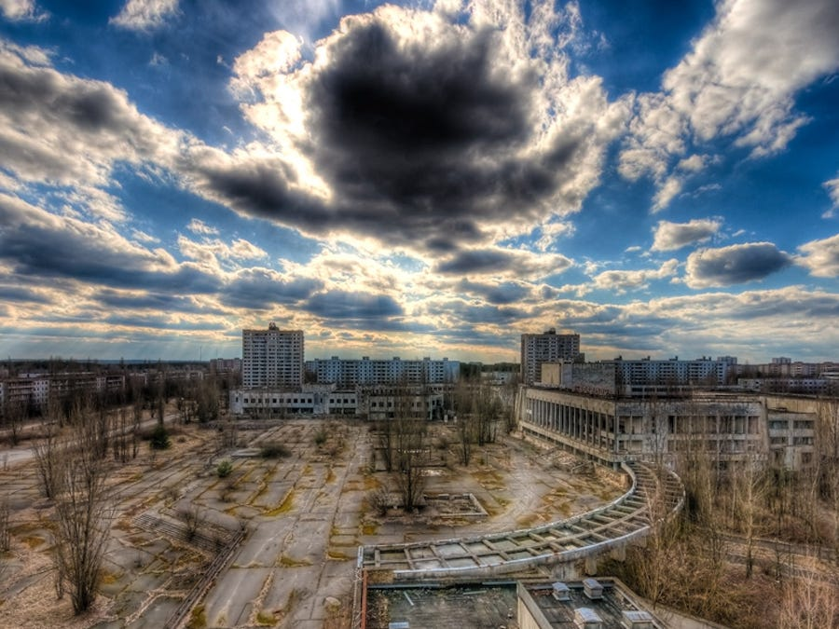

Slide 6
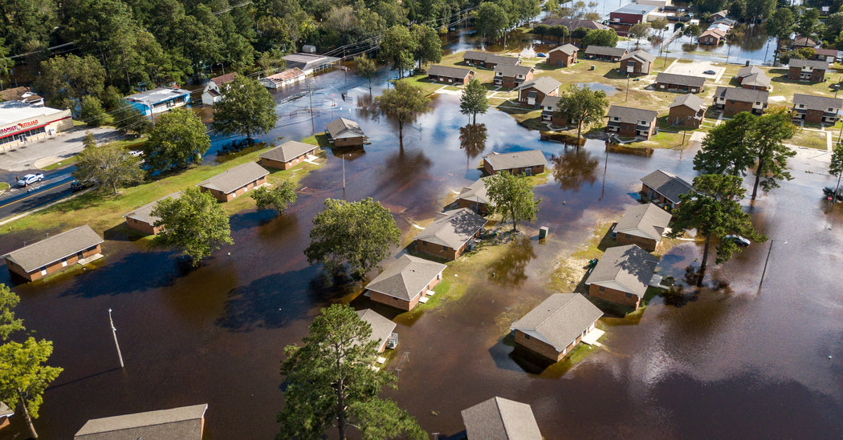

Slide 7
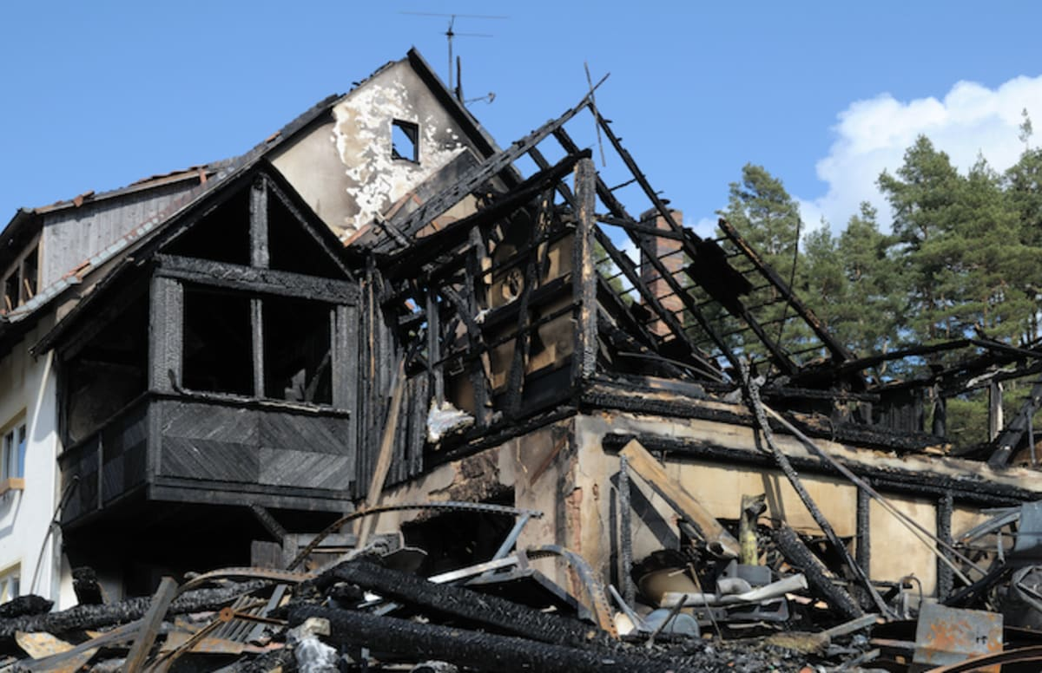

Slide 8
Signs of fire are:
Smell of smoke
Visible smoke.
Flame
The effect is leaves behind.

Slide 9
There are signs or evidence to Christianity.

Slide 10
POINT ONE
Your talk

Slide 11
But the things that come out of a person’s mouth come from the heart, and these defile them. Matthew 15:18

Slide 12
A good man brings good things out of the good stored up in his heart, and an evil man brings evil things out of the evil stored up in his heart. For the mouth speaks what the heart is full of. Luke 6:45

Slide 13
Those who consider themselves religious and yet do not keep a tight rein on their tongues deceive themselves, and their religion is worthless. James 1:26

Slide 14
POINT 2
Your actions

Slide 15
Do not merely listen to the word, and so deceive yourselves. Do what it says. James 1:22

Slide 16
Religion that God our Father accepts as pure and faultless is this: to look after orphans and widows in their distress and to keep oneself from being polluted by the world. James 1:27

Slide 17
POINT 3
How you look

Slide 18
If not, what did you go out to see? A man dressed in fine clothes? No, those who wear expensive clothes and indulge in luxury are in palaces. Luke 7:25

Slide 19
POINT 4
What you leave behind

Slide 20
Peace I leave with you; my peace I give you. I do not give to you as the world gives. Do not let your hearts be troubled and do not be afraid. John 14:27

Slide 21
CONCLUSION
Listen to yourself. Is your talk pleasing to Christ?
Pay attention to what you do. Are your actions pleasing to Christ and do they line up with His word?
Is your appearance pleasing to Christ?
Think about what you leave behind. Do you leave behind words of encouragement and love or do you leave behind hurt and negativity.

