Slide 1
Don’t do it

Slide 2
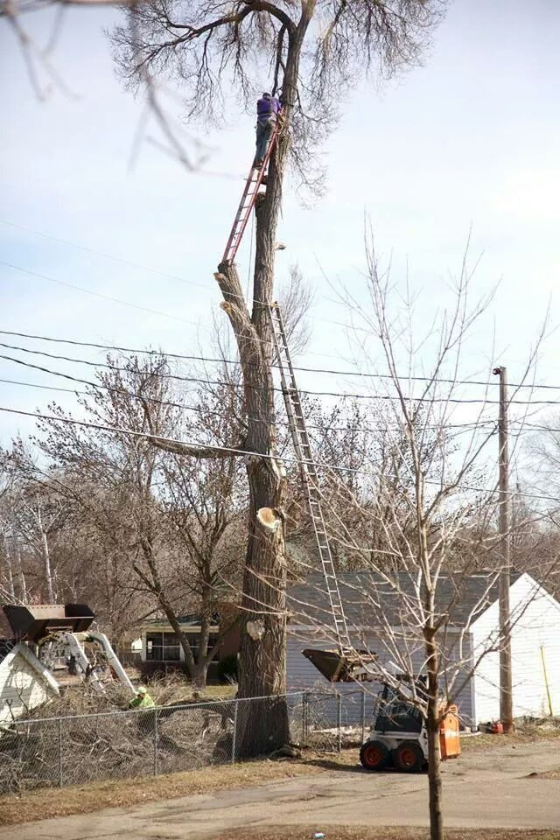
Don’t do it

Slide 3
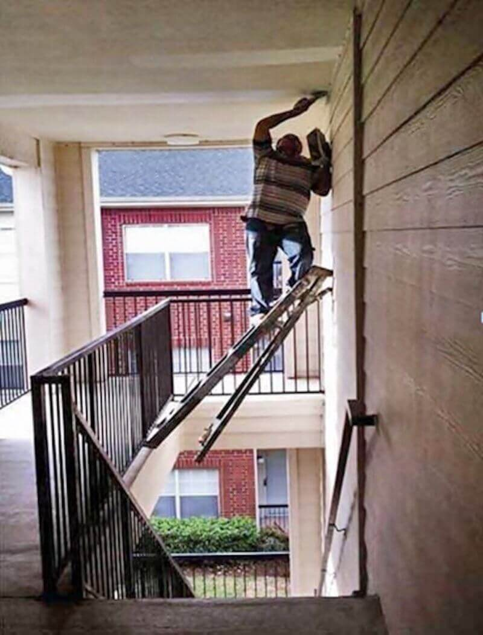
Don’t do it

Slide 4
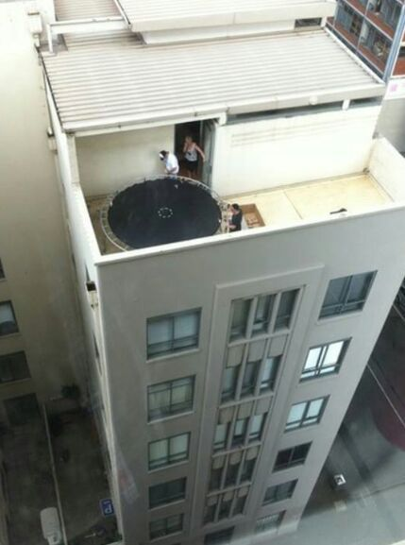
Don’t do it

Slide 5
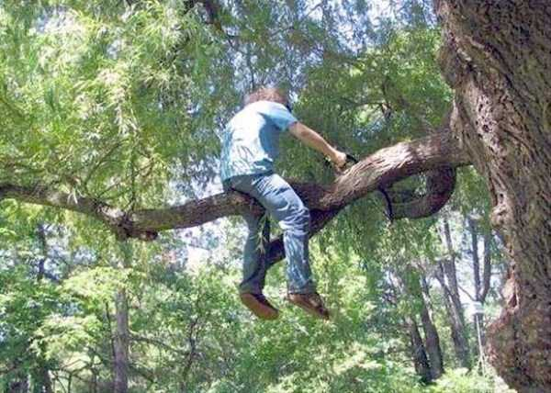
Don’t do it

Slide 6
POINT one
Don’t engage the enemy (Satan) in conversation.

Slide 7
DON’T DO IT!
We were created to converse with God, not Satan.

Slide 8
POINT one – don’t do it!
Satan knows how to trip us up.

Slide 9
Point two – don’t do it!
There are two major lies Satan tells us that we must never believe.

Slide 10
FIRST LIE
YOU ARE NOT GOOD ENOUGH.

Slide 11
YOU DON’T HAVE TO BE GOOD ENOUGH, JUST WILLING ENOUGH.

Slide 12
Point two
Gideon and Moses thought they were not good enough to do what God called them to do.

Slide 13
Don’t do it
“Pardon me, my lord,” Gideon replied, “but how can I save Israel? My clan is the weakest in Manasseh, and I am the least in my family.” Judges 6:15

Slide 14
Don’t do it
Moses said to the LORD, “Pardon your servant, Lord. I have never been eloquent, neither in the past nor since you have spoken to your servant. I am slow of speech and tongue.” Exodus 4:10

Slide 15
SECOND LIE
YOU ARE TO GOOD.

Slide 16
NAAMAN HAD AN OVERINFLATED VIEW OF HIMSELF.

Slide 17
But Naaman went away angry and said, “I thought that he would surely come out to me and stand and call on the name of the LORD his God, wave his hand over the spot and cure me of my leprosy. 2 Kings 5:11

Slide 18
Be humble and have a proper estimation of yourself.

Slide 19
DO THIS
The centurion in the New Testament had a proper estimation of himself.

Slide 20
Matthew 8:5-10
When Jesus had entered Capernaum, a centurion came to him, asking for help.
“Lord,” he said, “my servant lies at home paralyzed, suffering terribly.”

Slide 21
Matthew 8:5-10
Jesus said to him, “Shall I come and heal him?”
The centurion replied, “Lord, I do not deserve to have you come under my roof. But just say the word, and my servant will be healed.

Slide 22
Matthew 8:5-10
For I myself am a man under authority, with soldiers under me. I tell this one, ‘Go,’ and he goes; and that one, ‘Come,’ and he comes. I say to my servant, ‘Do this,’ and he does it.”

Slide 23
Matthew 8:5-10
When Jesus heard this, he was amazed and said to those following him, “Truly I tell you, I have not found anyone in Israel with such great faith

Slide 24
TRUTH
But you are a chosen generation, a royal priesthood, a holy nation, His own special people, that you may proclaim the praises of Him who called you out of darkness into His marvelous light.” 1 Peter 2:9.
“For God so loved that world that He gave his only begotten Son, that whoever believes in Him should not perish but have everlasting life.” John 3:16.

Slide 25
DON’T DO IT!
Do not engage the devil in conversation.
Do not think you are not good enough to be used of God.
Do not think you are better than anyone else.
Do not forget who you are in Christ.

