Slide 1
CONTEND
“What are we going to do about this?”

Slide 2
…BUT FIRST…
A WORD ABOUT A WATCHMAN ON THE WALL
Ezekiel 33:1-9

Slide 3
Dear friends, although I was very eager to write to you about the salvation we share, I felt compelled to write and urge you to contend for the faith that was once for all entrusted to God’s holy people.
Jude 3

Slide 4
FEAR MUST BE DEALT WITH IN ORDER FOR US TO BEGIN CONTENDING

Slide 5
Peace I leave with you; my peace I give you. I do not give to you as the world gives. Do not let your hearts be troubled and do not be afraid.
John 14: 27

Slide 6
“The Only Thing we have to fear is fear itself.”
Franklin Delano Roosevelt

Slide 7
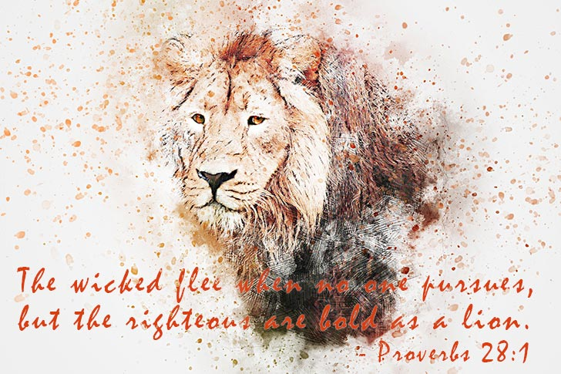

Slide 8
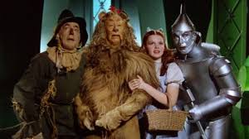

Slide 9
In the wizard of oz one of the great curiosities was the “cowardly lion”

Slide 10
THE truth about the king of beasts…

Slide 11
Be alert and of sober mind. Your enemy the devil prowls around like a roaring lion looking for someone to devour. Resist him, standing firm in the faith, because you know that the family of believers throughout the world is undergoing the same kind of sufferings.
1 Peter 5:8-9

Slide 12
1. BE ALERT & OF SOBER MIND

Slide 13
1. BE ALERT & OF A SOBER MIND
2. RESIST HIM BY TAKING A FAITH STAND

Slide 14
1. BE ALERT & OF A SOBER MIND
2. RESIST HIM BY TAKING A FAITH STAND
3. Join the pride

