Slide 1
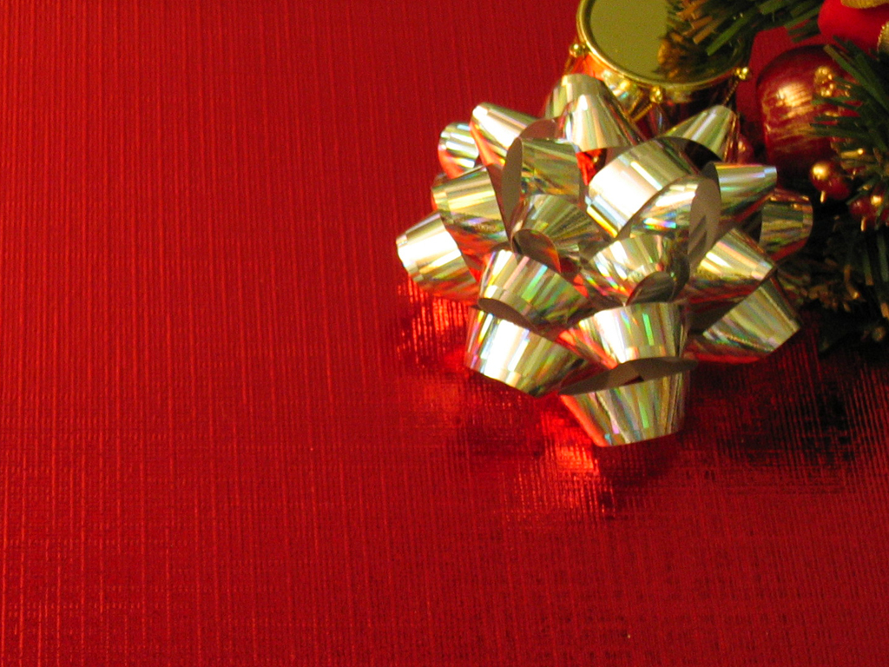
THREE GIFTS

Slide 2
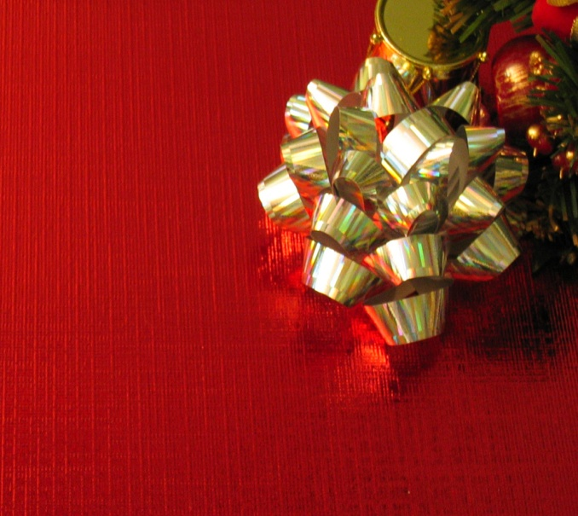
Three Gifts
“ And when they came into the house, they saw the child with Mary his mother, and they fell down and worshipped him. And opening their treasure boxes, they offered him gifts of gold, frankincense, and myrhh.”
Matthew 2:11

Slide 3
Three Gifts
MYRRH
INTRO

Slide 4
Three Gifts
Myrrh is a resin or oil obtained from a thorny tree that lives in desert places. It is slapped or whipped bringing out a resin.
INTRO

Slide 5
Three Gifts
Why does the bible feature this valuable liquid from Genesis to Revelation?
INTRO

Slide 6
Three Gifts
It is interesting the first time that myrrh shows up in Scripture
INTRO

Slide 7
Three Gifts
As they sat down to eat their meal, they looked up and saw a caravan of Ishmaelites coming from Gilead. Their camels were loaded with spices, balm and myrrh, and they were on their way to take them down to Egypt.
Genesis 37:25-27
INTRO

Slide 8
Three Gifts
Judah said to his brothers, “What will we gain if we kill our brother and cover up his blood? Come, let’s sell him to the Ishmaelites and not lay our hands on him; after all, he is our brother, our own flesh and blood.” His brothers agreed.
Genesis 37:25-27
INTRO

Slide 9
Three Gifts
Why would they bring this to the toddler King of Israel?
INTRO

Slide 10
Three Gifts
In what way can I bring this gift to the Christ of God?
INTRO

Slide 11
Three Gifts
BITTER
#1

Slide 12
Three Gifts
We prefer sweet things that have sweet effects
#1

Slide 13
Three Gifts
Most effective medicines have a bitterness that needs to be negotiated with…
#1

Slide 14
Three Gifts
Coffee with cream and sugar
Numbing meds for teething babies
#1

Slide 15
Three Gifts
Bitter Waters
Bitter Woman
Bitter Wine
#1

Slide 16
Three Gifts
An Angel in Revelation w/ a scroll
(sweet to bitter)
The touch of the gift of myrrh (bitter to sweet)
#1

Slide 17
Three Gifts
EASES PAIN
#2

Slide 18
Three Gifts
The Balm in Gilead
Is there no balm in Gilead? Is there no physician there? Why then is there no healing for the wound of my people?
Jeremiah 8:22
#2

Slide 19
Three Gifts
They brought Jesus to the place called Golgotha (which means “the place of the skull”). Then they offered him wine mixed with myrrh, but he did not take it.
Mark 15:22-23
#2

Slide 20
Three Gifts
Two very strong impulses:
Pain Avoidance
Pain Suppression
#2

Slide 21
Three Gifts
We are either numbed by shock and disappointment or eased by the presence of Grace
#2

Slide 22
Three Gifts
“If pain is weakness leaving my body, forgiveness is bitterness leaving my soul ”
#2

Slide 23
Three Gifts
USED IN DEATH
#3

Slide 24
Three Gifts
He was accompanied by Nicodemus, the man who earlier had visited Jesus at night. Nicodemus brought a mixture of myrrh and aloes, about seventy-five pounds. Taking Jesus’ body, the two of them wrapped it, with the spices, in strips of linen. This was in accordance with Jewish burial customs.
John 19:39-40
#3

Slide 25
Three Gifts
If you think about it, Christianity is a lifestyle that demonstrates life while it is preoccupied with death.
#3

Slide 26
Three Gifts
Jesus invited disciples to deny themselves, take up a cross daily, and follow Him
#3

Slide 27
Three Gifts
I want to know Christ—yes, to know the power of his resurrection and participation in his sufferings, becoming like him in his death, and so, somehow, attaining to the resurrection from the dead.
Philippians 3:10,11
#3

Slide 28
Three Gifts
The fellowship of his sufferings…
#3

Slide 29
Three Gifts
In what way can I bring this gift to the Christ of God?
CONCLUSION

Slide 30
Three Gifts
Press past the bitter
Give forgiveness
Enter into His sufferings
CONCLUSION

