Slide 1
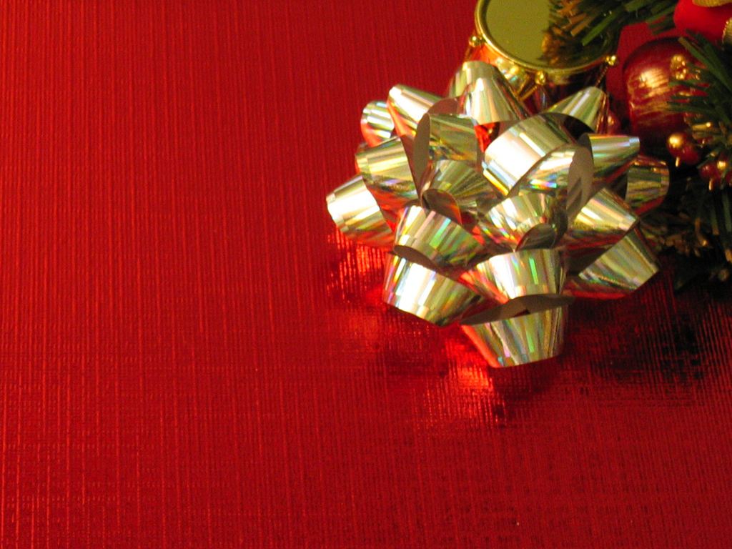
THREE GIFTS

Slide 2
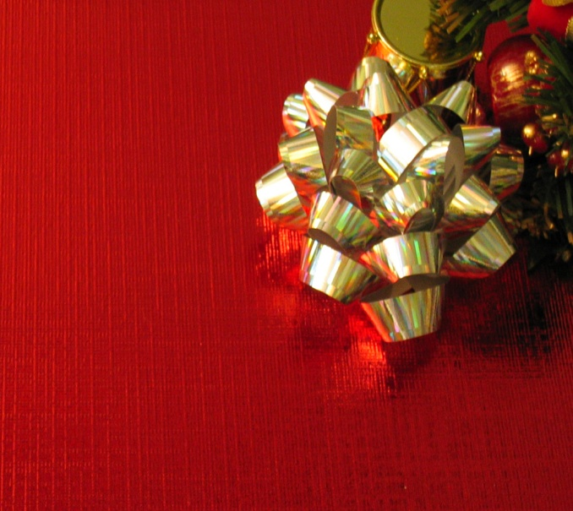
Three Gifts
“ And when they came into the house, they saw the child with Mary his mother, and they fell down and worshipped him. And opening their treasure boxes, they offered him gifts of gold, frankincense, and myrhh.”
Matthew 2:11

Slide 3
Three Gifts
FRANKINCENSE
INTRO

Slide 4
Three Gifts
Why does the bible feature this “noble incense” from Exodus to Revelation?
INTRO

Slide 5
Three Gifts
Why did these Magi bring it as one of their gifts?
INTRO

Slide 6
Three Gifts
“A multitude of camels will cover you, the young camels of Midian and Ephah; All those from Sheba will come; They will bring gold and frankincense, and will bear good news of the praises of the Lord.
Isaiah 60:6
INTRO

Slide 7
Three Gifts
In what way can I bring this gift to the Christ of God?
INTRO

Slide 8
Three Gifts
Frankincense was an important part of the ministry of the priests within the temple.
INTRO

Slide 9
Three Gifts
Frankincense is mentioned 17 times in Scripture mostly in connection with the function of the temple
INTRO

Slide 10
Three Gifts
Frankincense is mixed into the anointing oil, it is burned on the altar of incense in the Holy Place and is sprinkled on the shewbread.
INTRO

Slide 11
Three Gifts
NOBLE
#1

Slide 12
Three Gifts
The best grade of incense
#1

Slide 13
Three Gifts
Thanksgiving is the best kind of prayer to offer.
#1

Slide 14
Three Gifts
DESERT
BORN
#2

Slide 15
Three Gifts
Boswellia / Olibanum trees
grow in arid and dry places of the Arabian peninsula and the northern coast of Somaliland
#2

Slide 16
Three Gifts
Praise is a powerful form of prayer because it declares God’s grace in the face of lack.
#2

Slide 17
Three Gifts
INTIMATE
#3

Slide 18
Three Gifts
Trees are lashed on their bark and the resin that oozes out, hardens and then is scraped off and used to burn for rich aroma
#3

Slide 19
Three Gifts
The 12 loaves of shewbread was sprinkled with frankincense and speaks of intimate fellowship and bread covenant.
#3

Slide 20
Three Gifts
WORSHIP is a form of prayer that only gets deeper, more intimate, and more honest – through adversity
#3

Slide 21
Three Gifts
The fellowship of his sufferings…
#3

Slide 22
Three Gifts
ASCENDS
#4

Slide 23
Three Gifts
Incense is burned on earth and ascends into the heavens – we stand upon the earth and make request of heaven.
#4

Slide 24
Three Gifts
Our requests are made of a heavenly Father that has everything that we need.
#4

Slide 25
Three Gifts
We function as priests in INTERCESSION
#4

