Slide 1
THE GOSPEL
AND
CHRISTMAS

Slide 2
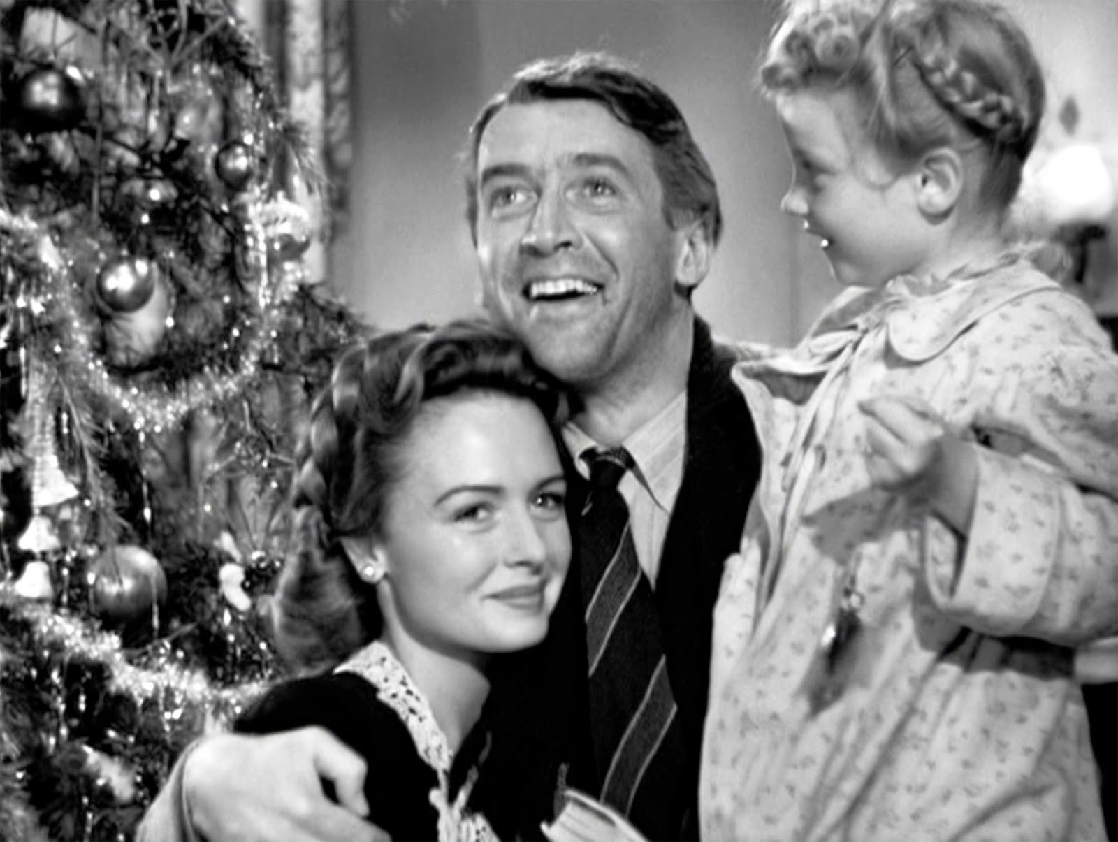

Slide 5
elf

Slide 6
4 PART MEANING OF CHRISTMAS
1. Jesus saved from sin.
2. Jesus revealed the kingdom.
3. Jesus overcame the devil.
4. The new creation.

Slide 7
1. Saved from sin
Matthew 1:21
You shall call his name Jesus,
for he will save his people from their sins. ESV

Slide 8
1. Saved from sin
Colossians 2:12-13
God raised him from the dead… and you, who were dead… God made alive together with him.

Slide 9
1. Saved from sin
Colossians 2:14
He forgave us all our trespasses by canceling the record of debt
that stood against us.

Slide 10
1. Saved from sin
Hebrews 9:26
He has appeared once for all at the end of the ages to put away sin by the sacrifice of himself. ESV

Slide 11
2. Revealed the Kingdom
The kingdom of God was at the center of all Jesus’ teaching.

Slide 12
2. Revealed the Kingdom
Jesus was teaching anyone who would listen that the kingdom of God was a here and now reality.
He had no other subject.

Slide 13
Luke 12:32
32 Fear not, little flock, for it is your Father's good pleasure to
give you the kingdom. ESV

Slide 14
Luke 4:43
I must preach the good news of the kingdom of God to the other towns as well; for I was sent for this purpose. ESV

Slide 15
Luke 17:21
21 Indeed, the kingdom of God is within (entos—inside) you." NKJV

Slide 16
3 Jesus overcame the devil
1John 3:8
The reason the Son of God appeared was to destroy the
works of the devil. ESV

Slide 17
3. Jesus overcame the devil
Mercy forgave us, but we’re still just as dead. How do we come to life?

Slide 18
2 Corinthians 5:17
Therefore, if anyone is in Christ, he is a new creation. The old has passed away; behold, the new has come. ESV

Slide 19
4. The new creation
A vital part of the gospel is that Jesus established the new creation. Forgiveness without it is pointless.

Slide 20
The gospel and Christmas
The meaning of Christmas is the good news that Jesus accomplished his 4 fold mission.

Slide 21
The reality of this is that your hope, your dreams, your past, your future is all wrapped up in that little baby in the manger.

Slide 22
Prayer
Lord, thank you for dying for us, removing sin, stripping Satan of his power, revealing the kingdom, and being the first new creature on the earth. That was you, but it’s also us. We also are new creatures with a new destiny. Now we have a new life and a bright future, all because of Christmas….through Christ our Lord…Amen.

