Slide 1
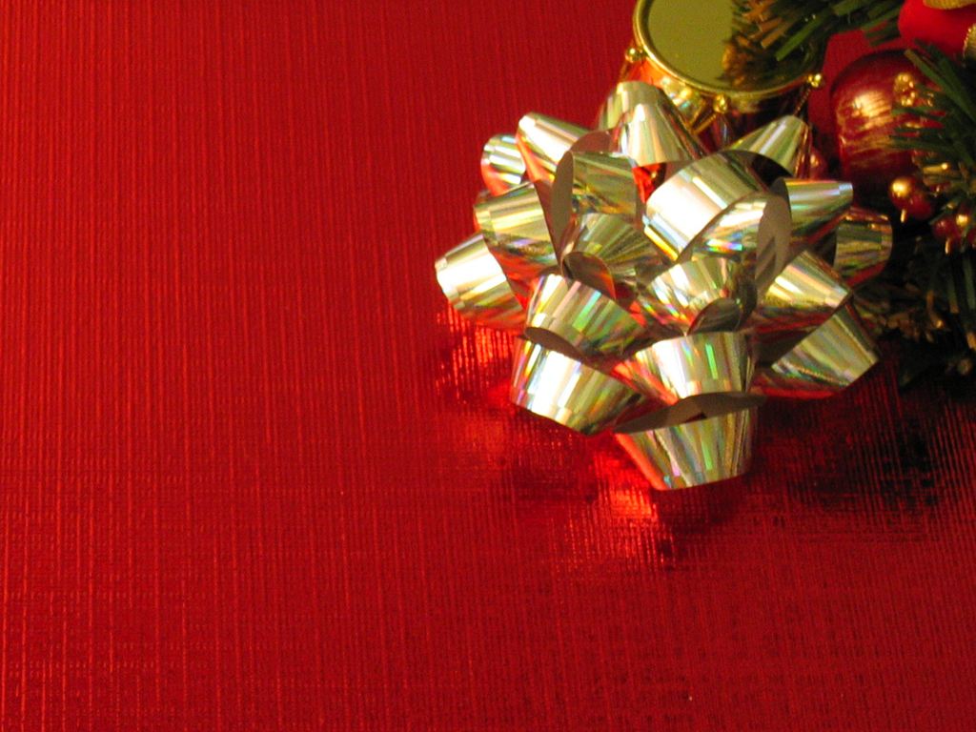
THREE GIFTS

Slide 2
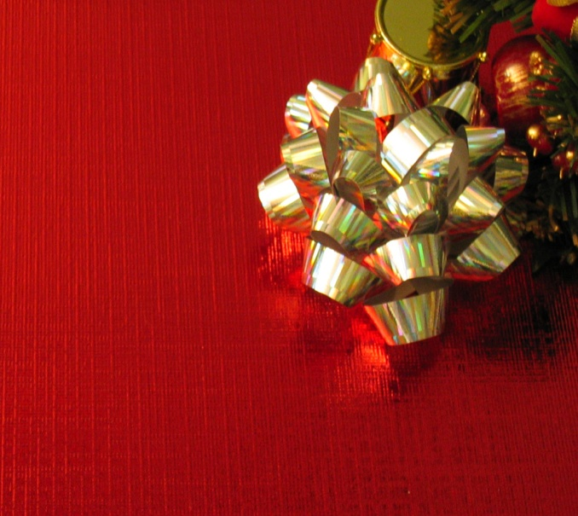
Three Gifts
“ And when they came into the house, they saw the child with Mary his mother, and they fell down and worshipped him. And opening their treasure boxes, they offered him gifts of gold, frankincense, and myrhh.”
Matthew 2:11

Slide 3
Three Gifts
GOLD
INTRO

Slide 4
Three Gifts
What is so special about a yellow- colored metal that has inspired “fever”, “rushes” and wars?
INTRO

Slide 5
Three Gifts
Why does the bible feature this yellow-colored metal from Genesis to Revelation?
INTRO

Slide 6
Three Gifts
Why did these Magi bring it as one of their gifts?
INTRO

Slide 7
Three Gifts
In what way can I bring this gift to the Christ of God?
INTRO

Slide 8
Three Gifts
RARE
#1

Slide 9
Three Gifts
“careful searching required”
#1

Slide 10
Three Gifts
NOBLE
#2

Slide 11
Three Gifts
“air and other chemicals do not affect it”
#2

Slide 12
Three Gifts
HIDDEN
#3

Slide 13
Three Gifts
“Because ore grades of 30 ppm are usually needed before gold is visible to the naked eye, in most gold mines the gold is invisible.”
#3

Slide 14
Three Gifts
TESTED
#4

Slide 15
Three Gifts
Two basic tests are brought to gold:
Acid test
Fire
#4

Slide 16
Three Gifts
WORKABLE
#5

Slide 17
Three Gifts
“gold can be stretched to a microscopic thread and beaten to a sheet that is transparent”
#5

