Slide 2
Matthew 28:18-20- “All authority in heaven and on earth has been given to me. ¹⁹Therefore go and make disciples of all nations, baptizing them in the name of the Father and of the Son and of the Holy Spirit, ²⁰and teaching them to obey everything I have commanded you. And surely I am with you always, to the very end of the age.”

Slide 3
Compelled By The Promise-
Psalm 2:8- Ask of me and I will give the nations as an inheritance for you.

Slide 4
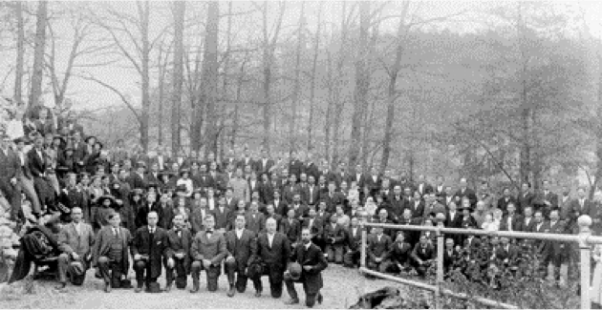

Slide 5
Started in 1914 with 314 people
106 years later, as part of the Assemblies of God, we have
69 million A/G adherents worldwide
370,000 churches
161,000 students
2,442 Training/Bible Schools

Slide 6
Every
41 seconds a new believer is added to the A/G
100 minutes a new A/G minister is enlisted.
137 minutes a new A/G church is planted
We have
2,756 Career Missionaries and Associates serving in
249 countries, territories, and provinces.
We, The A/G are working among 345 UPG’s (Unreached People Groups)

Slide 7
Rev. 5:9 “You have redeemed us to God by your blood, out of every tribe and tongue and people and nation”.

Slide 8
2. Compelled By The Problem.
270 countries and territories
249 of them have missionaries
What’s the problem?

Slide 9
“Ethnos”- a people, a group based on distinct cultural, physical, or geographic ties.
10,212 distinct nations “Ethnos” people groups
We are working in 1,985 of them.
8,227 of these groups are unreached
That is 40% of the world’s population who’ve never heard the gospel.

Slide 10
Europe-1,034 UPG’s
Latin America- 584 UPG’s
Africa- 867 UPG’s
Asia Pacific- 1,084 UPG’s
Northern Asia- 467 UPG’s
Eurasia- 4,191 UPG’s

Slide 11
3. Compelled By The Plan-
Romans 10:9, 14-15- “That if you confess with your mouth the Lord Jesus and believe in your heart that God has raised Him from the dead, you will be saved.
How then shall they call on Him in whom they have not believed?
How shall they believe in Him of whom they have not heard?
And how shall they hear without a preacher?
How shall they preach unless they are sent?”

Slide 12
Faith Promise-
A faith promise is not a pledge.
A pledge starts with your ability, your budget.
In contrast a Faith Promise starts with faith not facts.
It is a promise to give as God provides.
If God doesn’t provide you are not obligate to give.
Then why do it? Why can’t I just give it when I have extra? B/C that does not require faith. It is faith that please God (for without faith it is impossible to please God).

Slide 13
Why you need to make a faith promise.
It increases your faith
It helps you grow
It helps your church plan
It enlarges the kingdom
Souls get saved.

