Slide 1
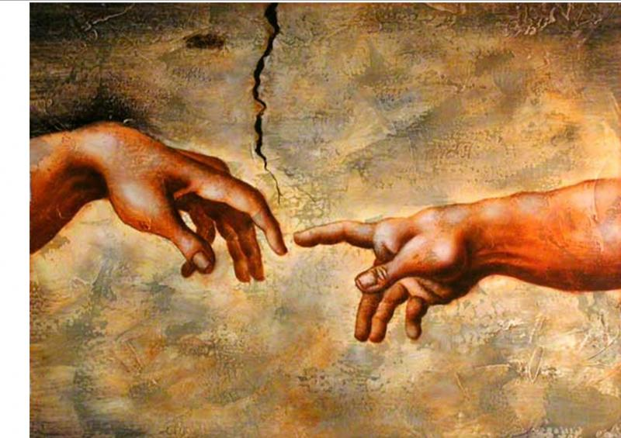
PERSONAL GOD

Slide 2
Your heavenly Father
Jesus taught us to pray, “Our Father in Heaven…”

Slide 3
Acts 17:27-28
He is actually not far from each one of us, 28 for "In him we live and move and have our being”;
ESV

Slide 4
Genesis 1:27
God created man in his own image. ESV

Slide 5
Obstacles to personal God
I never pray for my personal needs,….that would be selfish.

Slide 6
Obstacles to personal God
I know God loves me, but He’s up there and I’m down here.

Slide 7
Obstacles to personal God
We readily acknowledge God loves everyone in the world, but reluctant to accept that love personally.

Slide 8
Obstacles to personal God
Can God really be everywhere at once? How does He have time for a personal conversation with 7 billion people.

Slide 9
Revelation 3:20
Behold, I stand at the door and knock. If anyone hears my voice and opens the door, I will come in to him and eat with him, and he with me. ESV

Slide 10
Good news
God’s favorites are not world leaders, officials, and preachers.
We are all his favorites.

Slide 11
Ephesians 2:18-19
18 Through him we both have access in one Spirit to the Father.
19 So then you are no longer strangers and aliens, but you are fellow citizens with the saints and members of the household of God. ESV

Slide 12
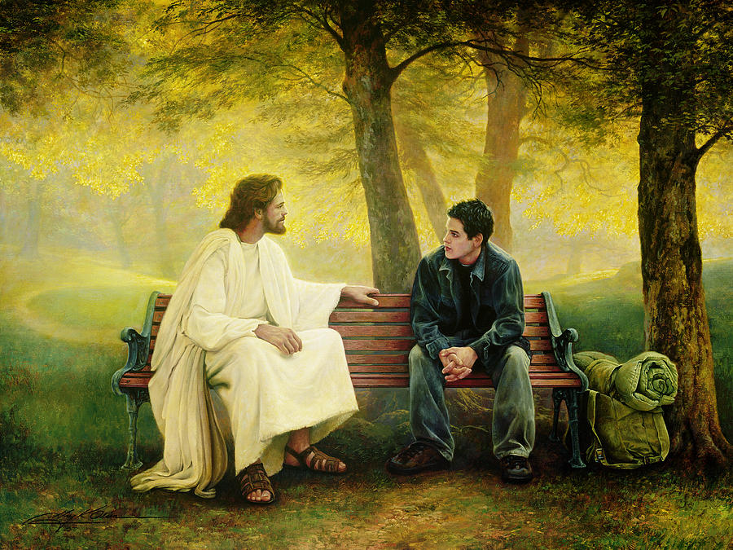

Slide 13
How close?
Someone said to me once,
“You’re as close to God as you want to be.”

Slide 14
Hebrews 4:16
Let us then with confidence draw near to the throne of grace, that we may receive mercy and find grace to help in time of need. esv

Slide 15
James 4:8
Draw near to God, and He will draw near to you. ESV

Slide 16
He’s not only your savior, but your confidant, helper, companion, Father, and friend.

Slide 17
Prayer
Lord, I confess I have not drawn as close to You as I should. I know now that you are good all of the time and have blessings, wisdom, and guidance for me every day. Thanks for making me a part of Your family. I accept Your gracious offer. Let’s talk more often. In Jesus’ name, amen.

