Slide 1
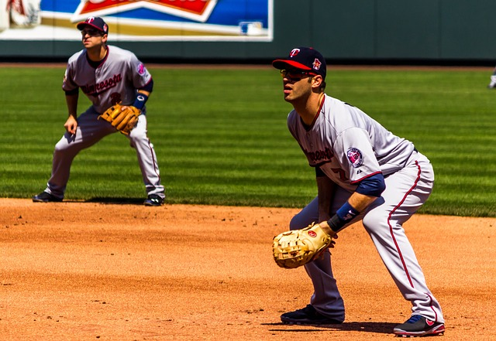
READY

Slide 2
1 Peter 3:15-16
If someone asks about your Christian hope, always be ready to explain it. 16 But do this in a gentle and respectful way. NLT

Slide 3
Be Ready
The key to sports, entertainment, job interviews is being ready.

Slide 4
Practice
You’re ready because you have practiced. Are you rehearsing your testimony?

Slide 5
Daniel 1:19-20
None was found like Daniel, Hananiah, Mishael, and Azariah. 20 In every matter of wisdom and understanding about which the king inquired of them, he found them ten times better than all the magicians and enchanters that were in all his kingdom. ESV

Slide 6
A good prayer
“Lord, help me to be ready for whatever comes my way today, and that I might be a good witness to and example of the hope that is within me.”

Slide 7
Credibility
Your testimony increases credibility when it is mixed with integrity, excellence, and creativity.

Slide 8
Success
Will we be successful without these qualities?

Slide 9
A good question
God, how can I be more effective than I am?

Slide 10
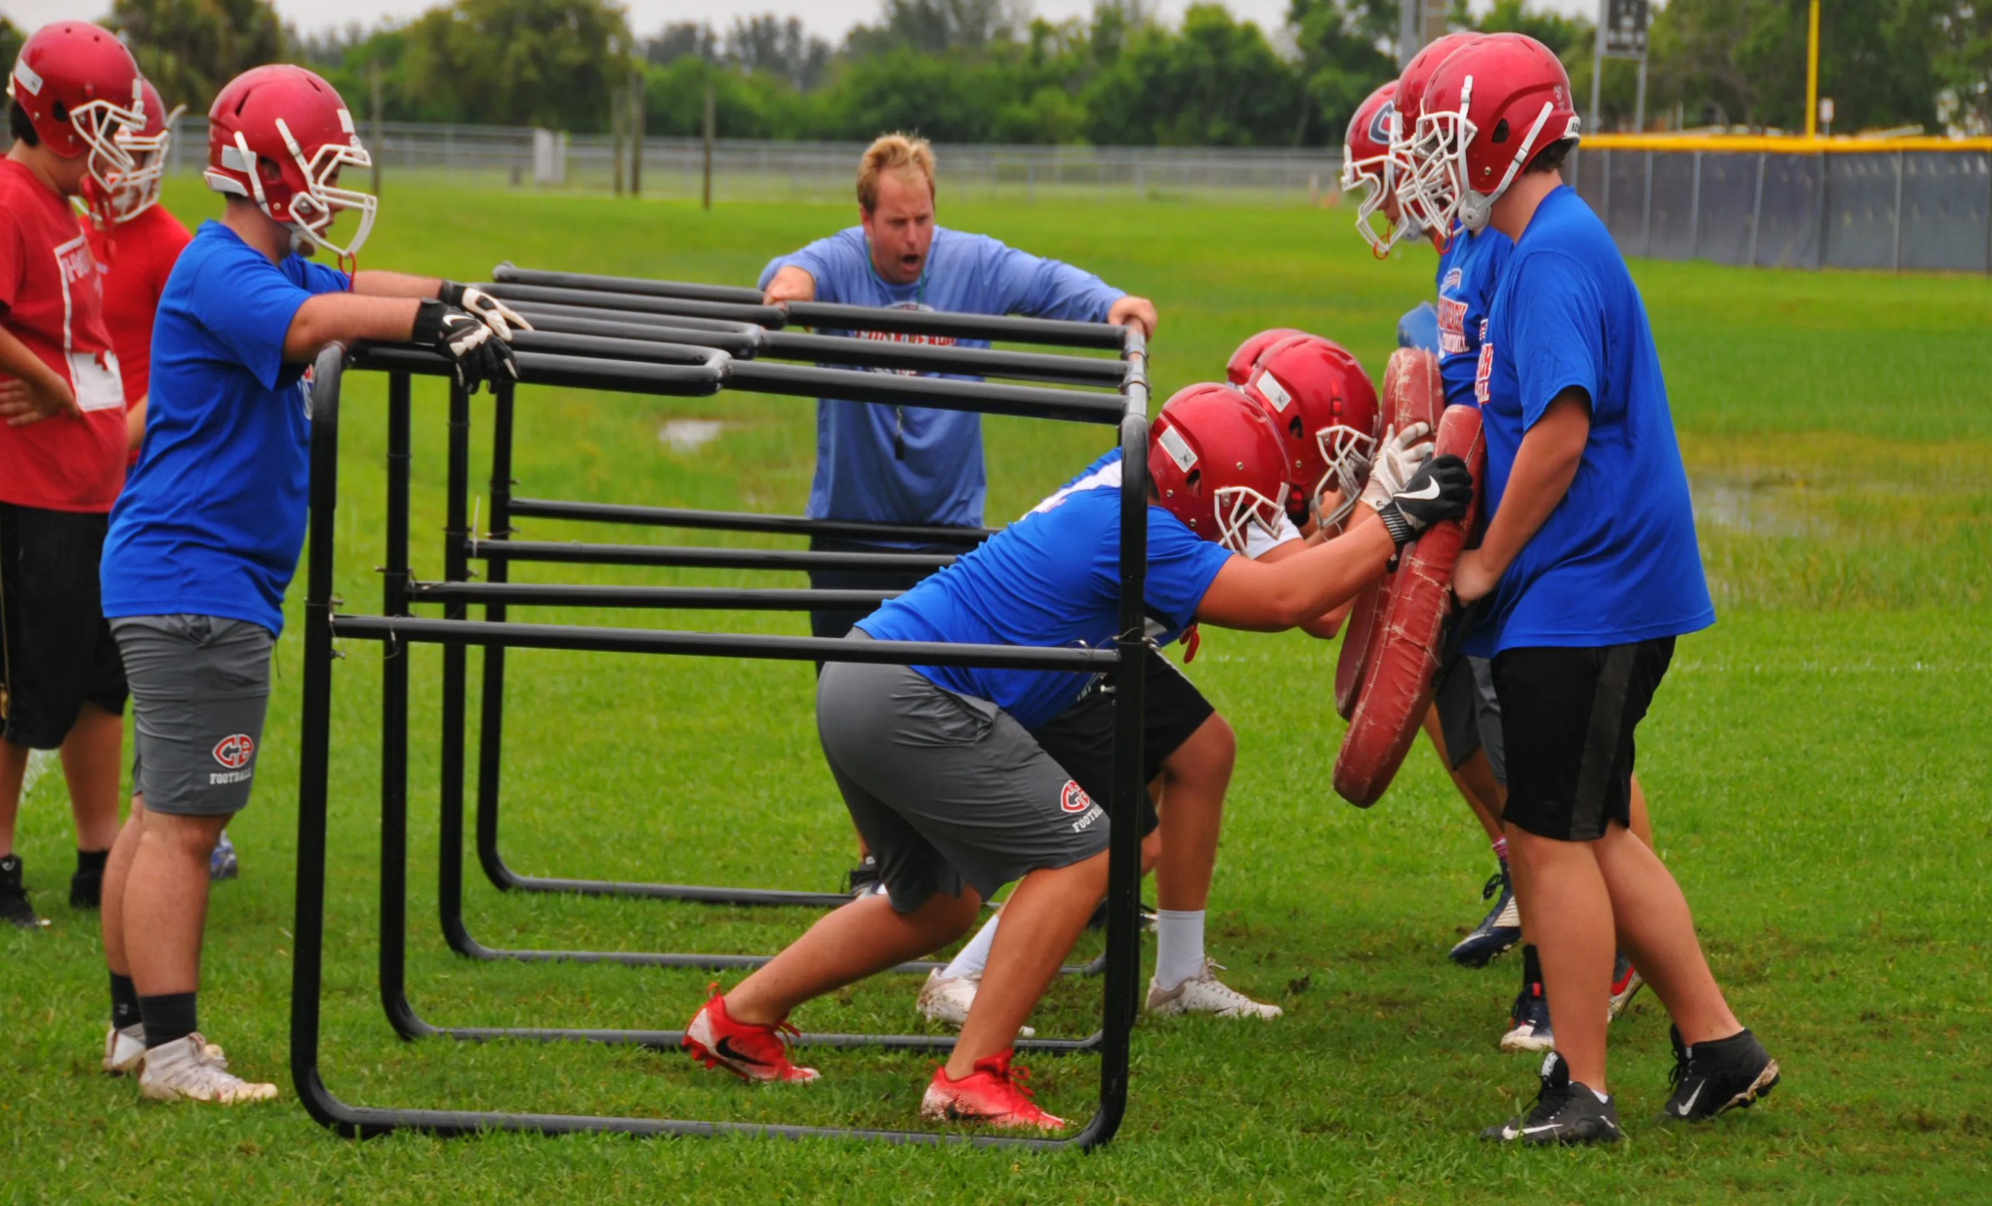

Slide 11
Not A Bible Expert?
Don’t share your religion, but Jesus who can change lives. Don’t lead with a Bible verse, but with a good word.

Slide 12
The wisdom of Jesus
Pray for wisdom…the kind Jesus used on every occasion. Wisdom amazes others much more than your eagerness.

Slide 13
All I know is…
The testimony of the man born blind.

Slide 14
Ask the Holy Spirit
Before you leave the house, ask the Holy Spirit for influence, anointing, and favor.

Slide 15
Practical and superior
The kingdom of God is practical, workable, and superior to all others.

Slide 16
Gospel means good news
Have you ever been reluctant to share good news? Don’t assume people don’t want to hear your message.

Slide 17
They want to hear a good word
Few want a religious word, but they do want to hear a word of encouragement, sympathy, and practical help.

Slide 18
Light of the world
Jesus said we are the light of the world. Nothing shines as bright as his light in us. It surpasses all other lights.

Slide 19
Levels of sharing
The Holy Spirit will lead you as to which level you can take a conversation. This takes wisdom.

Slide 20
Good for you, and them
Suggestion:
Have a good word that has already blessed you. It will also be a good word for someone else.

Slide 21
Spiritual magnets
Upbeat, knowledgeable, current,
friendly, aware, outgoing, kind, loving, helpful, blessed.

Slide 22
Prayer
Lord, help me to shine brighter, be kinder, and love people, so my testimony will have more effect. May others I meet today know that Jesus lives in me because he is shining through. Amen.

