Slide 1
SEVEN THINGS
SIGNS OF JESUS IN JOHN’s GOSPEL

Slide 2
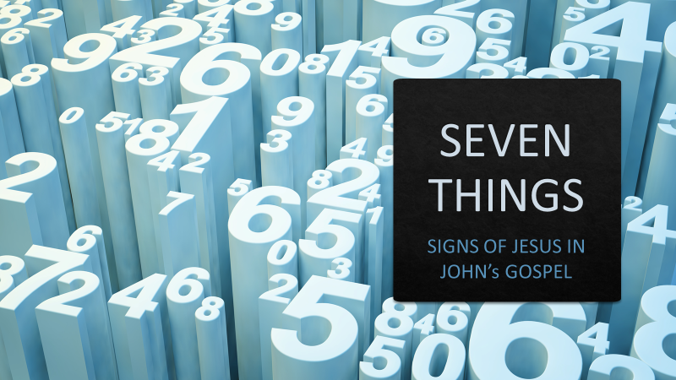
This is the disciple who testifies to these things and who wrote them down. We know that his testimony is true. Jesus did many other things as well. If every one of them were written down, I suppose that even the whole world would not have room for the books that would be written.
SCRIPTURE
John
21:24,25

Slide 3
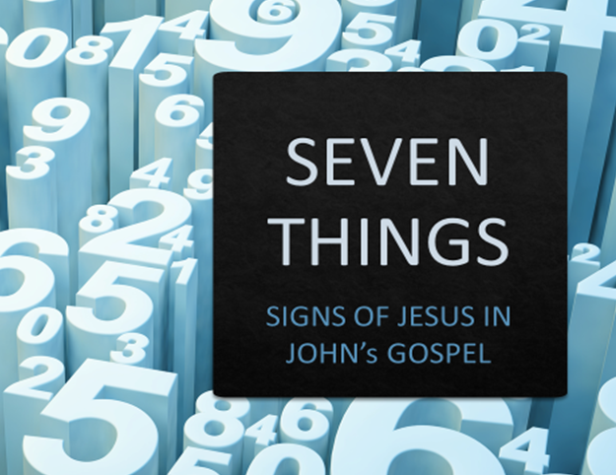
Jesus did many miracles involving many people in many areas inside and outside of Israel. Why only highlight SEVEN?
Why are these called SIGNS by John and not MIGHTY WORKS
INTRO

Slide 4
SEVEN THINGS: The Signs of Jesus in John
Water Into Wine
John 2:1
1

Slide 5
SEVEN THINGS: The Signs of Jesus in John
Galilee
Marriage Feast
Feast of New Wine
Moses, water in Blood
Ceremonial water made celebration
1

Slide 6
SEVEN THINGS: The Signs of Jesus in John
Healing of Royal Official’s Son
John 4:47
2

Slide 7
SEVEN THINGS: The Signs of Jesus in John
Galilee
He spoke a word
The one who receives and believes is blessed
Healing at a distance
2

Slide 8
SEVEN THINGS: The Signs of Jesus in John
Healing of Paralytic at Bethesda Pool
John 5:4
3

Slide 9
SEVEN THINGS: The Signs of Jesus in John
Sabbath
Jerusalem
Bethesda Pool
Inability of man
Mercy & Grace of God
3

Slide 10
SEVEN THINGS: The Signs of Jesus in John
Feeding of 5,000 men plus women and children
John 6:5
4

Slide 11
SEVEN THINGS: The Signs of Jesus in John
“The unnecessary miracle that tested and involved disciples”
4

Slide 12
SEVEN THINGS: The Signs of Jesus in John
Galilee
Phillip tested
5 loaves 2 fish
Disciples involved
Fed in the wilderness
4

Slide 13
SEVEN THINGS: The Signs of Jesus in John
Walking on Water
John 6:16-21
5

Slide 14
SEVEN THINGS: The Signs of Jesus in John
Galilee
Walking ON rather than THROUGH
Master over chaos
5

Slide 15
SEVEN THINGS: The Signs of Jesus in John
Giving of Sight to one born blind
John 9:1
6

Slide 16
SEVEN THINGS: The Signs of Jesus in John
Jerusalem
Sabbath
Pool of Siloam
Never had been done
Light of world
6

Slide 17
SEVEN THINGS: The Signs of Jesus in John
Raising of Lazarus from the Dead
John 11:38
7

Slide 18
SEVEN THINGS: The Signs of Jesus in John
Outside of Jerusalem
Dead for FOUR days
Dead had been raised by a prophet
7

Slide 19
SEVEN THINGS: The Signs of Jesus in John
His word in creative process
His word at distance
His word makes active
His word feeds masses
His word makes chaos a path
His word conquers blindness
His word raises the dead
CONCLUSION

