Slide 1
SEVEN THINGS
THE WORD OF GOD DOES

Slide 2
"Is not my word like fire?" declares the Lord, "and like a hammer which shatters a rock? Therefore behold, I am against the prophets," declares the Lord, 'who steal my words from each other.’”
SCRIPTURE
JEREMIAH 23:29-30

Slide 3
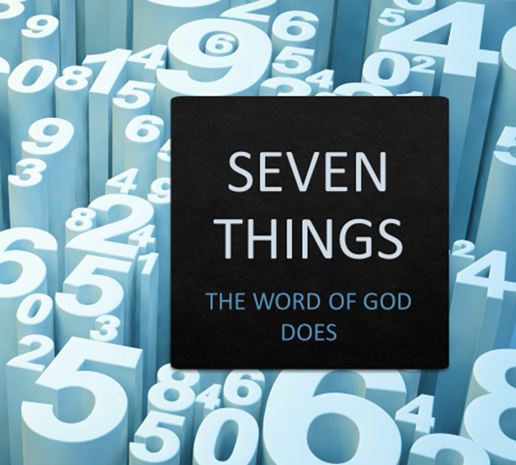
For the word of God is alive and active. Sharper than any double-edged sword, it penetrates even to dividing soul and spirit, joints and marrow; it judges the thoughts and attitudes of the heart.
SCRIPTURE
HEBREWS
4:12

Slide 4
General & Scientific Knowledge?
INTRO

Slide 5
General & Scientific Knowledge?
World Religions Knowledge?
INTRO

Slide 6
General & Scientific Knowledge?
World Religions Knowledge?
Theology & Christian Religion?
INTRO

Slide 7
General & Scientific Knowledge?
World Religions Knowledge?
Theology & Christian Religion?
INTRO

Slide 8
SEVEN THINGS: The Word of God Does
GENESIS
Thru
REVELATION
1

Slide 9
SEVEN THINGS: The Word of God Does
How & when the world was created
The reason humanity is as it is
The true nature of God
What happens to us after we die
POWER TO REVEAL

Slide 10
SEVEN THINGS: The Word of God Does
All Scripture is God-breathed and is useful for teaching, rebuking, correcting and training in righteousness, so that the servant of God may be thoroughly equipped for every good work.
2 Tim 3:16
2

Slide 11
SEVEN THINGS: The Word of God Does
It is the GOLD standard for:
Philosophies
Ideas
Solutions
POWER TO REFUTE

Slide 12
SEVEN THINGS: The Word of God Does
“This is the meaning of the parable: The seed is the word of God…But the seed on good soil stands for those with a noble and good heart, who hear the word, retain it, and by persevering produce a crop.”
Luke 8:11,15
3

Slide 13
SEVEN THINGS: The Word of God Does
The Word is seed
It has power in itself
It is received fully
It brings a harvest
POWER TO REPRODUCE

Slide 14
SEVEN THINGS: The Word of God Does
For “you were like sheep going astray,” but now you have returned to the Shepherd and Overseer of your souls.
1 Peter 2:25
4

Slide 15
SEVEN THINGS: The Word of God Does
Someone reading His Word
Someone hearing His Word
Someone refuting His Word
POWER TO RE-DIRECT

Slide 16
SEVEN THINGS: The Word of God Does
I am laid low in the dust; preserve my life according to your word. I gave an account of my ways and you answered me; teach me your decrees. Cause me to understand the way of your precepts, that I may meditate on your wonderful deeds. My soul is weary with sorrow; strengthen me according to your word.
Psalm 119:25-28
5

Slide 17
SEVEN THINGS: The Word of God Does
Spiritual revival
Psychological revival
Physical revival
POWER TO REVIVE

Slide 18
SEVEN THINGS: The Word of God Does
And without faith it is impossible to please God, because anyone who comes to him must believe that he exists and that he rewards those who earnestly seek him.
Hebrews 11:6
6

Slide 19
SEVEN THINGS: The Word of God Does
We encounter HIM, after seeking
We discover His will, after seeking
We find his benefits, after seeking
POWER TO REWARD

Slide 20
SEVEN THINGS: The Word of God Does
You also must be ready, because the Son of Man will come at an hour when you do not expect him.”
Luke 12:40
7

Slide 21
SEVEN THINGS: The Word of God Does
“It would not be right for us to neglect the ministry of the word of God in order to wait on tables. Brothers and sisters, choose seven men from among you who are known to be full of the Spirit and wisdom. We will turn this responsibility over to them and will give our attention to prayer and the ministry of the word.”
Acts 6:2-4
7

Slide 22
SEVEN THINGS: The Word of God Does
It prompts us to repentance
It cleanses us by washing
It renews our mind
It reveals the future
It prepares us for rapture/resurrection
POWER TO MAKE READY

Slide 23
SEVEN THINGS: The Word of God Does
It reveals
It refutes
It reproduces
It revives
It re-directs
It rewards
It makes ready
CONCLUSION

