Slide 1


SEVEN THINGS
THE LORD DOES
FOR HIS SHEEP

Slide 2

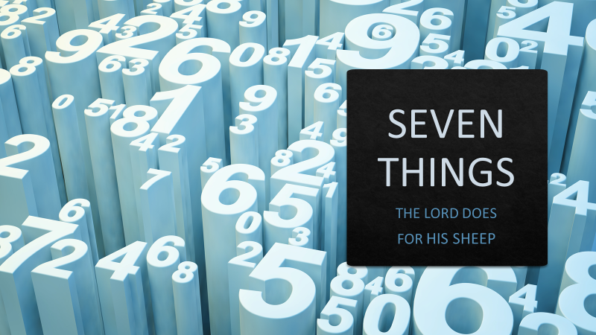
The LORD is my shepherd, I lack nothing. He makes me lie down in green pastures, he leads me beside quiet waters, he refreshes my soul.
SCRIPTURE
The 23rd
PSALM

Slide 3
He guides me along the right paths for his name’s sake. Even though I walk through the darkest valley, I will fear no evil, for you are with me; your rod and your staff, they comfort me.
SCRIPTURE
The 23rd
PSALM

Slide 4
You prepare a table before me in the presence of my enemies. You anoint my head with oil; my cup overflows. Surely your goodness and love will follow me all the days of my life, and I will dwell in the house of the LORD forever.
SCRIPTURE
The 23rd
PSALM

Slide 5
“The LORD is my shepherd…I shall not be in want”
The pressing question that must be answered from the start. Do you belong in the Lord’s sheepfold? Are you his?
INTRO
The 23rd
PSALM

Slide 6
SEVEN THINGS:
The Lord Does
For His Sheep
Free from fear of predators
MAKES THEM LIE DOWN IN GREEN PASTURES

Slide 7
SEVEN THINGS:
The Lord Does
For His Sheep
Free from fear of predators
Free from friction with others
MAKES THEM LIE DOWN IN GREEN PASTURES

Slide 8
SEVEN THINGS:
The Lord Does
For His Sheep
Free from fear of predators
Free from friction with others
Free from flies and parasites
MAKES THEM LIE DOWN IN GREEN PASTURES

Slide 9
SEVEN THINGS:
The Lord Does
For His Sheep
Free from fear of predators
Free from friction with others
Free from flies and parasites
Free from Hunger
MAKES THEM LIE DOWN IN GREEN PASTURES

Slide 10
SEVEN THINGS:
The Lord Does
For His Sheep
“God has not given us a spirit of fear but of power, love, and of a sound mind.”
(2 Tim 1:7)
Awareness of Christ and being in His presence brings about peace and a sound mind.
MAKES THEM LIE DOWN IN GREEN PASTURES

Slide 11
SEVEN THINGS:
The Lord Does
For His Sheep
Sheep are 70% water
LEADS THEM BESIDE STILL WATERS

Slide 12
SEVEN THINGS:
The Lord Does
For His Sheep
Sheep are 70% water
Urgency for water means a philosophy of “any water will do”
LEADS THEM BESIDE STILL WATERS

Slide 13
SEVEN THINGS:
The Lord Does
For His Sheep
Sheep are 70% water
Urgency for water means a philosophy of “any water will do”
Human thirst drives them astray to all sorts of watering holes
LEADS THEM BESIDE STILL WATERS

Slide 14
SEVEN THINGS:
The Lord Does
For His Sheep
SOURCES OF WATER
Dew on the grass
Deep wells/Springs
Streams
LEADS THEM BESIDE STILL WATERS

Slide 15
SEVEN THINGS:
The Lord Does
For His Sheep
“My people have committed two sins: They have forsaken me, the spring of living water, and have dug their own cisterns, broken cisterns that cannot hold water.
Jeremiah 2:13
LEADS THEM BESIDE STILL WATERS

Slide 16
SEVEN THINGS:
The Lord Does
For His Sheep
A consistent and rich devotional life will keep someone from thirsting and will ensure living water supply that springs up within them!
LEADS THEM BESIDE STILL WATERS

Slide 17
SEVEN THINGS:
The Lord Does
For His Sheep
Why, my soul, are you downcast? Why so disturbed within me? Put your hope in God, for I will yet praise him, my Savior and my God.
Psalm 43:5
RESTORES THE SOUL

Slide 18
SEVEN THINGS:
The Lord Does
For His Sheep
Cast down sheep have been turned on their back and cannot get back up – they can die within hours or a few days.
RESTORES THE SOUL

Slide 19
SEVEN THINGS:
The Lord Does
For His Sheep
Heavy wool
Things clinging to the wool
Fatness
Taking it easy
Coasting
RESTORES THE SOUL

Slide 20
SEVEN THINGS:
The Lord Does
For His Sheep
Buzzards circling are an indicator to a shepherd that there is a down-cast sheep. He leaves the 99 safe and goes looking.
RESTORES THE SOUL

Slide 21
SEVEN THINGS:
The Lord Does
For His Sheep
Our mind, will, and emotions can turn us around and upside-down and put us into a precarious situation! The Lord restores!
RESTORES THE SOUL

Slide 22
SEVEN THINGS:
The Lord Does
For His Sheep
Moves me out of habits
GUIDES INTO PATHS OF RIGHTEOUSNESS

Slide 23
SEVEN THINGS:
The Lord Does
For His Sheep
Moves me out of habits
Moves to new ground every week
GUIDES INTO PATHS OF RIGHTEOUSNESS

Slide 24
SEVEN THINGS:
The Lord Does
For His Sheep
Moves me out of habits
Moves to new ground every week
Avoids turning paths into ruts and gullies and overgrazed land
GUIDES INTO PATHS OF RIGHTEOUSNESS

Slide 25
SEVEN THINGS:
The Lord Does
For His Sheep
Then he said to them all: "Whoever wants to be my disciple must deny themselves and take up their cross daily and follow me.
Luke 9:23
GUIDES INTO PATHS OF RIGHTEOUSNESS

Slide 26
SEVEN THINGS:
The Lord Does
For His Sheep
Agape
Go it alone
No rights
Serve
Content
Cooperating
Choosing to follow
GUIDES INTO PATHS OF RIGHTEOUSNESS

Slide 27
SEVEN THINGS:
The Lord Does
For His Sheep
ROD
Power & authority of the Word
COMFORT WITH ROD & STAFF

Slide 28
SEVEN THINGS:
The Lord Does
For His Sheep
ROD
Power & authority of the Word
Discipline the wayward
COMFORT WITH ROD & STAFF

Slide 29
SEVEN THINGS:
The Lord Does
For His Sheep
ROD
Power & authority of the Word
Discipline the wayward
Discern and examine carefully
COMFORT WITH ROD & STAFF

Slide 30
SEVEN THINGS:
The Lord Does
For His Sheep
Search me, God, and know my heart; test me and know my anxious thoughts. See if there is any offensive way in me, and lead me in the way everlasting.
Psalm 139:23-24
COMFORT WITH ROD & STAFF

Slide 31
SEVEN THINGS:
The Lord Does
For His Sheep
STAFF
Promote intimate relationship
COMFORT WITH ROD & STAFF

Slide 32
SEVEN THINGS:
The Lord Does
For His Sheep
STAFF
Promote intimate relationship
Pull the skittish one near
COMFORT WITH ROD & STAFF

Slide 33
SEVEN THINGS:
The Lord Does
For His Sheep
STAFF
Promote intimate relationship
Discipline the wayward
Hold against side to indicate turn
COMFORT WITH ROD & STAFF

Slide 34
SEVEN THINGS:
The Lord Does
For His Sheep
STAFF
Promote intimate relationship
Discipline the wayward
Hold against side to indicate turn
Rescue from danger
COMFORT WITH ROD & STAFF

Slide 35
SEVEN THINGS:
The Lord Does
For His Sheep
The Word & Spirit work together in us to be the Lord’s
ROD & STAFF
What comfort!!!
COMFORT WITH ROD & STAFF

Slide 36
SEVEN THINGS:
The Lord Does
For His Sheep
MOUNTAIN TOP
The flock is led higher up into the mountains through the valleys and finds a MESA or TABLETOP area to stay for a while
PREPARES A TABLE IN THE PRESENCE OF THE ENEMY

Slide 37
SEVEN THINGS:
The Lord Does
For His Sheep
MOUNTAIN TOP
Clear out harmful plants
PREPARES A TABLE IN THE PRESENCE OF THE ENEMY

Slide 38
SEVEN THINGS:
The Lord Does
For His Sheep
MOUNTAIN TOP
Clear out harmful plants
Back off all the fierce predators or trap them.
PREPARES A TABLE IN THE PRESENCE OF THE ENEMY

Slide 39
SEVEN THINGS:
The Lord Does
For His Sheep
MOUNTAIN TOP
Clear out harmful plants
Back off all the fierce predators or trap them.
Clean out watering places and springs
PREPARES A TABLE IN THE PRESENCE OF THE ENEMY

Slide 40
SEVEN THINGS:
The Lord Does
For His Sheep
For we do not have a high priest who is unable to empathize with our weaknesses, but we have one who has been tempted in every way, just as we are—yet he did not sin.
Hebrews 4:15
PREPARES A TABLE IN THE PRESENCE OF THE ENEMY

Slide 41
SEVEN THINGS:
The Lord Does
For His Sheep
Every provision is made.
Grace has gone before us and even in the presence of our enemy we are in super-abundance.
He calls us higher!
PREPARES A TABLE IN THE PRESENCE OF THE ENEMY

Slide 42
SEVEN THINGS:
The Lord Does
For His Sheep
FLIES ARE ONE OF THE GREATEST FEARS OF SHEEP
The ears and nose are a target for winged parasites. Larvae crawl deeper into the sheep’s head and can make them miserable.
HE ANOINTS THE HEAD WITH OIL

Slide 43
SEVEN THINGS:
The Lord Does
For His Sheep
FLIES ARE ONE OF THE GREATEST FEARS OF SHEEP
Infected sheep bang their heads on rocks and posts or just wildly shake their head – they are vexed.
HE ANOINTS THE HEAD WITH OIL

Slide 44
SEVEN THINGS:
The Lord Does
For His Sheep
FLIES ARE ONE OF THE GREATEST FEARS OF SHEEP
Oil mixed with Sulphur and spices is poured upon the sheep’s head to frustrate the attempt of the flies.
HE ANOINTS THE HEAD WITH OIL

Slide 45
SEVEN THINGS:
The Lord Does
For His Sheep
FLIES ARE ONE OF THE GREATEST FEARS OF SHEEP
Anointed sheep respond immediately with peace and contentment and go back to enjoying their pasture.
HE ANOINTS THE HEAD WITH OIL

Slide 46
SEVEN THINGS:
The Lord Does
For His Sheep
LESSON FOR US
The enemy uses small distractions and irritations to seed bigger problems into our life through our thoughts. Opinions and reports can get inside our head and cause problems.
HE ANOINTS THE HEAD WITH OIL

Slide 47
SEVEN THINGS:
The Lord Does
For His Sheep
LESSON FOR US
Repeated anointings and fresh anointings are needed in order to keep us pest free!
HE ANOINTS THE HEAD WITH OIL

Slide 48
SEVEN THINGS:
The Lord Does
For His Sheep
GOODNESS & MERCY NOW
DWELLING IN THE HOUSE OF THE LORD
FOREVER
CONCLUSION

