Slide 2
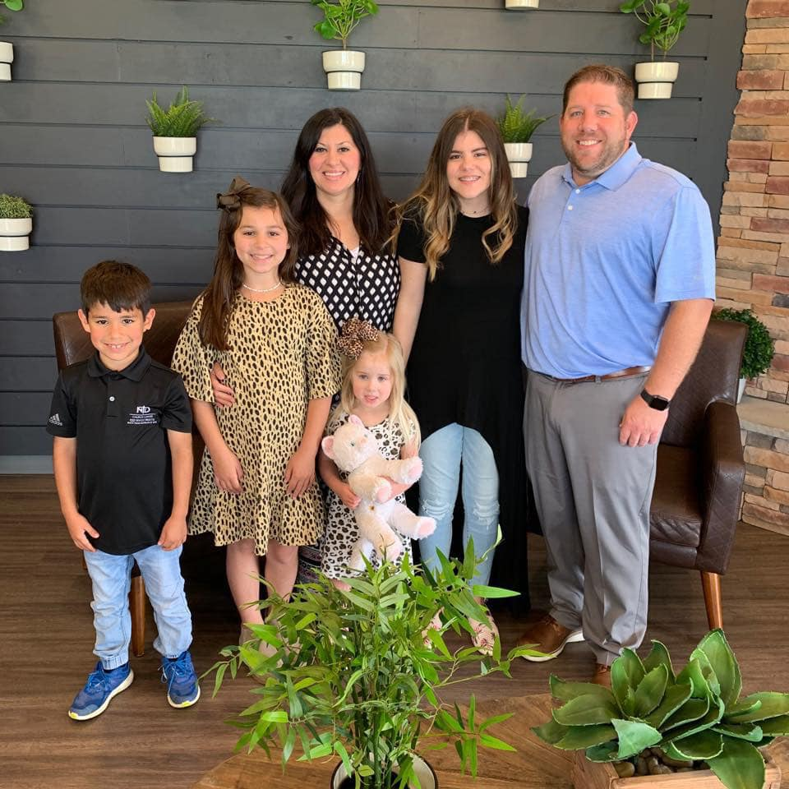

Slide 3
God is a master Storyteller
and He wants to create a
story with your life.

Slide 4
1. God is the Author
of your story.

Slide 5
Psalm 139:13-17
13 You made all the delicate, inner parts of my body and knit me together in my mother’s womb.
14 Thank you for making me so wonderfully complex! Your workmanship is marvelous—how well I know it.
15 You watched me as I was being formed in utter seclusion, as I was woven together in the dark of the womb.
16 You saw me before I was born. Every day of my life was recorded in your book. Every moment was laid out before a single day had passed.
17 How precious are your thoughts about me, They cannot be numbered!

Slide 6
Your story is the result
of God’s love for you.

Slide 7
2. God has a story
planned for you.

Slide 8
Jeremiah 29:11
‘For I know the plans I have for you,” says the Lord . “They are plans for good and not for disaster, to give you a future and a hope. ‘

Slide 9
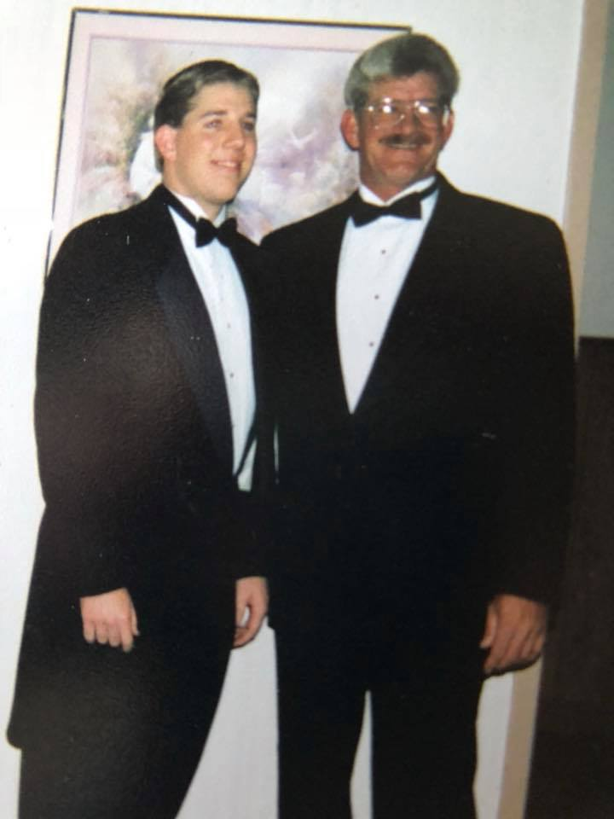

Slide 10
Ephesians 4:31-32
31 Get rid of all bitterness, rage, anger, harsh words, and slander, as well as all types of evil behavior. 32 Instead, be kind to each other, tenderhearted, forgiving one another, just as God through Christ has forgiven you.

Slide 11
Do not allow your story to be
interrupted by your own ways.

Slide 12
3. God can change
how your story ends.

Slide 13
2 Corinthians 5:17
This means that anyone who belongs to Christ has become a new person. The old life is gone; a new life has begun!

Slide 14
The person you were in the past
does not dictate your future story.

Slide 15
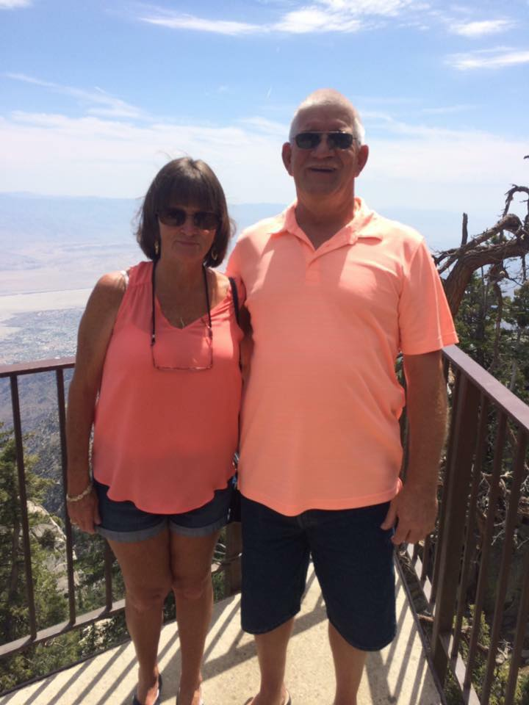

Slide 16
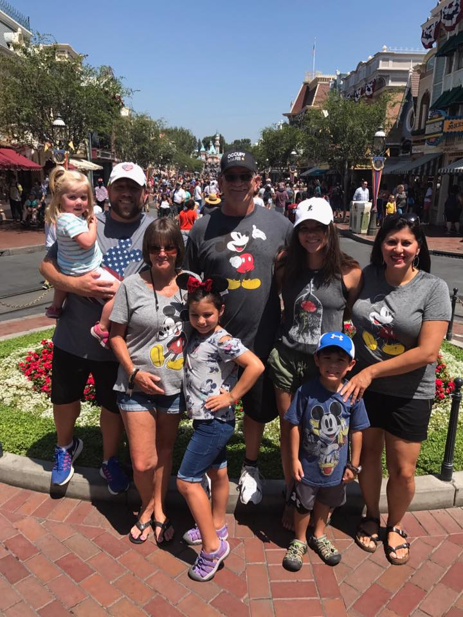

Slide 17
Tell God’s story.

