Slide 1
Where There is Smoke There is Fire
Luke 3:16
“…He will baptize you with the Holy Spirit and fire.”

Slide 2
Where There is Fire There is Smoke
Luke 3:16 (NIV)
¹⁶ John answered them all, “I baptize you with water. But one who is more powerful than I will come, the straps of whose sandals I am not worthy to untie. He will baptize you with the Holy Spirit and fire.

Slide 3
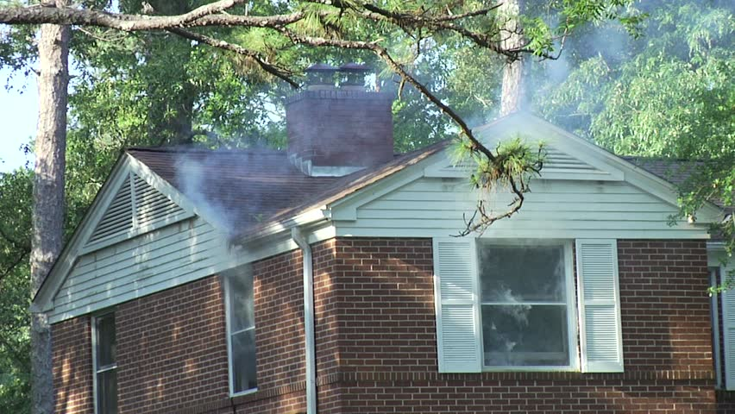
Where There is Fire There is Smoke

Slide 4
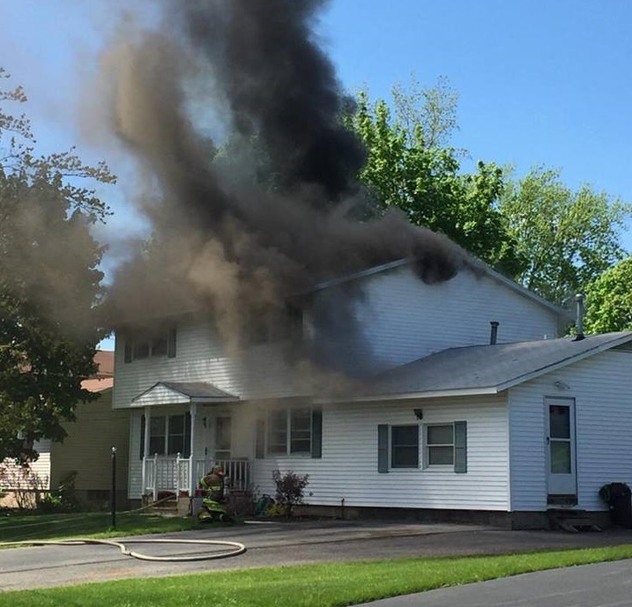
Where There is Fire There is Smoke

Slide 5
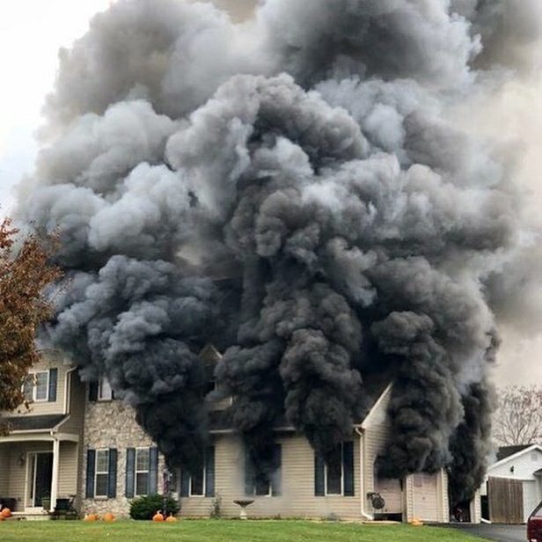
Where There is Fire There is Smoke

Slide 6
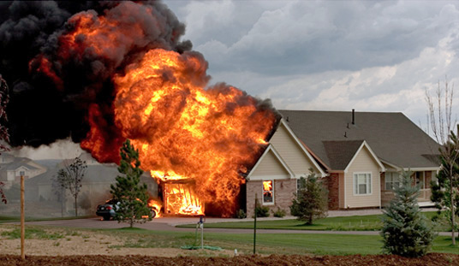
Where There is Fire There is Smoke

Slide 7
Where There is Fire There is Smoke
Hebrews 12:29 (NIV)
²⁹ for our “God is a consuming fire.”

Slide 8
Where There is Fire There is Smoke
Acts 2:3-4 (NIV)
³ They saw what seemed to be tongues of fire that separated and came to rest on each of them. ⁴ All of them were filled with the Holy Spirit and began to speak in other tongues as the Spirit enabled them.

Slide 9
Where There is Fire There is Smoke
If the fire of the Holy Spirit is dwelling in you, there should smoke!

Slide 10
Where There is Fire There is Smoke
Love: 1 John 4:7-8 (NIV)
⁷ Dear friends, let us love one another, for love comes from God. Everyone who loves has been born of God and knows God. ⁸ Whoever does not love does not know God, because God is love.

Slide 11
Where There is Fire There is Smoke
Grace (Unmerited favor): Colossians 3:13 (NIV)
¹³ Bear with each other and forgive one another if any of you has a grievance against someone. Forgive as the Lord forgave you.

Slide 12
Where There is Fire There is Smoke
Righteousness (moral excellence) Philippians 3:9
⁹ and be found in him, not having a righteousness of my own that comes from the law, but that which is through faith in Christ—the righteousness that comes from God on the basis of faith.

Slide 13
Where There is Fire There is Smoke
Freedom: John 8:36 (NIV)
³⁶ So if the Son sets you free, you will be free indeed.

Slide 14
Where There is Fire There is Smoke
Humility: 1 Peter 3:8 (NIV)
⁸ Finally, all of you, be like-minded, be sympathetic, love one another, be compassionate and humble.

Slide 15
Where There is Fire There is Smoke
Wisdom: James 3:17 (NIV)
¹⁷ But the wisdom that comes from heaven is first of all pure; then peace-loving, considerate, submissive, full of mercy and good fruit, impartial and sincere.

Slide 16
Where There is Fire There is Smoke
Truth: Ephesians 6:14 (NIV)
¹⁴ Stand firm then, with the belt of truth buckled around your waist, with the breastplate of righteousness in place,

Slide 17
Where There is Fire There is Smoke
Conclusion
Love
Give Grace
Display Righteousness
Walk in Freedom

Slide 18
Where There is Fire There is Smoke
Conclusion
Be Humble
Be Wise
Show the Truth
Love

Slide 19
Where There is Fire There is Smoke
Psalm 119:11 (NIV)
¹¹ I have hidden your word in my heart
that I might not sin against you.

