Slide 1
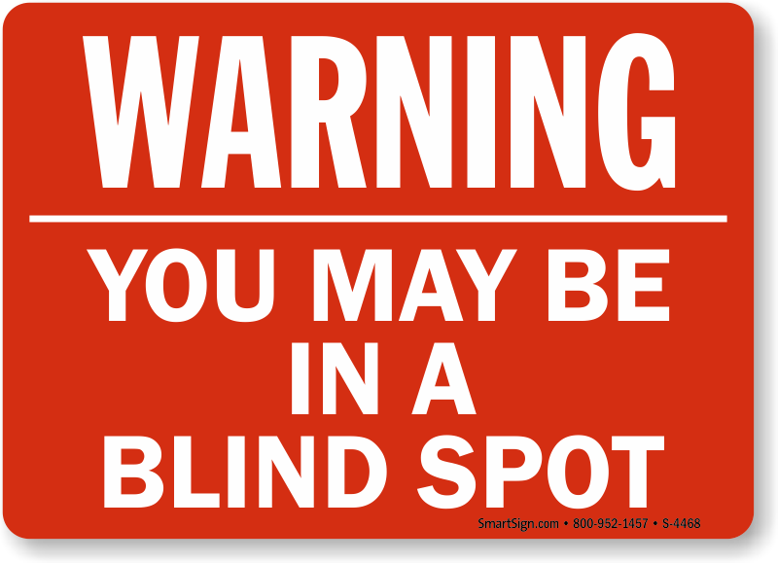
BLIND SPOTS
Psalm 146:8 (NIV)
The Lord gives sight to the blind, the Lord lifts up those who are bowed down, the Lord loves the righteous.

Slide 2
BLIND SPOTS
Denial

Slide 3
BLIND SPOTS
Denial
Luke 9:23 (NIV)
Then he said to them all: “Whoever wants to be my disciple must deny themselves and take up their cross daily and follow me.

Slide 4
BLIND SPOTS
Selfishness

Slide 5
BLIND SPOTS
Selfishness
Philippians 2:3-4 (NIV)
³ Do nothing out of selfish ambition or vain conceit. Rather, in humility value others above yourselves, ⁴ not looking to your own interests but each of you to the interests of the others.

Slide 6
BLIND SPOTS
Bitterness

Slide 7
BLIND SPOTS
Bitterness
Ephesians 4:31-32 (NIV)
³¹ Get rid of all bitterness, rage and anger, brawling and slander, along with every form of malice.

Slide 8
BLIND SPOTS
Bitterness
Ephesians 4:31-32 (NIV)
³² Be kind and compassionate to one another, forgiving each other, just as in Christ God forgave you.

Slide 9
BLIND SPOTS
Psalm 146:8 (NIV)
The Lord gives sight to the blind, the Lord lifts up those who are bowed down, the Lord loves the righteous.

