Slide 1
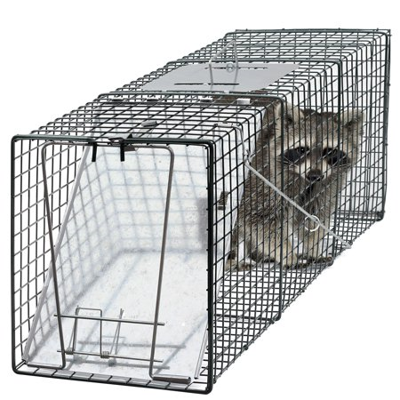
THE DEVIL’S TRAP

Slide 2
1 Peter 3:8-9
8 Finally, all of you, have unity of mind, sympathy, brotherly love, a tender heart, and a humble mind.
9 Do not repay evil for evil, or insult for insult , but instead bless that you may obtain a blessing.

Slide 3
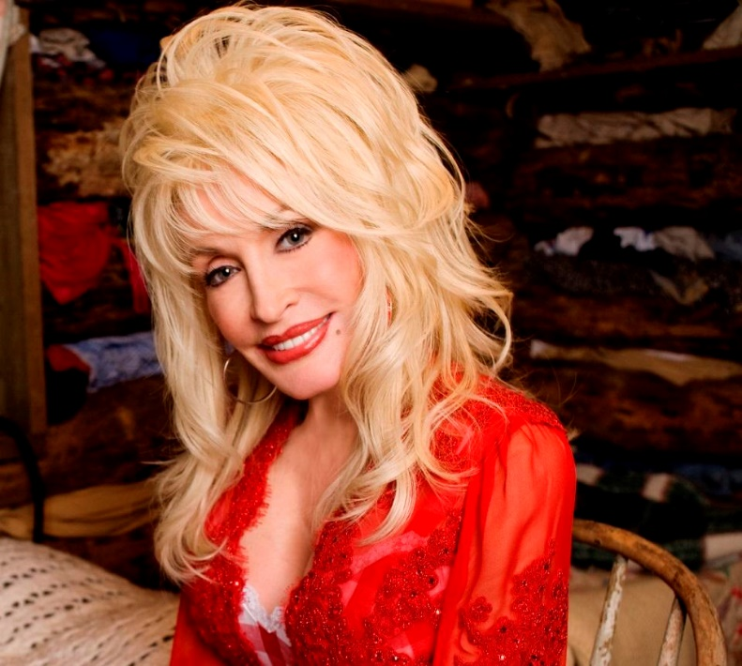
“I'm not offended by all the dumb blonde jokes because I know I'm not dumb... and I also know that I'm not blonde.”
-- Dolly Parton

Slide 4
Verse 2
What offends you?
What hurts your feelings?
Do people get on your nerves?
What gets your goat?
What irritates you?
What do you complain about?

Slide 5
Strife or peace
You can have strife or peace. You can’t have both. If peace, then be determined to get it hold on to it at all cost.

Slide 6
Offense
The Greek word for offense is “skandalon”which was bait to trap an animal or person.

Slide 7
Matthew 13:57-58
57 They took offense at him. But Jesus said to them, "A prophet is not without honor except in his hometown and in his own household." 58 And he did not do many mighty works there, because of their unbelief. ESV

Slide 8
OFFENDED BY JESUS
“I would never be offended by Jesus…except when he tells me to do something I don’t want to do!”

Slide 9
Lessons I’ve learned
Arguments are worthless.
Pride doesn’t have a pretty face.
Be patient.
Don’t insist on my own way.

Slide 10
Pass the test
Worry, stress, strife, offended, grouchy, critical, can become a habit that needs minimal provocation.

Slide 11
Strife robs you
Offense leads to strife.
Strife robs you of freedom, peace and power.

Slide 12
Pride is a trap
If I had displayed humility instead of pride I could have avoided many embarrassingly ugly situations in my life.

Slide 13
God trusted Job
When you have a test, it means God trusts you to pass it, like Job.

Slide 14
Important question
How do you handle people who rub you the wrong way, hurt your feelings, or offend you?
Vindication or reconciliation?

Slide 15
How to win
Don’t dwell on how to win the argument, but how you can avoid the argument. Your job is reconciliation.

Slide 16
It will happen
When people are rude…
When they get on your nerves…
When you are disrespected…
When you are falsely accused….
When your feelings are hurt…

Slide 17
Here’s the question
Will you represent Jesus or not?

Slide 18
Respecting Christ
Don’t worry about people respecting you….are you respecting Christ?

Slide 19
Don’t be distracted
Nehemiah’s task was to rebuild the walls of Jerusalem.
Sanballat and Tobiah laughed at and taunted Nehemiah.

Slide 20
God’s gracious hand
Nehemiah didn’t get into strife or argumentation. He simply said, “God’s gracious hand is upon me.”

Slide 21
Stay on your mission
If you have a button, someone is going to push it, the devil will make sure of it.
Don’t be thrown off your mission, which is to represent Christ.

Slide 22
Stay humble
Humility keeps God moving in your life.
Pride says I’ll handle it myself.

Slide 23
Humility is underrated
If you were completely humble, would you ever have strife in your life? Malice, envy, unhealthy comparisons, hurts, offenses?

Slide 24
1 Peter 5:5
Clothe yourselves with humility toward one another, for "God opposes the proud but gives grace to the humble.“ ESV

Slide 25
Prayer declaration
I am Christ’s representative on earth…to my family, my church, and my neighborhood. I am humble, kind, patient, forgiving, and passing every test.
I am Spirit-filled and strife-free, and continually blessed because of this.

