Slide 1
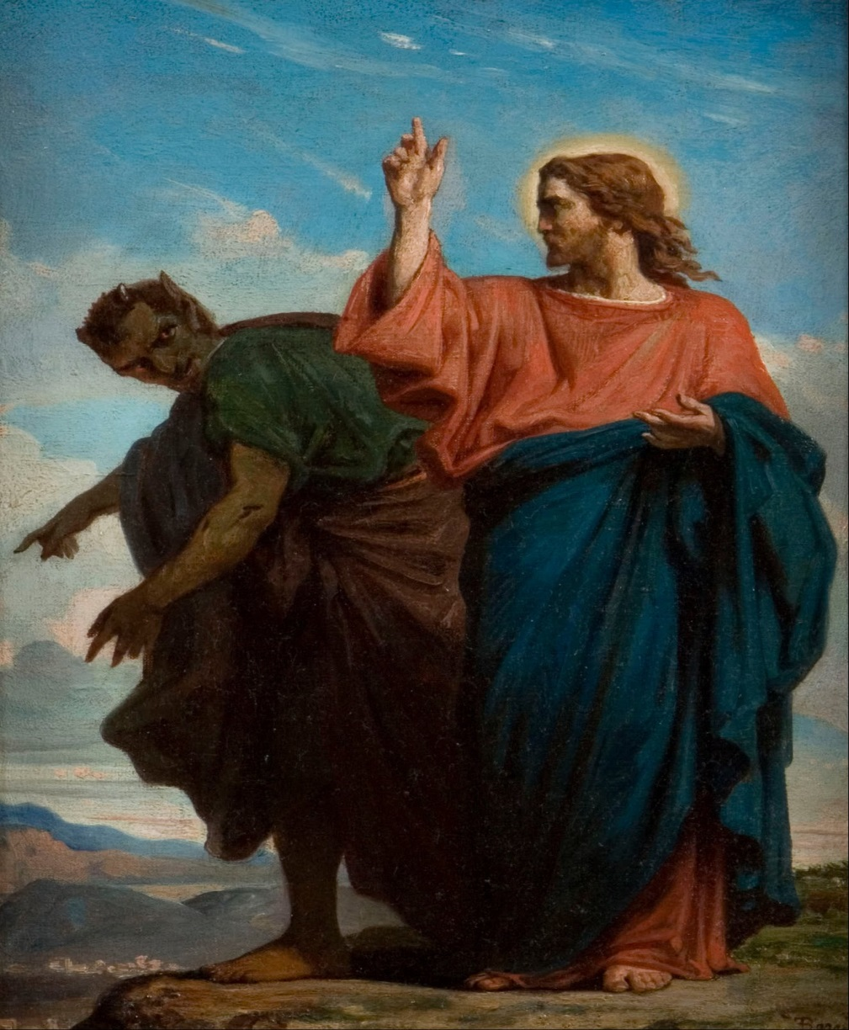
RESIST LIKE JESUS

Slide 2
Matthew 4:1
Then Jesus was led up by the Spirit into the wilderness to be tempted by the devil. ESV

Slide 3
Diabolos
The devil-- Greek--diabolos
False accuser, faultfinder, prosecutor, slanderer.

Slide 4
Satan
HEBREW-- Opponent; especially Satan, the arch-enemy of good, and life, and truth.

Slide 5
The devil’s strategy
We see throughout scripture that the devil shows up to accuse, condemn, pervert, lie, distort, steal, kill, and destroy.

Slide 6
Matthew 13:38-39
38 The field is the world, and the good seed is the children of the kingdom. The weeds are the sons of the evil one, 39 and the enemy who sowed them is the devil. ESV

Slide 7
Matthew 4:1
Then Jesus was led up by the Spirit into the wilderness to be tempted by the devil. ESV

Slide 8
John 14:30,31
…for the ruler of this world is coming. He has no claim on me (no place in me), 31 but I do as the Father has commanded me. ESV

Slide 9
Acts 10:38
…how God anointed Jesus of Nazareth with the Holy Spirit and with power. He went about doing good and healing all who were oppressed by the devil, for God was with him. ESV

Slide 11
Put another way….
The devil appears to be sharp, intelligent, and hip, but the devil is a liar, a hypocrite, and a deceiver. That’s his character, not his appearance.

Slide 12
Has the devil lied to you?
“You can’t do that.”
“You’ll never go anywhere.” “You’ll never get any better.”
“You’re father was that way.”
“You don’t have what it takes.”
“People don’t like you.”

Slide 13
Has the devil lied to you?
“You’re too old.”
“You’re a hypocrite.”
“You’re no good.”
“God doesn’t love you.”
“Nothing special about you.”

Slide 14
John 10:10
The thief comes only to steal and kill and destroy. I came that they may have life and have it abundantly. ESV

Slide 15
Ephesians 6:16
16 Take up the shield of faith, with which you can extinguish all the flaming darts of the evil one; ESV

Slide 16
The shield of faith
Your shield is your faith in God and His promises. By this you know you are forgiven, accepted, healed, valued, and loved.

Slide 17
Prayer
Thank you Lord, that in Christ the devil is defeated, powerless, and without authority.
We can walk in that victory with full assurance that it is complete and final.
Remind me to stand in the full armor of God and stay submitted to God and His word, through Christ our Lord, amen.

