Slide 1
What could possibly go wrong?

Slide 2
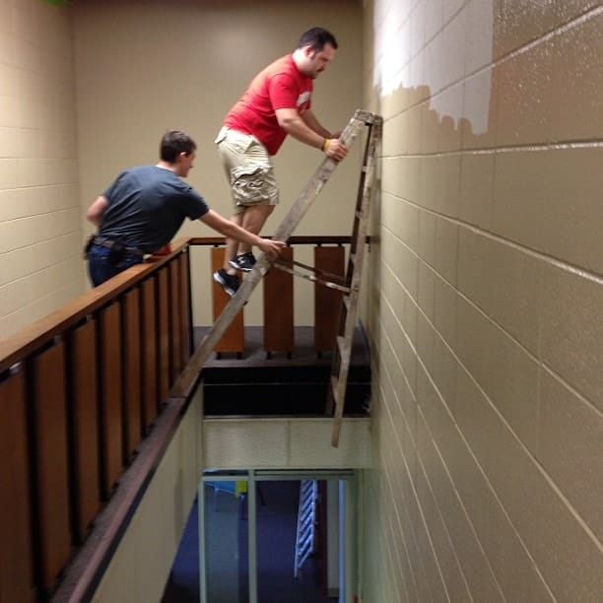
What could possibly go wrong?

Slide 3
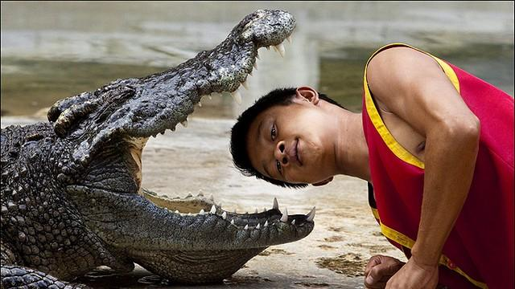
What could possibly go wrong?

Slide 4
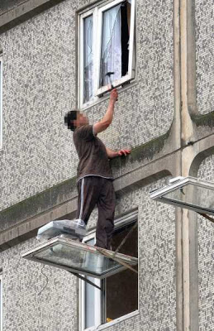
What could possibly go wrong?

Slide 5
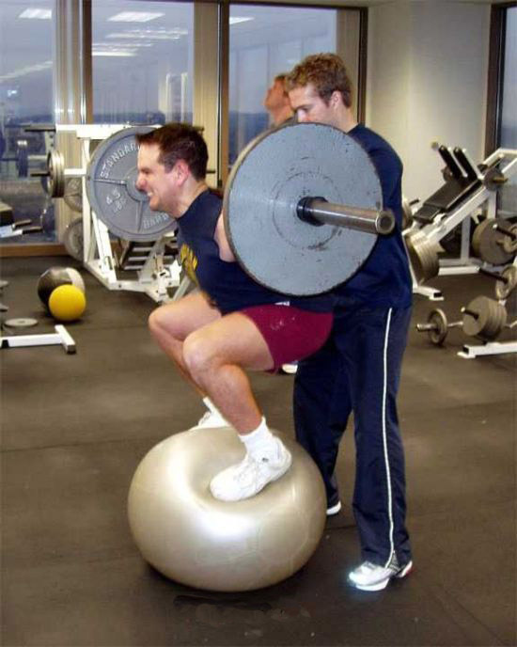
What could possibly go wrong?

Slide 6
Abram

Slide 7
scripture
And Abram believed the LORD, and the LORD counted him as righteous because of his faith. Genesis 15:6 NLT

Slide 8
Point one
Believe God

Slide 9
scripture
Now Sarai, Abram’s wife, had not been able to bear children for him. But she had an Egyptian servant named Hagar.
So Sarai said to Abram, “The LORD has prevented me from having children. Go and sleep with my servant. Perhaps I can have children through her.” And Abram agreed with Sarai’s proposal.
Genesis 16:1-2 NLT

Slide 10
Point two
Seek God for Direction – God Has a Plan and It Is Better Than Yours!

Slide 11
Helping God can lead to things going wrong.

Slide 12
Naaman

Slide 13
scripture
But Naaman became angry and stalked away. “I thought he would certainly come out to meet me!” he said. “I expected him to wave his hand over the leprosy and call on the name of the LORD his God and heal me! 2 Kings 5:11

Slide 14
Point three
Do Not Have Preconceived Ideas of How God Will Work His Promise – Be Open to Anything. After all, He IS God.

Slide 15
Preconceived ideas and anger can lead to things going wrong.

Slide 16
Elijah

Slide 17
Scripture
When Ahab got home, he told Jezebel everything Elijah had done, including the way he had killed all the prophets of Baal.
So Jezebel sent this message to Elijah: “May the gods strike me and even kill me if by this time tomorrow I have not killed you just as you killed them.”

Slide 18
scripture
Elijah was afraid and fled for his life. He went to Beersheba, a town in Judah, and he left his servant there.
Then he went on alone into the wilderness, traveling all day. He sat down under a solitary broom tree and prayed that he might die. “I have had enough, LORD,” he said. “Take my life, for I am no better than my ancestors who have already died.” 1 Kings 19:1-4

Slide 19
Point four
Do Not Take Your Eyes off of the Promise Maker.

Slide 20
Fear can lead to things going wrong.

Slide 21
conclusion
Do:
Believe God
Seek God for Direction
Be open to however, God wants to work.
DO NOT take your eyes off of God.

Slide 22
Conclusion
Don’t
Help God by doing things your own way.
Have preconceived ideas of how God should work.
Let yourself be angry when God doesn’t move the way you want Him to.
Let fear direct you.

