Slide 2
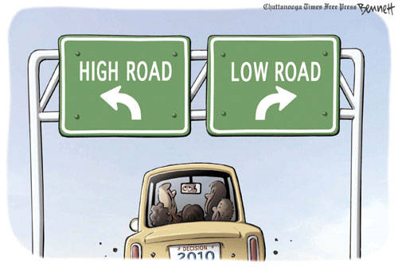
Which one are you on?
Can you really choose?

Slide 3
Philippians 3:13-14
13 …forgetting those things which are behind, (the former and worthless), and reaching out to those ahead (above, higher, Christ-like)…
14 I press toward the mark for the prize of the high calling of God in Christ Jesus. KJV

Slide 4
Question
What are some things in our lives that, like Paul, we left behind?
What are the things that are high (above) that keeps our lives on track?

Slide 5
Philippians 3: 19-20
19 …their end is destruction, whose God is their belly, and who glory in their shame, who mind (is fixated) on earthly (low) things.
20 (on the contrary) our conversation (daily walk) is in heaven; from whence also we look for the Savior, the Lord Jesus Christ: KJV

Slide 6
Question
What does it mean to “mind (be fixated) earthly things?”
In what way is our “conversation” in heaven?
Is Paul talking about heaven when we die, or the kingdom of heaven Jesus preached?

Slide 7
Proverbs 24:7
Wisdom is too high for a fool. ESV

Slide 8
Question
Why does the Psalmist call the person who takes the low road a fool?

Slide 9
Isaiah 33:5-6
5 The Lord is exalted, for he dwells on high;
he will fill Zion with justice and righteousness,
6 and he will be the stability of your times,
abundance of salvation, wisdom, and knowledge. ESV

Slide 10
Question
If we take the high road (where God travels), what might our attributes be?
God meets us on the low road in order to carry us to the high road. How do we get off the low road which is counter productive to our love, joy, and peace?

Slide 11
John 8:23
He said to them, "You are from below;
I am from above. You are of this world;
I am not of this world.”

Slide 12
Question
What does Jesus mean by the phrase “of this world?”
What was the high road for Jesus, and what was the low road that others travel?

Slide 13
Colossians 3:1-2
3 If you have been raised with Christ, seek the things that are above, where Christ is, seated at the right hand of God. 2 Set your minds on things that are above, not on things that are on earth. ESV

Slide 14
Question
List some ways to seek the things that are above (high road).
Give some examples of things that are below (low road).

Slide 15
Question
What is the high road in our thinking?
What is the low road?
What is the high road in our self talk and relationship with others?
What is the low road?

Slide 16
Matthew 7:13-14
13 "Enter by the narrow gate; for wide is the gate and broad is the way that leads to destruction, and there are many who enter there. 14 Narrow is the gate and difficult is the way which leads to life, and there are few who find it.” NKJV

Slide 17
Questions
Enter by the narrow gate. Enter what?
Are there similarities between the high road and the narrow road? How so?
Everybody is on the broad (low) road by nature. Is it possible to move up?

Slide 18
Concluding thoughts
In every event of my life I have a choice between a high road, and a low road.
My old nature is programmed for the low road, traveling the well worn path.
On the low road you will never be able to please God and reach your potential in Christ.

Slide 19
Concluding thoughts
God will forgive you, have mercy on you when you’re on the low road, but realize when you are on it, turn around, and go up
Higher where Jesus’ is. You know what the high road is, and it’s a choice you make a hundred times a day.

Slide 20
Laura Markham PHD Psychologist
“The high road is love. The low road is fear. Choose love as often as you can.”

Slide 21
Robert Frost
THE ROAD NOT TAKEN
(last lines)
Two road diverged in a wood,
(The high road and the low road),
And I took the one less traveled by,
And that has made all the difference.

