Slide 1
ARE YOU DUMB AS A ROCK?

Slide 2
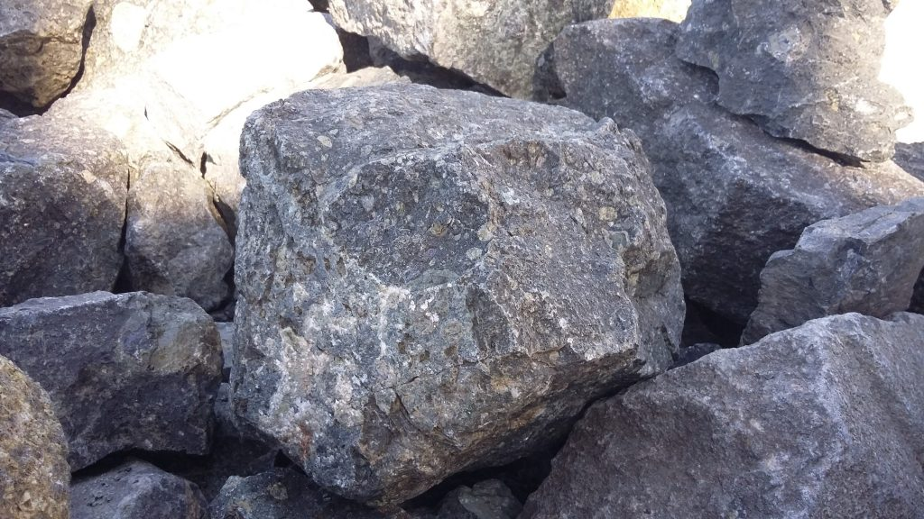

Slide 3
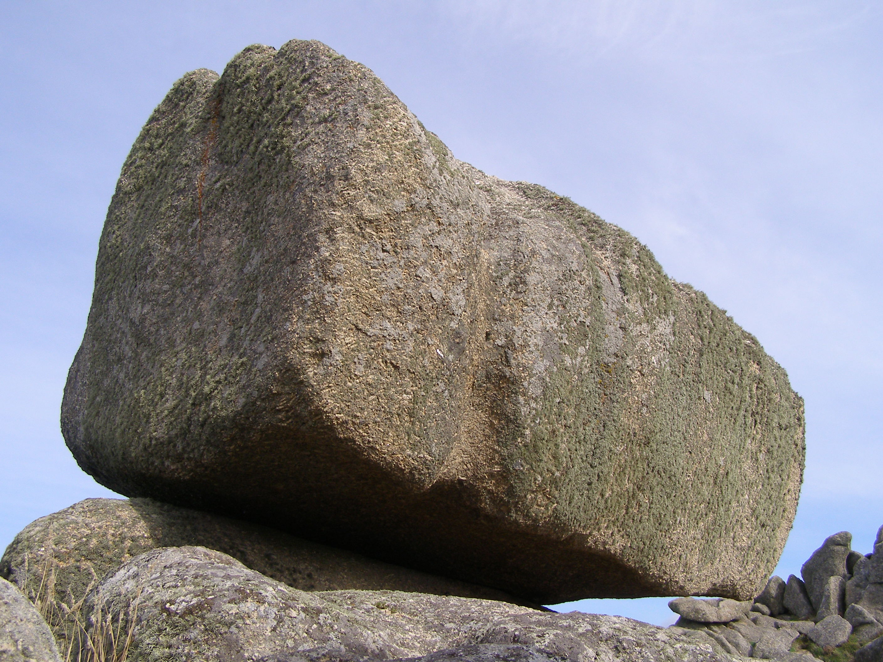

Slide 4
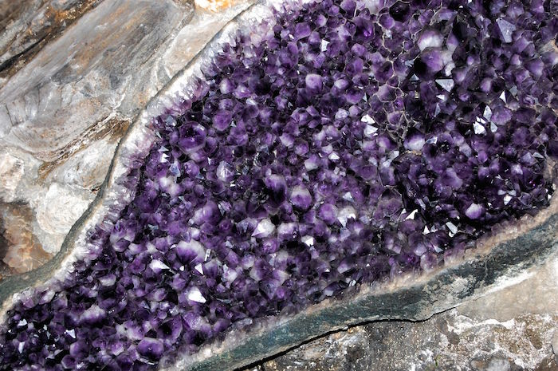

Slide 5
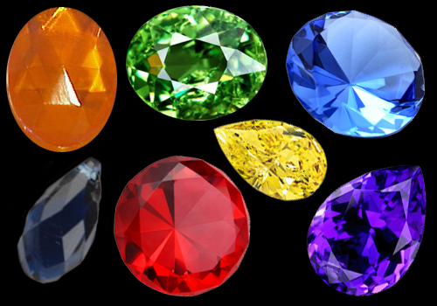

Slide 6
DEFINITION “DUMB AS A ROCK”
SLANG: Very Unintelligent

Slide 7
Definition of “Rock”
a large mass of stone forming a hill, cliff, promontory, or the like.
Geology. mineral matter of variable composition, consolidated or unconsolidated, assembled in masses or considerable quantities in nature, as by the action of heat or water.
a stone of any size.
something resembling or suggesting a rock.
a firm foundation or support: The Lord is my rock.

Slide 8
Joshua 4:7
7 tell them that the flow of the Jordan was cut off before the ark of the covenant of the LORD. When it crossed the Jordan, the waters of the Jordan were cut off. These stones are to be a memorial to the people of Israel forever.”

Slide 9
POINT ONE
Stones can serve as a reminder. We need to not only remember the things God has done for us but help others remember as well.

Slide 10
Joshua 24:27
“See!” he said to all the people. “This stone will be a witness against us. It has heard all the words the LORD has said to us. It will be a witness against you if you are untrue to your God.”

Slide 11
POINT TWO
We need to be a witness to what God has done. We can’t keep the story to ourselves.
Share your testimony.

Slide 12
Numbers 20:8
8 “Take the staff, and you and your brother Aaron gather the assembly together. Speak to that rock before their eyes and it will pour out its water. You will bring water out of the rock for the community so they and their livestock can drink.”

Slide 13
POINT THREE
Just as the rock produced nourishment. We need to be the rock that nourishes others. We need to produce love and encouragement to those who are thirsting for it.

Slide 14
Luke 19:37,38
When he came near the place where the road goes down the Mount of Olives, the whole crowd of disciples began joyfully to praise God in loud voices for all the miracles they had seen:
“Blessed is the king who comes in the name of the Lord! Peace in heaven and glory in the highest!”

Slide 15
Luke 19:39,40
39 Some of the Pharisees in the crowd said to Jesus, “Teacher, rebuke your disciples!”
40 “I tell you,” he replied, “if they keep quiet, the stones will cry out.”

Slide 16
POINT FOUR
Be a source of praise!

Slide 17
2 SAMUEL 22:1-3
David sang to the LORD the words of this song when the LORD delivered him from the hand of all his enemies and from the hand of Saul.
2 He said: “The LORD is my rock, my fortress and my deliverer;
3 my God is my rock, in whom I take refuge, my shield and the horn of my salvation. He is my stronghold, my refuge and my savior— from violent people you save me.

Slide 18
POINT FIVE
Look to the true “Rock”. He is your refuge and deliverer. He is your shield and
stronghold.

Slide 19
God is…
Strong when you are weak.
Big when you feel small.
Shelter from life’s storms.
Refuge from your enemies.
Your Rock

Slide 20
CONCLUSION
Be a memorial stone and remember what God has done for you and help others remember.
Be a witness stone for yourself and others.
Be a rock that gushes water or nourishment to others.
Be a rock of praise.
Be a rock that looks to the true Rock and points the way to others.

Slide 21
BOTTOM LINE
Are you as dumb as a rock?
Rocks can be used of God.
Can you?

