Slide 1
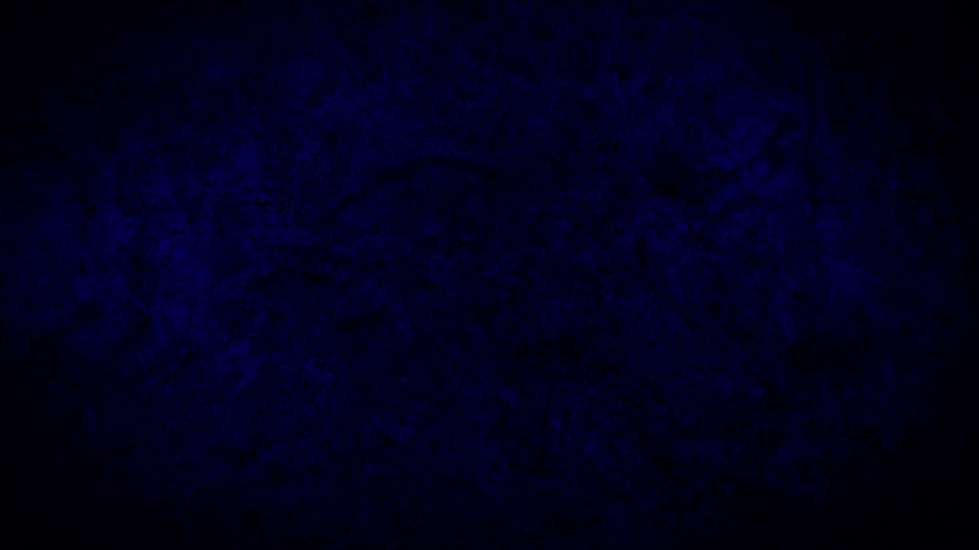
AFTERMATH

Slide 2
AFTERMATH
FIND THE WAY OUT
OR
FIND THE WAY IN

Slide 3
Panic and Pressure has a way of scrambling the brain and blinding a person. Have you ever been through an airplane orientation and even sat on a row leading to an exit?

Slide 4
Now there was a Pharisee, a man named Nicodemus who was a member of the Jewish ruling council. He came to Jesus at night and said, “Rabbi, we know that you are a teacher who has come from God. For no one could perform the signs you are doing if God were not with him.”
John 3:1-21

Slide 5
“You seem to have God with you – You have my attention.”
POINT #1

Slide 6
Nicodemus was optimally situated in a nation…
POINT #1

Slide 7
Nicodemus was optimally educated…
POINT #1

Slide 8
Nicodemus was optimally located on the time-line…
POINT #1

Slide 9
Nicodemus was optimally located on the earth…
POINT #1

Slide 10
BUT he was missing the point entirely!
POINT #1

Slide 11
“ His name shall be ‘Emmanuel – GOD WITH US’ “ (ISA 7:14)
POINT #1

Slide 12
Jesus knows that Nicodemus is CLOSE yet so FAR AWAY
POINT #1

Slide 13
Jesus replied, “Very truly I tell you, no one can see the kingdom of God unless they are born again.” “How can someone be born when they are old?” Nicodemus asked. “Surely they cannot enter a second time into their mother’s womb to be born!”
John 3:1-21

Slide 14
Jesus answered, “Very truly I tell you, no one can enter the kingdom of God unless they are born of water and the Spirit. Flesh gives birth to flesh, but the Spirit gives birth to spirit. You should not be surprised at my saying, ‘You must be born again.’ The wind blows wherever it pleases. You hear its sound, but you cannot tell where it comes from or where it is going. So it is with everyone born of the Spirit.” “How can this be?” Nicodemus asked.
John 3:1-21

Slide 15
Born again
Born of the Spirit
Led of the Spirit
In order to SEE…In order to ENTER
POINT #2

Slide 16
“How can this be?”
Proof of the cluelessness of the best that humanity has to offer.
POINT #2

Slide 17
This is the great disconnect…the great gulf…the great mystery
POINT #2

Slide 18
This is the place of mercy and grace! This is the place of the work of God!
POINT #2

Slide 19
“Then they asked him, “What must we do to do the works God requires?” - BELIEVE
John 6:28
POINT #2

Slide 20
“You are Israel’s teacher,” said Jesus, “and do you not understand these things? Very truly I tell you, we speak of what we know, and we testify to what we have seen, but still you people do not accept our testimony. I have spoken to you of earthly things and you do not believe; how then will you believe if I speak of heavenly things?
John 3:1-21

Slide 21
The first movement on earth in the right direction is one of faith…you have not accepted, believed, or received.
POINT #3

Slide 22
The men by the door or way themselves do not see it and attempt to prevent others from going in who do see it.
(Luke 11:52)
POINT #3

Slide 23
Nicodemus is at least willing to make a concession no one else of his kind is willing to make…”There is more than meets the eye here” “Something is going on!”
POINT #3

Slide 24
No one has ever gone into heaven except the one who came from heaven—the Son of Man.
John 3:1-21

Slide 25
Jesus reveals something heavenly to Nicodemus.
POINT #4

Slide 26
He reveals a nugget about himself
POINT #4

Slide 27
He tells him a fact about heaven only known in heaven.
POINT #4

Slide 28
Those sorts of facts require faith to jump out and grab on.
POINT #4

Slide 29
Just as Moses lifted up the snake in the wilderness, so the Son of Man must be lifted up, that everyone who believes may have eternal life in him.” For God so loved the world that he gave his one and only Son, that whoever believes in him shall not perish but have eternal life.
John 3:1-21

Slide 30
Brass Serpent on a pole in the wilderness.
LOOK AT IT AND LIVE!
Numbers 21:1-9
POINT #5

Slide 31
BONUS POINT:
Love motivating the great gift of the ONE and ONLY to escape just punishment and instead have life that lasts forever
POINT #5

Slide 32
He spoke to this Jewish leader the gospel in the terms closest to him and added something that called on faith in him.
POINT #5

Slide 33
The DOOR was being illumined and revealed once again in the terms of God’s love.
POINT #5

Slide 34
For God did not send his Son into the world to condemn the world, but to save the world through him. Whoever believes in him is not condemned, but whoever does not believe stands condemned already because they have not believed in the name of God’s one and only Son.
John 3:1-21

Slide 35
Nicodemus was looking in the wrong place because of where tradition said it should be and what it should look like…
POINT #6

Slide 36
Jesus raises the stakes for Nicodemus and reveals the outline of the door and its exact location and the consequences for missing it.
POINT #6

Slide 37
This is the verdict: Light has come into the world, but people loved darkness instead of light because their deeds were evil. Everyone who does evil hates the light and will not come into the light for fear that their deeds will be exposed. But whoever lives by the truth comes into the light, so that it may be seen plainly that what they have done has been done in the sight of God.
John 3:1-21

Slide 38
Nicodemus thought that being expert in the law would be his salvation…he had it upside down and backwards…
POINT #7

Slide 39
He had learned to fear God, hide and excuse his sin, and reparse Scripture to ensure he was not found out…
POINT #7

Slide 40
Adam wrapped himself in fig leaves that he had stitched together and Nicodemus had hidden behind Torah scrolls that indicted him.
POINT #7

Slide 41
Jesus in love confronted Nicodemus and lead him into a position where he could feel the light of truth burning into his spirit and respond accordingly.
POINT #7

Slide 42
CONCLUSION:
The only way to live in the AFTERMATH is to SEE and ENTER INTO the DOOR of the Kingdom of God.

Slide 43
CONCLUSION:
To do this, you must be BORN AGAIN.
Are you?

Slide 44
CONCLUSION:
Maybe you would move a step or two towards the light?
Maybe you are ready right now to be born again?

Slide 45
CONCLUSION:
Maybe you have been born again and you have lost your edge of conviction regarding how vital and necessary it is to find the door and stay on the way! Others need your help!!

