Slide 1
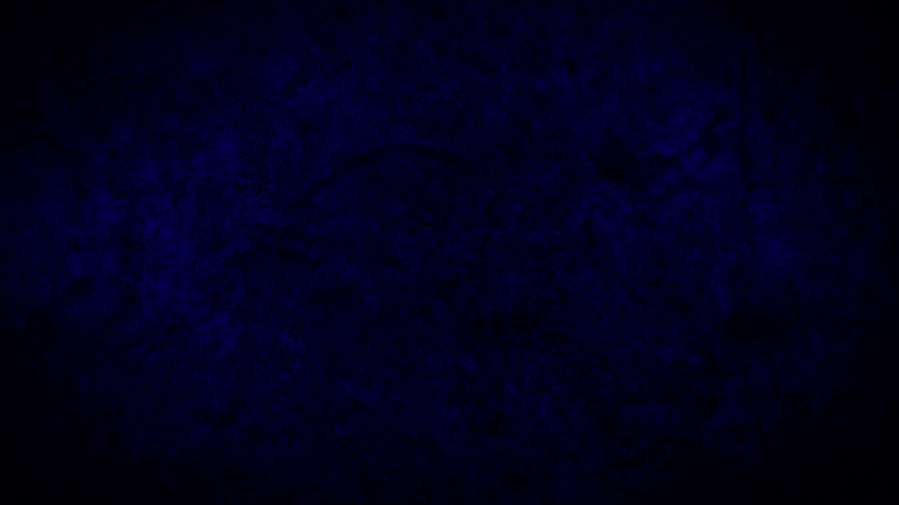
AFTERMATH

Slide 2
After-effect, backwash, child, conclusion, consequence, corollary, development, effect, fate, fruit, issue, outcome, outgrowth, precipitate, product, result, resultant, sequel, sequence, upshot

Slide 3
After a shaking or major event of a negative nature the developing situation and the activity of people is in the AFTERMATH

Slide 4
VISION CHURCH is going to focus like a laser beam upon the Kingdom of God

Slide 5
Weekly sermon on Jesus teaching on the Kingdom
Daily devotional on that teaching of Jesus

Slide 6
AFTERMATH
Prayer is a great place to start.

Slide 7
“This, then, is how you should pray: “ ‘Our Father in heaven, hallowed be your name, your kingdom come, your will be done, on earth as it is in heaven.
Matthew 6:9-15

Slide 8
Give us today our daily bread. And forgive us our debts, as we also have forgiven our debtors. And lead us not into temptation, but deliver us from the evil one.’
Matthew 6:9-15

Slide 9
Our Father in heaven
POINT #1

Slide 10
Our Father in heaven
POINT #1

Slide 11
Jesus’ desire and the Father is the same
REVELATION #1

Slide 12
Lord, thank you, for your great desire to include everyone!
THANK YOU #1

Slide 13
Holy Spirit, help me to be more of a team player and invite others
REQUEST #1

Slide 14
They want MAXIMUM involvement is we, us, & OUR
REVELATION #2

Slide 15
Lord, thank you, for your great desire to have exclusive relationship with me
THANK YOU #2

Slide 16
Lord, those things that exclude me from you, help me to want to let go.
REQUEST #2

Slide 17
Our Father in heaven
POINT #2

Slide 18
Jesus came to open up the possibilitiy of relationship with God is as FATHER
REVELATION #1

Slide 19
Father, thank you, that you desire to be my father and for me to be your son/daughter
THANK YOU #1

Slide 20
Lord, I struggle with the idea of being good enough to be in such a high relationship, HELP!
REQUEST #1

Slide 21
FATHER speaks of strength, defense, provision, and expected development
REVELATION #2

Slide 22
Father, thank you, that you provide resources for what you expect from me and in me.
THANK YOU #2

Slide 23
Father, help me overcome my tendency to rebel or seek my own way rather than to submit to your wise way!
REQUEST#2

Slide 24
Our Father in heaven
POINT #1

Slide 25
HEAVEN is the unseen and unperceived realm that is only seen through FAITH.
REVELATION #1

Slide 26
Father, thank you, for providing to me a measure of faith – the ability to believe and trust.
THANK YOU #1

Slide 27
Father, help me retract my faith from where it is misplaced and heal up from disappointments and properly invest my faith.
REQUEST#1

Slide 28
HEAVEN is the place and the culture that works as it should – this is our aim.
REVELATION #2

Slide 29
Father, thank you, for setting a high goal for us that can stir our spirits and lift us up!
THANK YOU #2

Slide 30
Father, help me to desire, speak, and do according to the culture of heaven and hit the mark of heaven!
REQUEST #2

