Slide 1
SCHEDULE OF SERVICES
SUNDAY
Passionate Core Prayer 9:00 - 9:30 a.m.
Donuts & Fellowship 9:30 a.m.
Morning Worship 9:45 a.m.
Vision Kidz Church 9:45 a.m.
Men’s and Ladies’ Share Groups 4:00 p.m.
VISION CHURCH OF THE AG
www.visionchurch.ag
TUESDAY
SEEING JESUS...
FOR US,
IN US,
THROUGH US!
TRUTH SEEKERS 7:00 p.m.
WEDNESDAY
Morning Prayer Canceled
Wise and Wonderful Seniors 11:00 a.m.
Royal Rangers & Girls Ministries 6:30 p.m.

Slide 2
NEW SERIES:
LADIES SHARE GROUP
STARTS TODAY
SUNDAYS AT 4:00 P.M. IN THE MPB

Slide 3
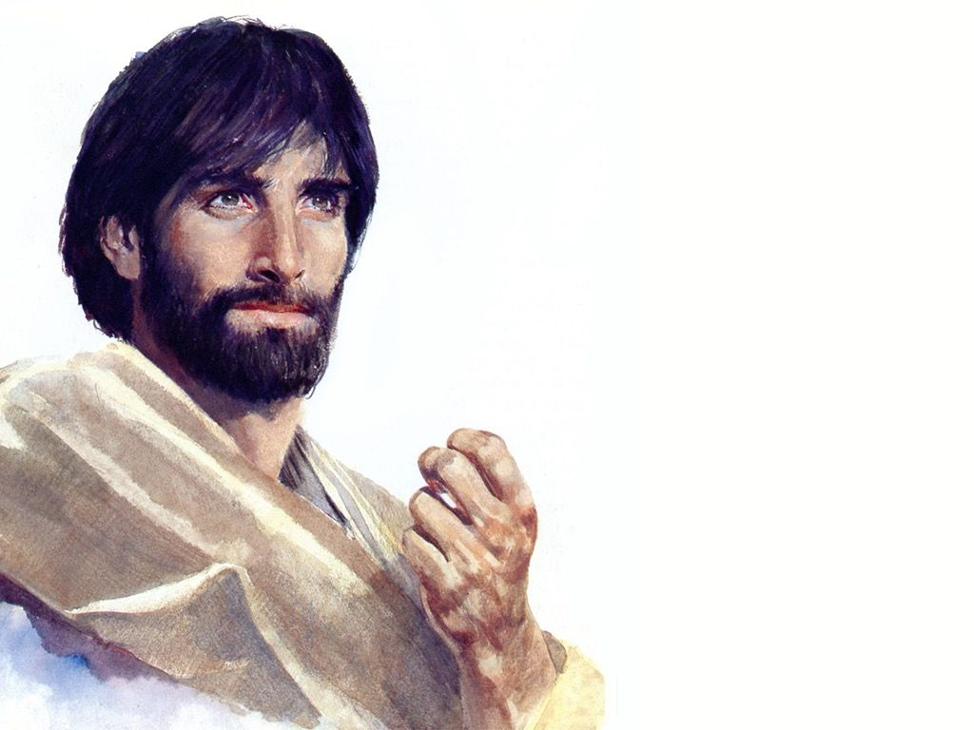
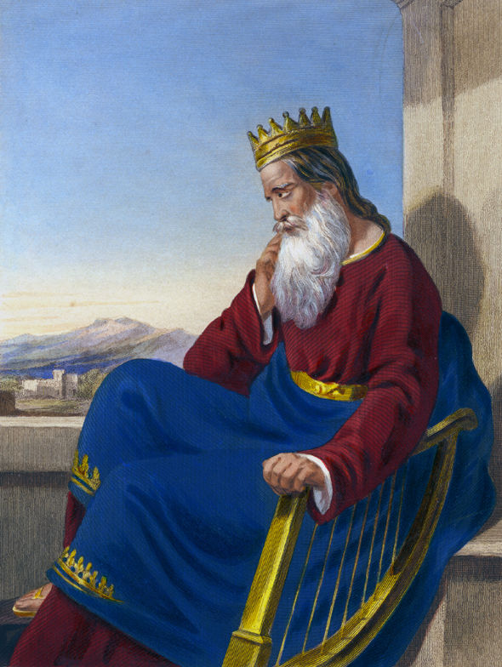
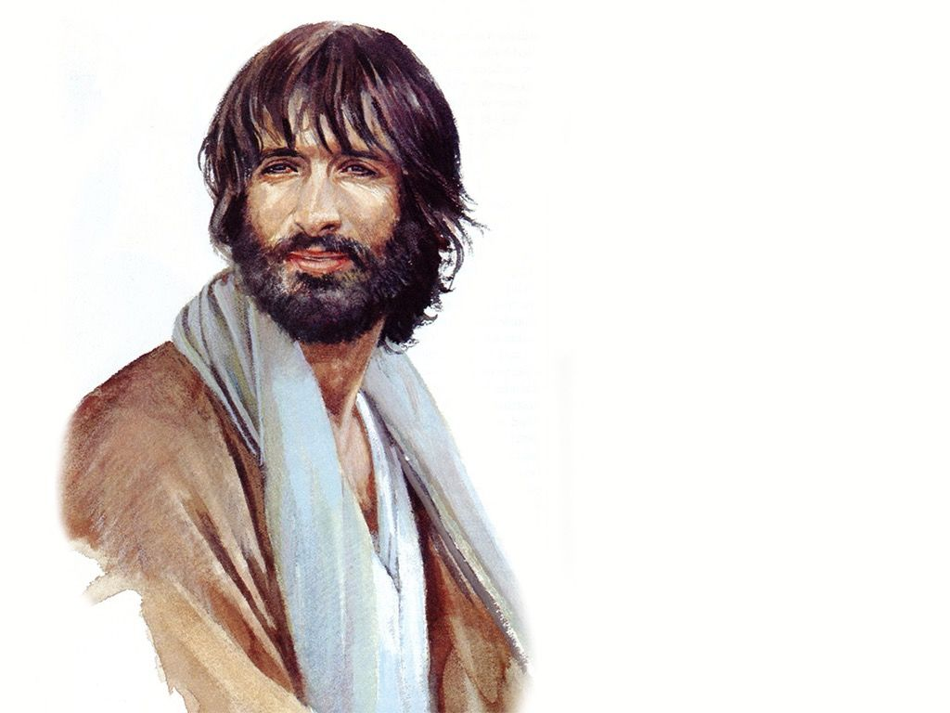
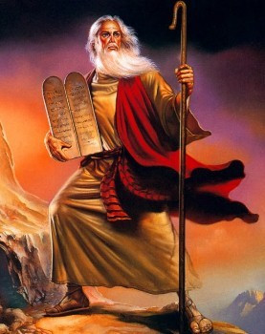
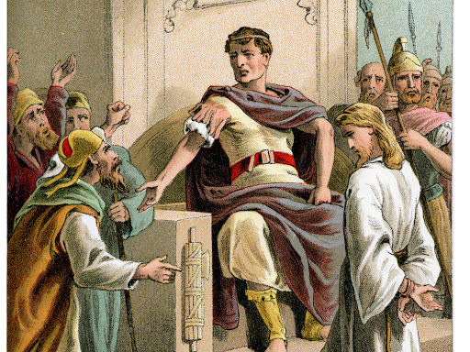
NEW MEN’S SHARE GROUP
STARTS TODAY
Seeing ME in
the MEn of
The Bible
SUNDAYS AT 4:00 P.M. IN THE MAIN BUILDING

Slide 4
Introduction to Biblical languages – The Bible From 30,000 feet
Religions and Philosophies – The Flood of Noah – Young Earth Cosmology
The Supernatural – UFOs -- Angels & Demons
“Contradictions and Hard-To-Understand Scripture”
How to Study the Bible More Effectively – Bible Prophecy & Current Events
TUESDAYS FROM 7:00 – 8:30 P.M. IN THE M.P.B.
SNACKS AND BIBLICAL FACTS

Slide 5
Wednesday Mornings @ 6 a.m.
Canceled at this time.

Slide 6
The Wise & Wonderful
Wednesdays: 11 a.m. in the MPB
THIS WEEK’S SPEAKER:
T.B.D.
THERE WILL BE A HOT DOG LUNCH
AFTER THE SERVICE. COME AND
ENJOY THE FELLOWSHIP AND FOOD.

Slide 7
VOLUNTEERZ NEEDED FOR THE
VISION INFANTZ & VISION TODDLERZ
(THE ENTIRE SERVICE IS SHOWN ON THE MONITORS IN THOSE TWO ROOMS SO YOU WON’T MISS A THING)
FOR MORE INFO, PLEASE CONTACT TASHA MARTIN
womensministries@visionchurch.ag

Slide 8
Got unwanted bags?
Don’t throw them away
Needs them.
On Sundays, you can bring them here to Becky Henton, and she will gladly take them over.

Slide 9
FOR
SOLES
SOULS
“GENTLY USED” ITEMS NEEDED:
MEN’S DRESS SHOES
SNEAKERS
KHAKI SLACKS
BLUE JEANS
FOR MORE INFO
CONTACT
BECKY
HENTON
DEPOSIT IN BOX IN FOYER
BENEFITTING MIDDLE AND HIGH SCHOOL STUDENTS OF LWISD
WE’RE LOVING

Slide 10
A TIME OF REFRESHING
9:45 A.M.

Slide 11
April 12, 2020
Resurrection Sunday Service 9:45 AM
Children’s Egg Hunt 11:30 AM
VISITOR PRIZES – CANDY – SURPRISE EGGS

Slide 12
March Missionary Birthdays
Missionary Kids:
Hope Deal: 03/06

Slide 13
CLICK
SHOP
GIVE

Slide 14
EASYTITHE
Download the APP to your smartphone
Create an account with Vision Church of AG
Select the fund you are giving to
Select dollar amount
Click “Give Now” then click “Give”
Repeat for each fund
Use your cell phone any time to maintain your stewardship.

