Slide 1
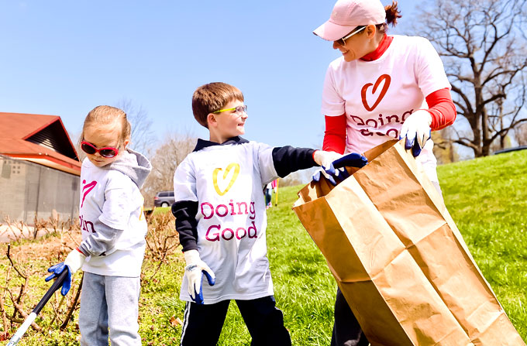
BE GOOD—DO GOOD
Jesus is our example

Slide 2
2 Samuel 9:1-3
One day David asked, "Is anyone in Saul's family still alive—anyone to whom I can show kindness for Jonathan's sake?" 2 He summoned a man named Ziba.
3 The king asked him, "Is anyone still alive from Saul's family? If so, I want to show God's kindness to them."
Ziba replied, "Yes, one of Jonathan's sons is still alive. He is crippled in both feet.“ ESV

Slide 3
Why did David care?

Slide 4
Jeremiah 32:40-41
I will make with them an everlasting covenant, that I will not turn away from doing good to them. 41 I will rejoice in doing them good… ESV

Slide 5
Rules for Doing Good

Slide 6
Ways we can do good
Care.
Tell the truth.
Love your neighbor as yourself.
Be generous.
Follow the Spirit’s lead.
Seize an opportunity.
Make it daily.
Let your light shine.

Slide 7
Galatians 6:9-10
9 And let us not grow weary of doing good, for in due season we will reap, if we do not give up.
10 So then, as we have opportunity, let us do good to everyone, and especially to those who are of the household of faith. ESV

Slide 8
It’s not a feather in your hat,
It’s a star in your crown.

Slide 9
Ripples of kindness…
Doing good…..
Makes your testimony credible.
Makes God attentive to your prayers.
Gives God glory.
Is sowing seeds of kindness.
Produces happiness.
Natural to the new creature.

Slide 10
1 Peter 2:15
For this is the will of God, that by doing good
you should silence the ignorant (agnostic) and foolish (naysayers).

Slide 11
Acts 10:38
God anointed Jesus of Nazareth with the Holy Spirit and with power. He went about doing good and healing all who were oppressed by the devil, for God was with him. ESV

Slide 12
A pot of self-pity is emptied
by
a single good deed.

Slide 13
Matthew 5:16
Let your light shine before others, so that they may see your good works and give glory to your Father who is in heaven. ESV

Slide 14
Prayer
Lord, you have sworn to do good to us. You always look for opportunity to bless us.
Because of this, we in turn will look for opportunities to bless and do good to others. It keeps our hearts open to your will, and those in need. Your word says, “Be kind to one another, tenderhearted, forgiving one another, just as Christ has forgiven us.” Jesus commanded this, and a blessing to go with it. We will let our light shine—doing this with intention, not for attention. We will keep our hearts and hands open to do good on every occasion, in Jesus name, amen.

