Slide 1
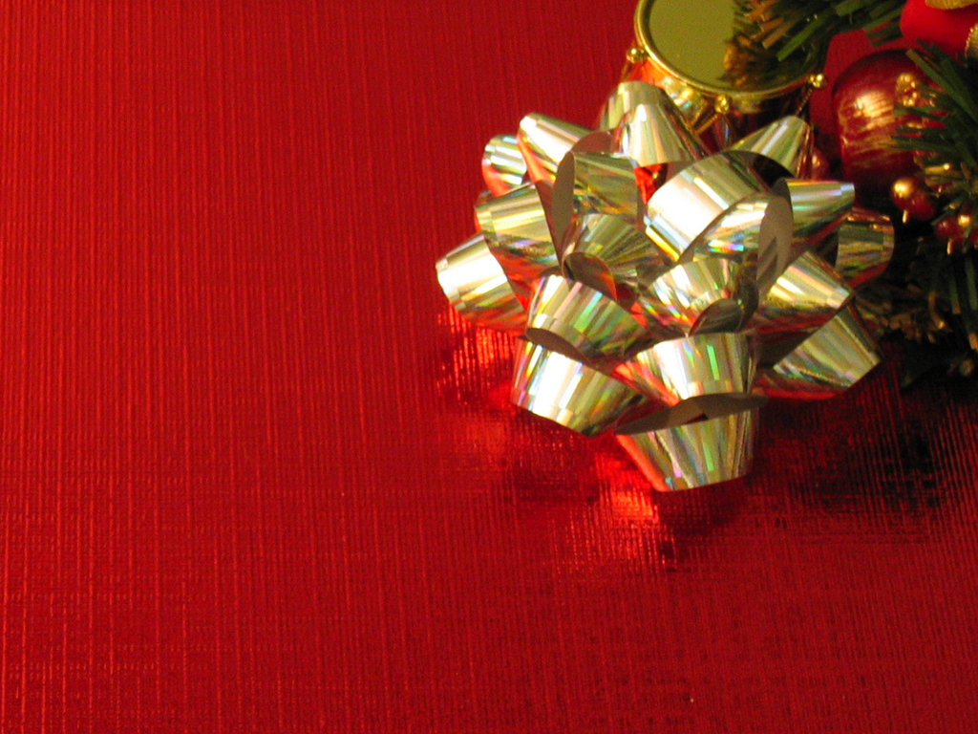
Three
Gifts

Slide 2
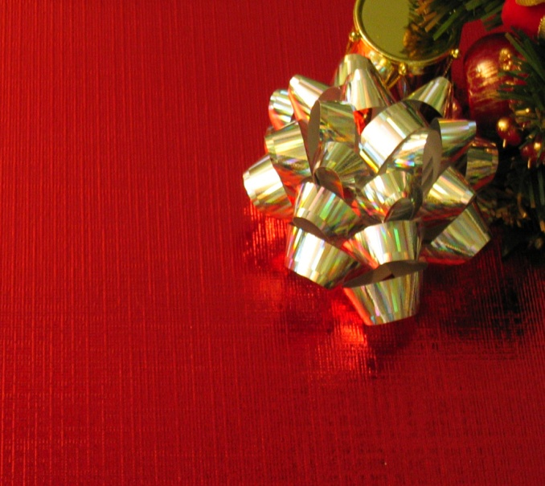
Three Gifts
“ On coming to the house, they saw the child with his mother Mary, and they bowed down and worshipped him. “
Matthew
2:11

Slide 3
Three Gifts
“ Then they opened their treasures and presented him with gifts of gold, frankincense, and myrrh.“
Matthew
2:11

Slide 4
Three
Gifts
Gift #1
LOVE
REVIEW

Slide 5
Three
Gifts
Gift #2
JOY
REVIEW

Slide 6
Three
Gifts
"Glory to God in the highest heaven, and on earth peace to those on whom his favor rests."
Luke
2:14

Slide 7
Three
Gifts
Gift #3
PEACE
INTRO

Slide 8
Three
Gifts
- freedom from disturbance; tranquility.
- freedom from interference
- a state or period in which there is no war or a war has ended.
PEACE
INTRO

Slide 9
Three
Gifts
PEACE IS…
POSITIVE
#1

Slide 10
Three
Gifts
POSITIVE
consisting in or characterized by the presence or possession of features or qualities rather than their absence.
#1

Slide 11
Three
Gifts
POSITIVE
“The fruit of that righteousness will be PEACE; its effect will be quietness and confidence forever” ISAIAH 32:17
#1

Slide 12
Three
Gifts
PEACE IS…
EVIDENT
#2

Slide 13
Three
Gifts
EVIDENT
plain or obvious; clearly seen or understood.
#2

Slide 14
Three
Gifts
EVIDENT
“Peace, be still”
(Matt 8:23)
#2

Slide 15
Three
Gifts
PEACE IS…
AFFECTIVE
#3

Slide 16
Three
Gifts
AFFECTIVE
relating to moods, feelings, and attitudes.
#3

Slide 17
Three
Gifts
AFFECTIVE
Peace I leave with you; my peace I give you. I do not give to you as the world gives. Do not let your hearts be troubled and do not be afraid. (John 14:27)
#3

Slide 18
Three
Gifts
PEACE IS…
COMMUNICABLE
#4

Slide 19
Three
Gifts
COMMUNICABLE
able to be communicated to others.
#4

Slide 20
Three
Gifts
COMMUNICABLE
“ peace on earth”
“my peace I give to you”
#4

Slide 21
Three
Gifts
COMMUNICABLE
But he was pierced for our transgressions; the punishment that brought us peace was on him and by his wounds we are healed”
(Isaiah 53:5)
#4

Slide 22
Three
Gifts
PEACE IS…
EXCEPTIONAL
#5

Slide 23
Three
Gifts
EXCEPTIONAL
unusual; not typical.
unusually good; outstanding.
#5

Slide 24
Three
Gifts
EXCEPTIONAL
“ There is no peace,” says my God, “for the wicked” (ISA 57:21)
“And we know that we are of God, and the whole world lies in wickedness.” (1 John 5:19)
#5

Slide 25
Three
Gifts
NO GOD –
NO PEACE
KNOW GOD – KNOW PEACE
#5

Slide 26
Three
Gifts
EXCEPTIONAL
“ I have told you these things, so that in me you may have PEACE. In this world you will have trouble. But take heart! I have overcome the world.” (John 16:33)
#5

Slide 27
Three
Gifts
EXCEPTIONAL
“ And the PEACE of God which transcends all understanding will guard your hearts and your minds in Christ Jesus.” (Philippians 4:7)
#5

Slide 28
Three
Gifts
P OSITIVE
E VIDENT
A FFECTIVE
C OMMUNICABLE
E XCEPTIONAL
CONCLUSION

Slide 29
Three
Gifts
PEACE is a gift of God and is available – it must be received and be given away
CONCLUSION

