Slide 1
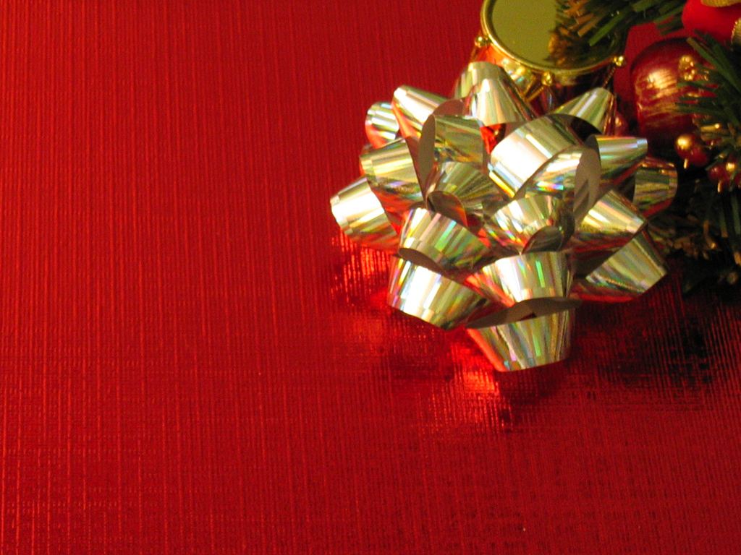
Three Gifts

Slide 2
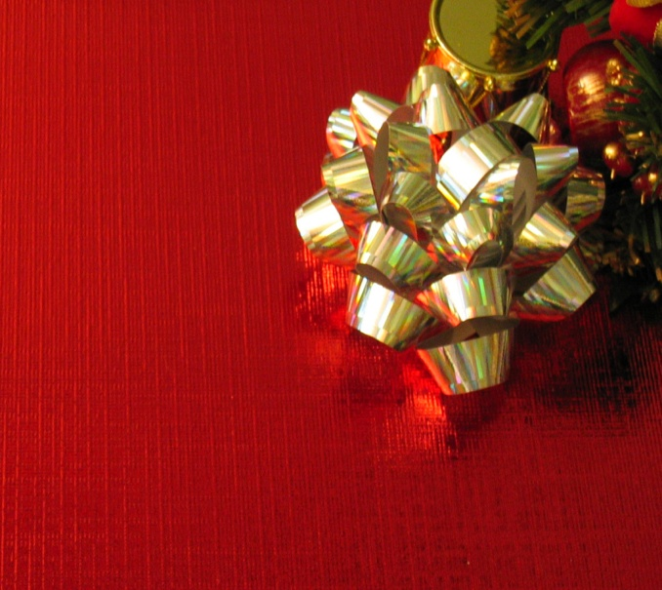
Three Gifts
“ On coming to the house, they saw the child with his mother Mary, and they bowed down and worshipped him. “
Matthew
2:11

Slide 3
Three Gifts
“ Then they opened their treasures and presented him with gifts of gold, frankincense, and myrrh.“
Matthew
2:11

Slide 4
Three Gifts
Gift #1
LOVE
REVIEW

Slide 5
Three Gifts
“And the angel said unto them, Fear not: for, behold, I bring you good tidings of great JOY, which shall be to all people. For unto you is born this day in the city of David a Savior, which is Christ the Lord.“
Luke
2:10,11

Slide 6
Three Gifts
Gift #2
JOY
INTRO

Slide 7
Three Gifts
1a: the emotion evoked by well-being, success, or good fortune or by the prospect of possessing what one desires : DELIGHT
b: the expression or exhibition of such emotion : REJOICE
2: a state of happiness or felicity : BLISS
3: a source or cause of delight
JOY
INTRO

Slide 8
Three Gifts
But the fruit of the Spirit is love, joy, peace…
#1

Slide 9
Three Gifts
JOY IS ROOTED & FRUITED IN THE SPIRIT
#1

Slide 10
Three Gifts
JOY is a divine download with a human response
#1

Slide 11
Three Gifts
You make known to me the path of life; you will fill me with joy in your presence, with eternal pleasures at your right hand.
Psalm
16:11

Slide 12
Three Gifts
JOY is about PRESENCE more than PRESENTS
#2

Slide 13
Three Gifts
All of Israel’s history is a story of God calling them into His presence
#2

Slide 14
Three Gifts
JOY comes in the area of ENCOUNTER and DISCOVERY
(REVELATION)
#2

Slide 15
Three Gifts
…fixing our eyes on Jesus, the pioneer and perfecter of faith. For the JOY set before him he endured
the cross, scorning its shame, and sat down at the right hand of the throne of God.
Hebrews
12:2

Slide 16
Three Gifts
JOY is a
fore-taste
of the future
#3

Slide 17
Three Gifts
² Consider it pure joy, my brothers and sisters,^{[a]} whenever you face trials of many kinds, ³ because you know that the testing of your faith produces perseverance. ⁴ Let perseverance finish its work so that you may be mature and complete, not lacking anything.
James
1:2-4

Slide 18
Three Gifts
JOY is the energy which fuels PERSERVERANCE
#4

Slide 19
Three Gifts
JOY is a
SELF-LESS ADVENTURE
#5

Slide 20
Three Gifts
JESUS
first
#5

Slide 21
Three Gifts
OTHERS
next
#5

Slide 22
Three Gifts
YOURSELF
last
#5

Slide 23
Three Gifts
JOY is available
REJOICING can be restored
LAUGHTER & SINGING can be renewed
CONCLUSION

Slide 24
Three Gifts
Seek
Go-after
Pursue
Long for
Get emotional about
His PRESENCE
CONCLUSION

