Slide 1
Celebrate the Presents Presence

Slide 2
TOP FIVE WORST CHRISTMAS GIFTS OF ALL TIME
PICTURE FRAME
UNDERWEAR
UGLY CHRISTMAS SWEATER
WALL CLOCK OR ALARM CLOCK
WEIGHING SCALES

Slide 3
TOP FIVE BEST CHRISTMAS PRESENTS OF ALL TIME
COFFEE
EARPHONES/HEADPHONES
BED SHEETS
WRIST WATCH
RESTAURANT GIFT CARDS

Slide 4
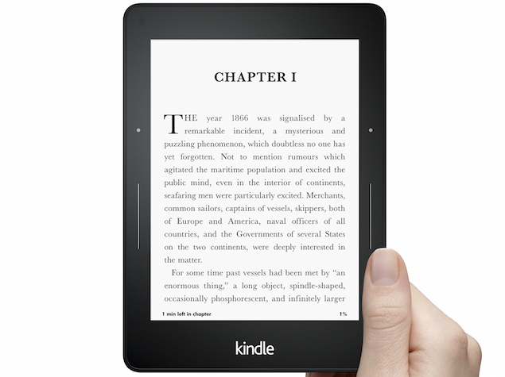
GIFTS FOR MEN AND WOMEN THAT MADE THE TOP TEN FOR 2019

Slide 5
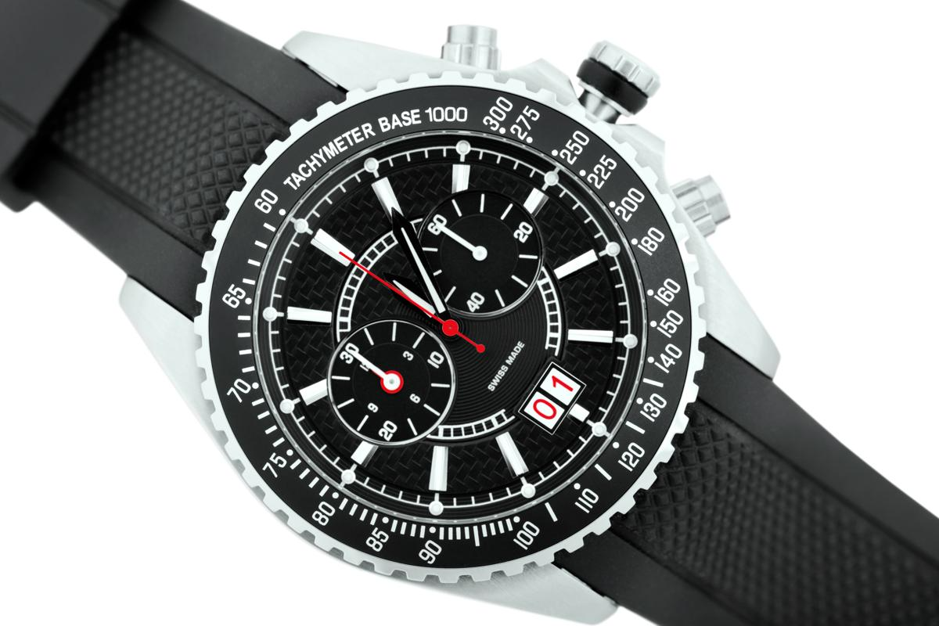
GIFTS FOR MEN AND WOMEN THAT MADE THE TOP TEN FOR 2019

Slide 6
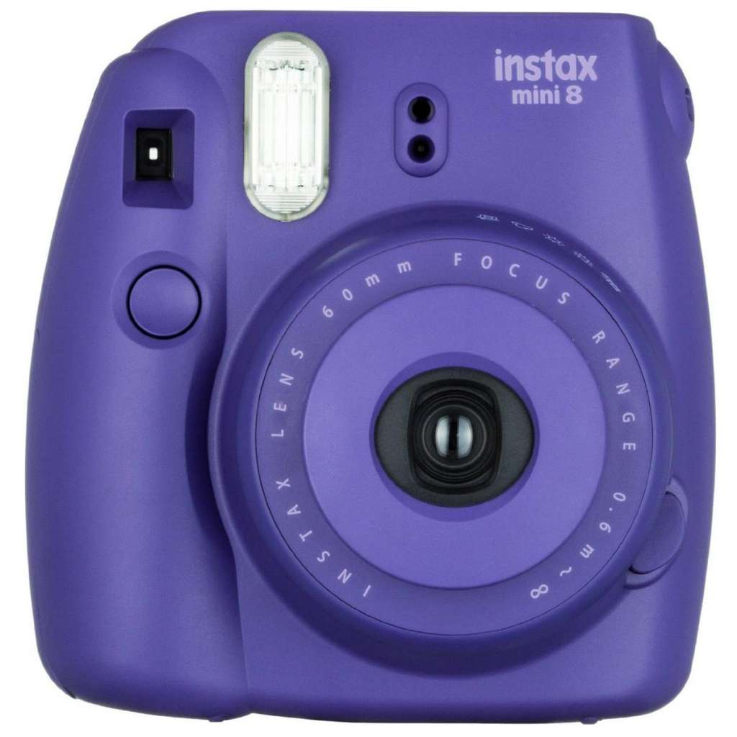
GIFTS FOR MEN AND WOMEN THAT MADE THE TOP TEN FOR 2019

Slide 7
POINT ONE
We need to be more concerned about PRESENCE and not PRESENTS.

Slide 8
POINT ONE
Presents don’t last. God’s presence lasts forever.

Slide 9
Scripture
You make known to me the path of life; you will fill me with joy in your presence, with eternal pleasures at your right hand. Psalm 16:11
In the shelter of your presence you hide them from all human intrigues; you keep them safe in your dwelling from accusing tongues. Psalm 31:20

Slide 10
Scripture
Because of my integrity you uphold me and set me in your presence forever. Psalm 41:12
Surely the righteous will praise your name, and the upright will live in your presence. Psalm 140:13

Slide 11
SCRIPTURE
This is how we know that we belong to the truth and how we set our hearts at rest in his presence:
If our hearts condemn us, we know that God is greater than our hearts, and he knows everything.
Dear friends, if our hearts do not condemn us, we have confidence before God
and receive from him anything we ask, because we keep his commands and do what pleases him.

Slide 12
SCRIPTURE
And this is his command: to believe in the name of his Son, Jesus Christ, and to love one another as he commanded us.
The one who keeps God’s commands lives in him, and he in them. And this is how we know that he lives in us: We know it by the Spirit he gave us.
1 JOHN 3: 19-24 NIV

Slide 13
SCRIPTURE
This is His commandment, that we believe [with personal faith and confident trust] in the name of His Son Jesus Christ, and [that we unselfishly] love and seek the best for one another, just as He commanded us.
The one who habitually keeps His commandments [obeying His word and following His precepts, abides and] remains in Him, and He in him. By this we know and have the proof that He [really] abides in us, by the Spirit whom He has given us [as a gift]. 1 JOHN 3: 23-24 AMP

Slide 14
POINT TWO
We keep ourselves from God’s presence by putting ourselves first.
The arrogant cannot stand in your presence. You hate all who do wrong; Psalm 5:5

Slide 15
POINT TWO
You can tell what/who is most important in your life by how much of your time you give it.

Slide 16
POINT TWO
You can tell what/who is most important in your life by where it lines up in your list of priorities.

Slide 17
POINT THREE
It takes absolutely no effort to be away from God’s presence.

Slide 18
SCRIPTURE
Then she called, “Samson, the Philistines are upon you!” He awoke from his sleep and thought, “I’ll go out as before and shake myself free.” But he did not know that the LORD had left him. Judges 16:20

Slide 19
POINT THREE
We have to be intentional about being in God’s presence.

Slide 20
POINT THREE
It is important to keep the main thing, the main thing. Being in God’s presence must be the main thing.

Slide 21
CONCLUSION
At Christmas we think of presents. What we should be thinking about is presence.
Being in God’s presence.
Being in the presence of our family.
Think of the things that keep you out of God’s presence.

Slide 22
SCRIPTURE
Dear children, keep away from anything that might take God’s place in your hearts. 1 John 5:21 NLT

