Slide 1
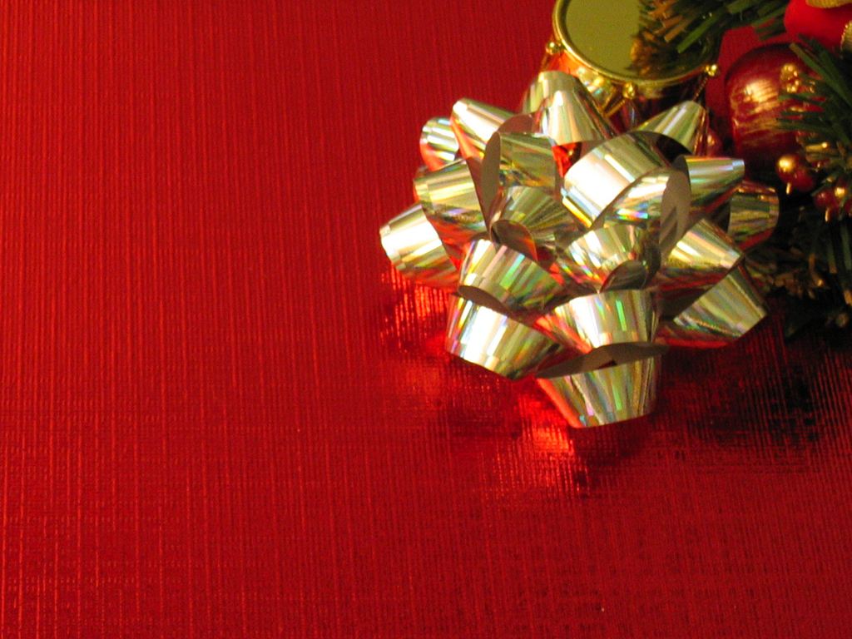
Three Gifts

Slide 2
Three Gifts
“ On coming to the house, they saw the child with his mother Mary, and they bowed down and worshipped him. “
Matthew
2:11

Slide 3
Three Gifts
“ Then they opened their treasures and presented him with gifts of gold, frankincense, and myrrh.“
Matthew
2:11

Slide 4
Three Gifts
Gift #1
LOVE
INTRO

Slide 5
Three Gifts
“For God so loved the world that He gave…”
#1

Slide 6
Three Gifts
The
Great
MOTIVATION
#1

Slide 7
Three Gifts
MOTIVATION is so important when it comes to a gift.
#1

Slide 8
Three Gifts
The
Great
CONTRIBUTION
#2

Slide 9
Three Gifts
“that He gave”
#2

Slide 10
Three Gifts
“It is possible to give without love but it is impossible to love without giving”
#2

Slide 11
Three Gifts
GIVING is more about the heart of the giver than the receiver or rejector
#2

Slide 12
Three Gifts
“His one and only Son”
#3

Slide 13
Three Gifts
The
Great
VALUATION
#3

Slide 14
Three Gifts
The VALUE of the gift says something about the RECEIVER than the GIVER
#3

Slide 15
Three Gifts
QUESTION:
Why is it so difficult to receive?
#3

Slide 16
Three Gifts
“That whosover…”
#4

Slide 17
Three Gifts
The
Great
INVITATION
#4

Slide 18
Three Gifts
God thinks:
“The more…
The merrier”
#4

Slide 19
Three Gifts
We tend to think:
“The more elite…
The more special…”
#4

Slide 20
Three Gifts
“believes in Him…”
#5

Slide 21
Three Gifts
The
Great
RECEPTION
#5

Slide 22
Three Gifts
True and authentic reception is key
#5

Slide 23
Three Gifts
“should not perish”
#6

Slide 24
Three Gifts
The
Great
EMANCIPATION
#6

Slide 25
Three Gifts
The destiny of every human being is turned completely around by this gift!
#6

Slide 26
Three Gifts
“but have everlasting life”
#7

Slide 27
Three Gifts
The
Great
TRANSITION
#7

Slide 28
Three Gifts
This is the greatest RAGS to RICHES story ever!
#7

Slide 29
Three Gifts
This kind of LOVE
is GOD’s
kind of love
It is meant to be given freely and received freely
CONCLUSION

