Slide 1
ARE YOU READY FOR HEAVEN?
Colossians 3:9-10
You have put off the old self with its practices 10 and have put on the new self, which is being renewed in knowledge after the image of its creator. ESV

Slide 2
The problem
Many have accepted Jesus as their savior, but are waiting until they die to live out of their new nature.

Slide 3
How to prepare
The way to prepare for Heaven is to live as if you are there already….because, in a sense, you are.

Slide 4
Colossians 3:1-2
If then you have been raised with Christ, seek the things that are above, where Christ is, seated at the right hand of God. 2 Set your minds on things that are above, not on things that are on earth. ESV

Slide 5
Matthew 6:10
Jesus taught us to pray, “Thy kingdom come, Thy will be done, on earth as it is in Heaven.”

Slide 6
Dual citizenship
Who were the first people to live on earth and in Heaven at the same time?

Slide 7
Morning Prayer
“Lord, today I am going to live, think, and talk as if I have already died and gone to Heaven.”

Slide 8
How will you fit in?
Have you ever wondered how you will
fit in, in heaven? On earth we don’t get called out for being negative, critical, gossipy, judgmental, jealous, envious, etc.
But there you will. An angel might come along side and say, “You’re ruining things up here, it’s back to school for you.”

Slide 9
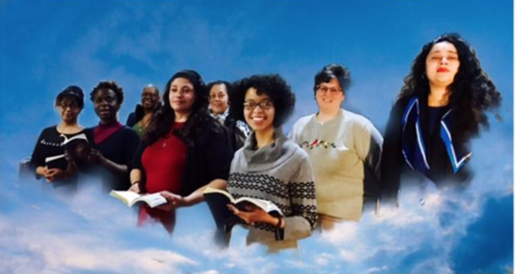
Heaven’s Choir
If you want to sing in Heaven’s choir, choir practice starts right now.

Slide 10
Steve’s paraphrase of Galatians 5:19-21
Now the works of the flesh are easily discernable in your life: They are all the negatives that drag you and others down.
I’m warning you that if you continue to Iive, think, and relate to others like this, you are missing out on the kingdom of God. ESV

Slide 11
Galatians 5:22-23
The fruit of the Spirit is love, joy, peace, patience, kindness, goodness, faithfulness, 23 gentleness, self-control; ESV

Slide 12
Colossians 3:8-10
8 Put away anger, wrath, malice, slander, and obscene talk from your mouth. 9 Do not lie to one another, seeing that you have put off the old self with its practices 10 and have put on the new self, which is being renewed in knowledge after the image of its creator. ESV

Slide 13
Get ready now!
In Heaven you will not be an angel. You will be you in a different body.

Slide 14
Earthly is anti-kingdom
Paul said, “Put to death what is earthly (low down) in you.”
This is something you are responsible for. Don’t ask God to do it for you….you put it to death. Get rid of everything that is anti-kingdom.

Slide 15
Seek the kingdom
Seek the kingdom, not a mansion in Heaven. Making the kingdom first priority here is the best way to prepare yourself for the future.

Slide 16
In Heaven right now
Can you see Heaven in your mind’s eye? What is going on up there right now?

Slide 17
Galatians 5:16
This I say then, walk in the Spirit, and you will not fulfil the lust of the flesh (your selfish desires). NKJV

Slide 18
Morning prayer
“Lord, today I commit myself to enjoy life in your kingdom—walking in love, joy, and peace…dead to selfishness, alive to Christ. Every moment will bring a test today…a choice between the kingdom where I am in charge, or the real king Jesus…In his name I pray, amen.”

