Slide 1
:
THE LAME WALK & THE BLIND SEE

Slide 2
CAPERNAUM
NAZARETH
JERUSALEM
REVIEW

Slide 3
Vision Church wants to be just like Capernaum
REVIEW

Slide 4
ALL THE GRACE OF HEAVEN AVAILABLE
FAITH IS THE GREAT CONNECTOR
REVIEW

Slide 5
FAITH willing to acknowledge God in the tiniest way.
REVIEW

Slide 6
FAITH that is willing to accept God’s Word as the ultimate authority.
REVIEW

Slide 7
FAITH that ASSERTS itself until GRACE happens
REVIEW

Slide 8
JERUSALEM NEEDS SOME CAPERNAUM TO COME TO TOWN
REVIEW

Slide 9
UNFEELING PEOPLE
UNABLE PEOPLE
CLOSE BUT FAR
OFFENDED EASILY
NEED A COME BACK
REVIEW

Slide 10
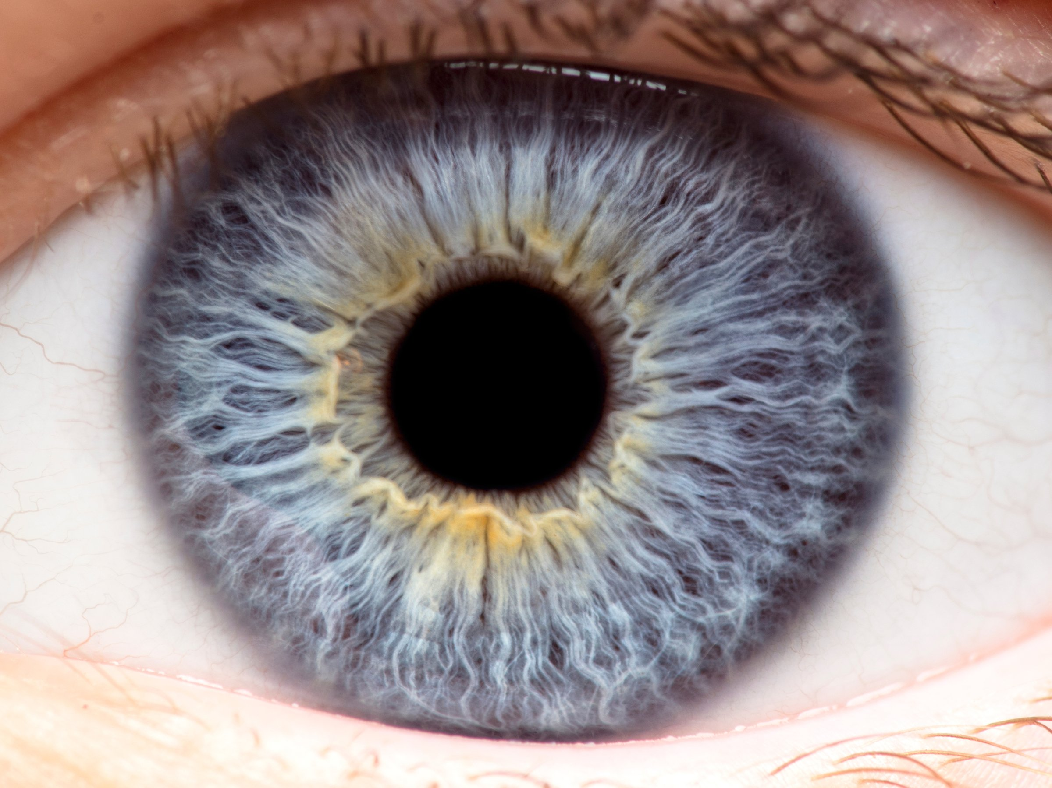
THE EYE
Those who cannot see (Spirit & Body)
Those who will not see (Soul)
INTRO

Slide 11
THE EYE
Some
AMAZING
facts
INTRO

Slide 12
BLINDNESS
Those who cannot see (Spirit & Body)
Those who will not see (Soul)
INTRO

Slide 13
BLINDNESS
Those who cannot see (Spirit & Body)
Those who will not see (Soul)
INTRO

Slide 14
9 As he went along, he saw a man blind from birth. ² His disciples asked him, “Rabbi, who sinned, this man or his parents, that he was born blind?”
³ “Neither this man nor his parents sinned,” said Jesus, “but this happened so that the works of God might be displayed in him. ⁴ As long as it is day, we must do the works of him who sent me. Night is coming, when no one can work. ⁵ While I am in the world, I am the light of the world.”
BLIND
John 9:1-41

Slide 15
Bad theology
Grace opportunity
Light is the first principle of sight
OBSERVE

Slide 16
⁶ After saying this, he spit on the ground, made some mud with the saliva, and put it on the man’s eyes. ⁷ “Go,” he told him, “wash in the Pool of Siloam” (this word means “Sent”). So the man went and washed, and came home seeing.
⁸ His neighbors and those who had formerly seen him begging asked, “Isn’t this the same man who used to sit and beg?” ⁹ Some claimed that he was. Others said, “No, he only looks like him.” But he himself insisted, “I am the man.”
BLIND
John 9:1-41

Slide 17
Mud & Spit
Eye- Making Kit
Long walk for a blind man
Miracles change people AND challenge those who encounter them
OBSERVE

Slide 18
¹⁰ “How then were your eyes opened?” they asked.
¹¹ He replied, “The man they call Jesus made some mud and put it on my eyes. He told me to go to Siloam and wash. So I went and washed, and then I could see.”
¹² “Where is this man?” they asked him.
“I don’t know,” he said.
¹³ They brought to the Pharisees the man who had been blind. ¹⁴ Now the day on which Jesus had made the mud and opened the man’s eyes was a Sabbath.
BLIND
John 9:1-41

Slide 19
Miracle investigations reveal the light by which people live
Miracles are great for proper people on proper days
OBSERVE

Slide 20
¹⁵ Therefore the Pharisees also asked him how he had received his sight. “He put mud on my eyes,” the man replied, “and I washed, and now I see.”
¹⁶ Some of the Pharisees said, “This man is not from God, for he does not keep the Sabbath.”
But others asked, “How can a sinner perform such signs?” So they were divided.
¹⁷ Then they turned again to the blind man, “What have you to say about him? It was your eyes he opened.”
The man replied, “He is a prophet.”
BLIND
John 9:1-41

Slide 21
When grace and peace hits law and order
Prophets #1 job is to challenge spiritual blindness
(a light / THE LIGHT)
OBSERVE

Slide 22
¹⁸ They still did not believe that he had been blind and had received his sight until they sent for the man’s parents. ¹⁹ “Is this your son?” they asked. “Is this the one you say was born blind? How is it that now he can see?”
²⁰ “We know he is our son,” the parents answered, “and we know he was born blind. ²¹ But how he can see now, or who opened his eyes, we don’t know. Ask him. He is of age; he will speak for himself.”
BLIND
John 9:1-41

Slide 23
The problem is the choice not the observation.
What will one do with what they have seen?
OBSERVE

Slide 24
²² His parents said this because they were afraid of the Jewish leaders, who already had decided that anyone who acknowledged that Jesus was the Messiah would be put out of the synagogue. ²³ That was why his parents said, “He is of age; ask him.”
²⁴ A second time they summoned the man who had been blind. “Give glory to God by telling the truth,” they said. “We know this man is a sinner.”
²⁵ He replied, “Whether he is a sinner or not, I don’t know. One thing I do know. I was blind but now I see!”
BLIND
John 9:1-41

Slide 25
Even after a miracle people can wimp out on God
A man with an experience is not at the mercy of a man with an argument
OBSERVE

Slide 26
²⁶ Then they asked him, “What did he do to you? How did he open your eyes?”
²⁷ He answered, “I have told you already and you did not listen. Why do you want to hear it again? Do you want to become his disciples too?”
²⁸ Then they hurled insults at him and said, “You are this fellow’s disciple! We are disciples of Moses! ²⁹ We know that God spoke to Moses, but as for this fellow, we don’t even know where he comes from.”
BLIND
John 9:1-41

Slide 27
Lack of faith can mock a phenomenal miracle
Simple faith can see so clearly that it thinks everyone should go ALL IN
OBSERVE

Slide 28
³⁰ The man answered, “Now that is remarkable! You don’t know where he comes from, yet he opened my eyes. ³¹ We know that God does not listen to sinners. He listens to the godly person who does his will. ³² Nobody has ever heard of opening the eyes of a man born blind. ³³ If this man were not from God, he could do nothing.”
³⁴ To this they replied, “You were steeped in sin at birth; how dare you lecture us!” And they threw him out.
BLIND
John 9:1-41

Slide 29
Teaching should come after seeing
Willful blindness lashes out at people who miraculously see
OBSERVE

Slide 30
³⁵ Jesus heard that they had thrown him out, and when he found him, he said, “Do you believe in the Son of Man?”
³⁶ “Who is he, sir?” the man asked. “Tell me so that I may believe in him.”
³⁷ Jesus said, “You have now seen him; in fact, he is the one speaking with you.”
³⁸ Then the man said, “Lord, I believe,” and he worshiped him.
BLIND
John 9:1-41

Slide 31
There is more to “seeing Jesus” than seeing Jesus
Faith linked to Grace brings REAL VISION
OBSERVE

Slide 32
³⁹ Jesus said,^{[a]} “For judgment I have come into this world, so that the blind will see and those who see will become blind.”
⁴⁰ Some Pharisees who were with him heard him say this and asked, “What? Are we blind too?”
⁴¹ Jesus said, “If you were blind, you would not be guilty of sin; but now that you claim you can see, your guilt remains.
BLIND
John 9:1-41

Slide 33
The risk of light and revelation is the judgement which follows
OBSERVE

Slide 34
Jesus is THE cure for blindness
SPIRITUAL
PSYCHOLOGICAL
PHYSICAL
CONCLUSION

Slide 35
Where is your blindspot?
What do you have a sense you should be seeing but you are not?
CONCLUSION

Slide 36
The Word of God is a great “eye-salve” do you need some?
Where is darkness persisting, Jesus is LIGHT!
CONCLUSION

