Slide 1
4 PERSONALITIES—
WHICH ONE IS YOURS?

Slide 2
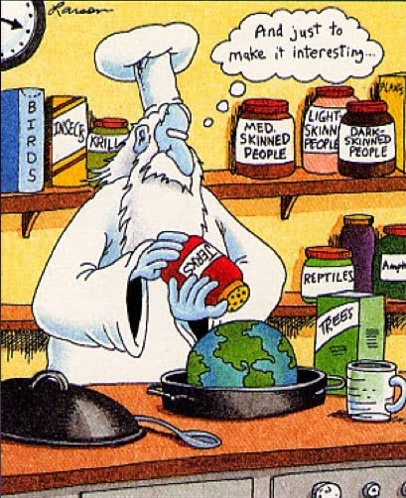
Just to make it interesting…

Slide 3
Bible personalities
1. Analyzer-organizer-- Luke 2. Creator/performer-- David
3. Promoter leader-- Peter
4. Helper supporter-- Martha

Slide 4
In which quadrant is Jesus?
Jesus is in the center.

Slide 5
Which one are you?
1. Analyzer-organizer / Puritan 2. Creator/smart-aleck
performer/socialite
3. Promoter leader/ tyrant
4. Helper supporter/doormat

Slide 6
How do you process?
We are all different, but fit in to 4 basic personalities, or the way you process information.

Slide 7
Getting healthy
We get healthy by realizing that we all process information with different ears and responses. This hopefully will provide understanding….and understanding will lead to better communication...and better communication makes for healthy relationships.

Slide 8
Different, not better
One type is not better or inferior to the others. It takes all four to have
a healthy group of people,
like the church.

Slide 9
A healthy culture
It would not be an interesting or healthy culture if everyone was the same. God makes us different to compliment each other. Your personality is your gift to the body of Christ.

Slide 10
1 Corinthians 12:14,18-20
14 For the body does not consist of one member but of many.
18 But as it is, God arranged the members (personality types) in the body, each one of them, as he chose. 19 If all were a single member, where would the body be?
20 As it is, there are many parts, yet one body. ESV

