Slide 1
Who are you going to believe?

Slide 2
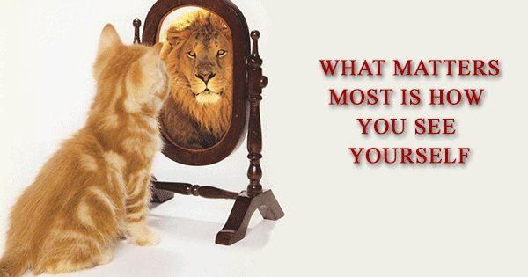
introduction

Slide 3
introduction
Surround yourself with those who see greatness within you.

Slide 4
Satan’s tricks
Satan fills us with doubt.

Slide 5
Satan’s tricks
Genesis 3:1
Now the serpent was more crafty than any of the wild animals the LORD God had made. He said to the woman, “Did God really say, ‘You must not eat from any tree in the garden’?”

Slide 6
Satan’s tricks
Satan is a liar

Slide 7
Satan’s tricks
John 8:44
You belong to your father, the devil, and you want to carry out your father’s desires. He was a murderer from the beginning, not holding to the truth, for there is no truth in him. When he lies, he speaks his native language, for he is a liar and the father of lies.

Slide 8
Satan’s tricks
Satan is a thief and a destroyer

Slide 9
Satan’s tricks
John 10:10
The thief comes only to steal and kill and destroy; I have come that they may have life, and have it to the full.

Slide 10
What does god say?
I am a child of God

Slide 11
What does god say?
But to all who did receive him, who believed in his name, he gave the right to become children of God.” – John 1:12
“And if children, then heirs – heirs of God and fellow heirs with Christ.” – Romans 8:17

Slide 12
What does god say?
I belong to God and I am loved by God.

Slide 13
What God says
“Fear not, for I have redeemed you; I have called you by name, you are mine.”
Isaiah 43:1
“See what kind of love the Father has given to us, that we should be called children of God; and so we are.”
1 John 3:1

Slide 14
What god says
I am the apple of God’s eye

Slide 15
What god says
“The Lord appeared to us in the past, saying: I have loved you with an everlasting love; I have drawn you with loving-kindness.” – Jeremiah 31:3
“… for he who touches you touches the apple of his eye.” – Zechariah 2:8

Slide 16
What god says
I am a friend of Jesus

Slide 17
What god says
“No longer do I call you servants, for the servant does not know what his master is doing; but I have called you friends, for all that I have heard from my Father I have made known to you.” – John 15:15

Slide 18
What god says
I am fearfully and wonderfully made

Slide 19
What god says
“I praise you, for I am fearfully and wonderfully made. Wonderful are your works; My soul knows it very well.”
Psalm 139:14

Slide 20
What god says
I am known by Him.

Slide 21
What god says
“Before I formed you in the womb I knew you, and before you were born I consecrated you; I appointed you a prophet to the nations.” – Jeremiah 1:5

Slide 22
What god says
I am God’s workmanship

Slide 23
What god says
“For we are his workmanship, created in Christ Jesus for good works, which God prepared beforehand, that we should walk in them.” – Ephesians 2:10

Slide 24
What god says
My name is engraved on the palm of his hand – He will never forget me.

Slide 25
What god says
“Can a mother forget the baby at her breast and have no compassion on the child she has borne? Though she may forget, I will not forget you!
See, I have engraved you on the palms of my hands; your walls are ever before me. “
Isaiah 49:15-16

Slide 26
Who are you going to believe
Think about what you are thinking about.

Slide 27
Who are you going to believe?
Do the thoughts you are thinking line up with what God would say?

