Slide 1
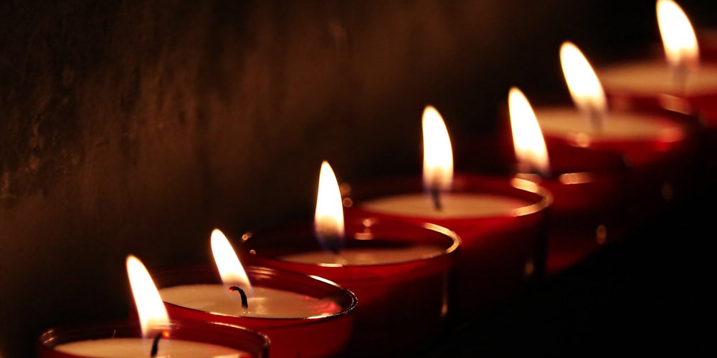
The Seven-Fold Spirit of God

Slide 2
LOVE
HUMILITY WISDOM TRUTH
→
PRESENCE
REVIEW
DISCOVERING
THE
FLAMES

Slide 3
LOVE
GRACE
RIGHTEOUSNESS
FREEDOM
←
PEOPLE
REVIEW
DISCOVERING
THE
FLAMES

Slide 4
The question is not whether we will burn but what will ignite us and how we will burn.
INTRODUCTION
HOW ARE YOU BURNING?

Slide 5
Considering the Seven-Fold Spirit will serve to reveal some answers.
INTRODUCTION
HOW ARE YOU BURNING?

Slide 6
POINT #1
THE GOD QUESTION IS ANSWERED HERE.
HOW ARE YOU BURNING?

Slide 7
^{Either I am my god}
^{or}
^{YHWH is my God.}
POINT #1
HOW ARE YOU BURNING?

Slide 8
LOVE is the PRIMARY indicator what kind of LOVE do you love with?
POINT #1
HOW ARE YOU BURNING?

Slide 9
^{THE IDOLATRY QUESTION}
^{IS ANSWERED HERE.}
POINT #2
HOW ARE YOU BURNING?

Slide 10
POINT #2
^{What are my favorites?}
HOW ARE YOU BURNING?

Slide 11
POINT #2
^{Where do I connect?}
HOW ARE YOU BURNING?

Slide 12
Where do I tend to camp out and feel the most comfortable?
POINT #2
HOW ARE YOU BURNING?

Slide 13
THE CHRISTIAN DEVELOPMENT QUESTION IS ANSWERED HERE.
POINT #3
HOW ARE YOU BURNING?

Slide 14
Where is the life and example of Christ different from mine?
POINT #3
HOW ARE YOU BURNING?

Slide 15
^{Where do I struggle the most?}
POINT #3
HOW ARE YOU BURNING?

Slide 16
Where is the Holy Spirit wanting to take me next?
POINT #3
HOW ARE YOU BURNING?

Slide 17
CONCLUSION
^{ONE OF MY BURNING QUESTIONS.}
HOW ARE YOU BURNING?

Slide 18
CONCLUSION
^{“What is holiness?”}
HOW ARE YOU BURNING?

