Slide 1
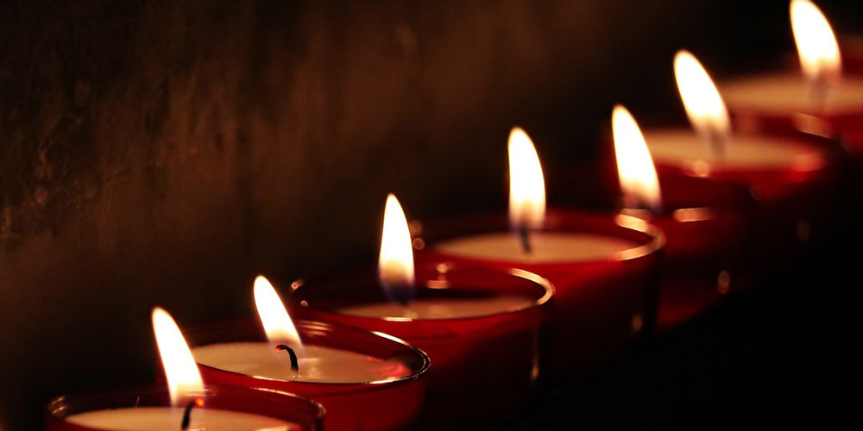
The Seven-Fold Spirit of God

Slide 2
LOVE
HUMILITY WISDOM TRUTH
→
PRESENCE
REVIEW
DISCOVERING
THE
FLAMES

Slide 3
LOVE
GRACE
RIGHTEOUSNESS
?
←
PEOPLE
REVIEW
DISCOVERING
THE
FLAMES

Slide 4
^{GOD ALONE IS RIGHTEOUS}
HUMANITY’s RIGHTEOUSNESS IS A PROBLEM
JESUS ALONE IS THE ANSWER FOR UNRIGHTEOUSNESS
NEW CREATION RESULTS IN TRUE RIGHTEOUSNESS
REVIEW
THE SPIRIT OF RIGHTEOUSNESS

Slide 5
But when he, the Spirit of truth, comes, he will guide you into all the truth. He will not speak on his own; he will speak only what he hears, and he will tell you what is yet to come. JOHN 16:13
INTRODUCTIONS
THE SPIRIT OF FREEDOM

Slide 6
To the Jews who had believed him, Jesus said, “If you hold to my teaching, you are really my disciples. Then you will know the truth, and the truth will set you free.” JOHN 8:31-32
INTRODUCTIONS
THE SPIRIT OF FREEDOM

Slide 7
^{SPIRIT CONNECTIONS}
^{LOVE LOVE}
^{GRACE HUMILITY}
^{RIGHTEOUSNESS WISDOM}
^{FREEDOM TRUTH}
INTRODUCTION
THE SPIRIT OF FREEDOM

Slide 8
“The Spirit of the Lord is on me,
^{because he has anointed me}
to proclaim good news to the poor.
He has sent me to proclaim freedom for the prisoners and recovery of sight for the blind, to set the oppressed free, to proclaim the year of the Lord’s favor.”
^{LUKE 4:18,19}
POINT #1
THE SPIRIT OF FREEDOM

Slide 9
POINT #1
^{JESUS IS}
^{“FREEDOM FOCUSED”}
THE SPIRIT OF FREEDOM

Slide 10
POINT #1
JESUS LED WITH THIS MESSAGE BECAUSE IT WAS THE MESSAGE TO THOSE IN PRISON…HUMANITY IS IN PRISON.
THE SPIRIT OF FREEDOM

Slide 11
POINT #1
JESUS LED WITH THIS MESSAGE BECAUSE IT RESONATES WITH THE SPIRIT OF MAN MADE IN GOD’s IMAGE
THE SPIRIT OF FREEDOM

Slide 12
POINT #1
JESUS IS THE ONLY ONE WHO CAN MAKE GOOD ON THE PROMISE OF FREEDOM.
THE SPIRIT OF FREEDOM

Slide 13
POINT #1
TRUTH IS THE GREAT CONDUIT INTO FREEDOM
THE SPIRIT OF FREEDOM

Slide 14
Now the Lord is that spirit, and where the Spirit of the Lord is, there is freedom.
^{2 Cor 3:17}
POINT #2
THE SPIRIT OF FREEDOM

Slide 15
POINT #2
THE SPIRIT OF THE LORD BRINGS FREEDOM and CULTIVATES FREEDOM
THE SPIRIT OF FREEDOM

Slide 16
POINT #2
THE PRESENCE OF THE LORD MUST BE PURSUED
THE SPIRIT OF FREEDOM

Slide 17
POINT #2
PURSUING FREEDOM IS NOT THE SAME AS PURSUING THE PRESENCE
THE SPIRIT OF FREEDOM

Slide 18
It is for freedom that Christ has set us free. Stand firm, then, and do not let yourselves be burdened again by a yoke of slavery. Galatians 5:1
POINT #3
THE SPIRIT OF FREEDOM

Slide 19
POINT #3
FREEDOM MUST BE REFRESHED OR IT DECAYS INTO INDULGENCE
THE SPIRIT OF FREEDOM

Slide 20
POINT #3
We must refresh our time in his presence
THE SPIRIT OF FREEDOM

Slide 21
POINT #3
We must refresh our time in his word
THE SPIRIT OF FREEDOM

Slide 22
I will walk about in freedom, for I have sought out your precepts.
^{Psalms 119:45}
POINT #3
THE SPIRIT OF FREEDOM

Slide 23
But whoever looks intently into the perfect law that gives freedom and continues in it-not forgetting what they have heard but doing it-they will be blessed in what they do.
^{James 1:25}
POINT #3
THE SPIRIT OF FREEDOM

Slide 24
POINT #3
We must refresh our time in fellowship with his people
THE SPIRIT OF FREEDOM

Slide 25
For you were called to freedom brothers. Only do not use your freedom as an opportunity for the flesh, but through love serve one another.
^{Galatians 5:13}
POINT #3
THE SPIRIT OF FREEDOM

Slide 26
^{HAVE YOU FOUND FREEDOM?}
HOW IS YOUR FREEDOM MAINTENANCE PROGRAM GOING?
HOW IS YOUR FREEDOM TORCH BURNING?
CONCLUSION
THE SPIRIT OF FREEDOM

