Slide 1
HEZEKIAH’S PRAYER
How to get out of a tough situation

Slide 2


Slide 3


Slide 4
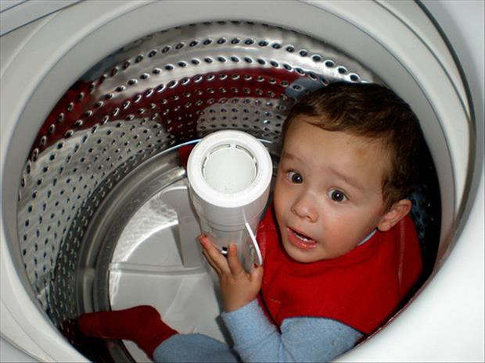

Slide 5


Slide 6
HEZEKIAH WAS A KING WITH A PROBLEM

Slide 7
2 kings 19:1-2
When King Hezekiah heard this, he tore his clothes and put on sackcloth and went into the temple of the LORD. He sent Eliakim the palace administrator, Shebna the secretary and the leading priests, all wearing sackcloth, to the prophet Isaiah son of Amoz.

Slide 8
2 kings 19:14-19
Hezekiah received the letter from the messengers and read it. Then he went up to the temple of the LORD and spread it out before the LORD. And Hezekiah prayed to the LORD: “LORD, the God of Israel, enthroned between the cherubim, you alone are God over all the kingdoms of the earth. You have made heaven and earth.

Slide 9
2 kings 19:14-19
Give ear, LORD, and hear; open your eyes, LORD, and see; listen to the words Sennacherib has sent to ridicule the living God. “It is true, LORD, that the Assyrian kings have laid waste these nations and their lands.

Slide 10
2 kings 19:14-19
They have thrown their gods into the fire and destroyed them, for they were not gods but only wood and stone, fashioned by human hands. Now, LORD our God, deliver us from his hand, so that all the kingdoms of the earth may know that you alone, LORD, are God.”

Slide 11
Point 1
Humble yourself

Slide 12
Point 1
Humility is crucial if you want to receive anything from God.

Slide 13
Point 2
Get prayer support

Slide 14
Point 2
Pride says I don’t need help.
Humility says I do.

Slide 15
Point 3
Lay it all out there.

Slide 16
Point 3
Hezekiah showed God what the enemy was doing. He told the truth about the situation.

Slide 17
Point 4
Make your request.

Slide 18
Point 4
Prayers don’t have to be long to be effective.

Slide 19
James 5:16
Therefore confess your sins to each other and pray for each other so that you may be healed. The prayer of a righteous person is powerful and effective.

Slide 20
CONCLUSION
When you are in a tough situation:
Humble yourself.
Get prayer support.
Lay it all out there.
Make your request.

