Slide 1
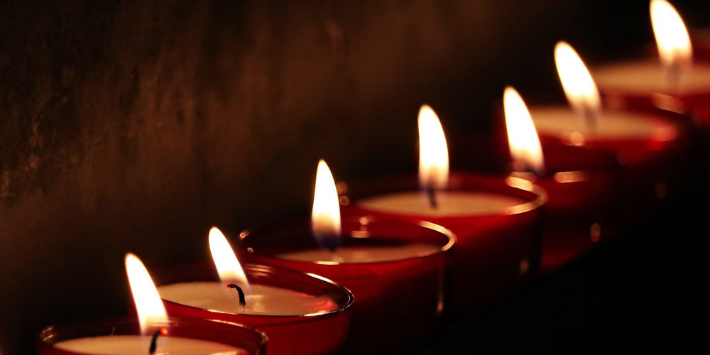
The Seven-Fold Spirit of God

Slide 2
LOVE
HUMILITY WISDOM TRUTH
→
PRESENCE
REVIEW
THE GRACE CONNECTIONS

Slide 3
LOVE
GRACE
?
?
←
PEOPLE
REVIEW
THE GRACE CONNECTIONS

Slide 4
UNITY
SUDDENLY
FILLED THE ROOM
REVIEW
FIRE
LANGUAGE
THE GRACE
ARRIVAL
SPIRIT-ENABLED
BEWILDERMENT

Slide 5
¹³ If you then, though you are evil, know how to give good gifts to your children, how much more will your Father in heaven give the Holy Spirit to those who ask him!”
Luke 11:13
INTRODUCTION
THE
GRACE-FILLED
FATHER

Slide 6
^{GIFTS OF PRESENCE}
^{GIFTS OF TIME}
^{GIFTS OF WORDS}
^{GIFTS OF RESOURCES}
^{GIFTS OF REPUTATION}
REVIEW
THE
GRACE-FILLED
FATHER

Slide 7
the quality of being morally right or justifiable.
synonyms: | goodness, uprightness, decency, integrity, worthiness, morality, justice, honesty, honor, innocence, saintliness, purity,
INTRODUCTION
THE SPIRIT OF RIGHTEOUSNESS

Slide 8
¹⁰ As it is written:
“There is no one righteous, not even one; ¹¹ there is no one who understands; there is no one who seeks God. ¹² All have turned away, they have together become worthless; there is no one who does good, not even one.”^{[a]}
^{Romans 3:10-12}
INTRODUCTION
THE SPIRIT OF RIGHTEOUSNESS

Slide 9
^{GOD IS THE ORIGINATOR}
^{GOD IS FIRST}
^{GOD IS THE STANDARD}
^{GOD ALONE IS RIGHTEOUS}
POINT #1
THE SPIRIT OF RIGHTEOUSNESS

Slide 10
^{HUMANITY IS CREATED}
^{HUMANITY IS FALLEN}
HUMANITY HAS FORSAKEN THE STANDARD
HUMANITY’s RIGHTEOUSNESS IS A PROBLEM
POINT #2
THE SPIRIT OF RIGHTEOUSNESS

Slide 11
^{JESUS IS THE LOGOS}
JESUS WAS THERE FROM THE BEGINNING
JESUS IS THE ONLY ONE WHO CAN KEEP THE STANDARD
JESUS ALONE IS THE ANSWER FOR UNRIGHTEOUSNESS
POINT #3
THE SPIRIT OF RIGHTEOUSNESS

Slide 12
^{MAN MUST BE BORN AGAIN}
MAN MUST ACCEPT GOD’s RIGHTEOUSNESS
MAN MUST SURRENDER HIS SENSE OF RIGHTNESS
NEW CREATION RESULTS IN TRUE RIGHTEOUSNESS
POINT #4
THE SPIRIT OF RIGHTEOUSNESS

Slide 13
We will burn with a righteousness…which one will it be?
^{What will offend us?}
Our walk with God will result in an automatic rebuke of darkness – are we ready for that?
CONCLUSION
THE SPIRIT OF RIGHTEOUSNESS

